Slide 1
Welcome
to Research InSightS LIVE
We will be starting at
17:00 CEST

Slide 3
354,000
> 5 million
> 8 million
Russian and Ukrainian soldiers have been killed or injured
number of internally displaced
people in Ukraine
refugees across Europe
(Reuters)
(UNHCR)
(UNHCR)
+/- 17.6
million
At least
$411 billion
$5 billion
just to clear rubble
people in Ukraine in need of humanitarian assistance
expected cost of reconstruction
of Ukraine
(UNHCR)
(WB)
(NRC)

Slide 5
(Daniel Berehulak/The New York Times)
https://www.usip.org/publications/2022/08/fragile-ukraine-grain-deal-raises-cautions-talks-putin

Slide 6
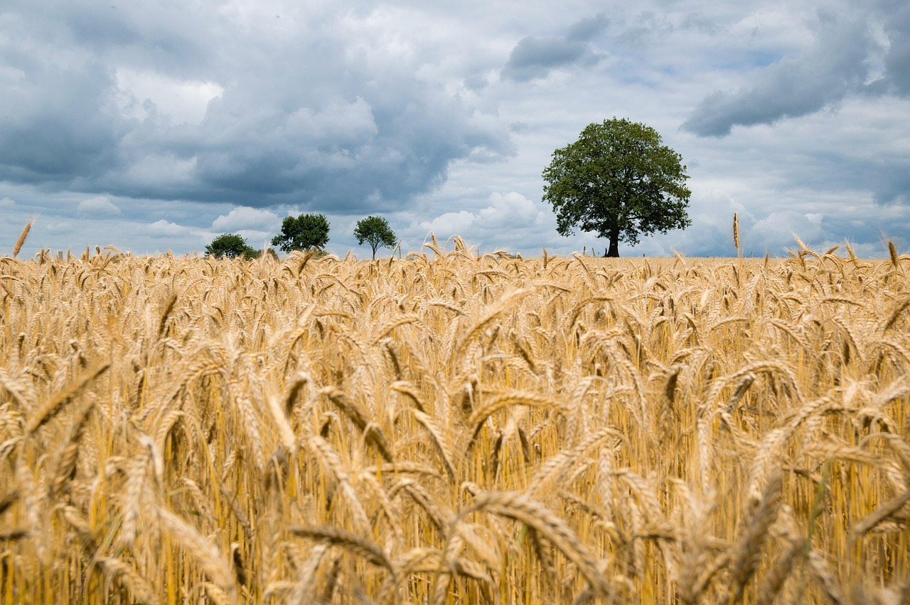
Countries most vulnerable amid wheat shortages
Somalia
Benin
Loas
Egypt
Sudan
DR Congo
Senegal
Countries among the world’s
least developed which are most dependent on wheat imports
from Russia and Ukraine (2020)
Tanzania
Image adapted from UNCTAD, Statista (2022)

Slide 7
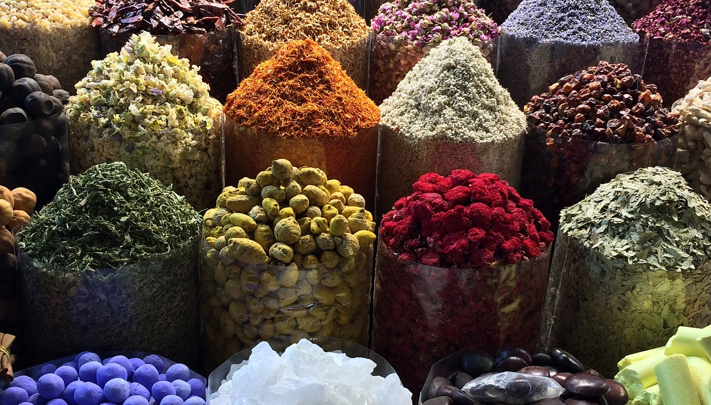
Food traders’ profits
Median food traders’ profits and revenues 2018-2022
(index numbers, 2019=100)
230
Profit before tax
210
190
170
Gross profit
Operating revenues
150
130
110
90
*preliminary
results
Image adapted from UNCTAD secretariat
calculations based on Orbis database
70
2018
2019
2020
2021
2022

Slide 8
A group of ten leading ‘momentum-driven’ hedge funds made an estimated $1.9 billion trading on the food price spike at the start of the Ukraine war that drove millions into hunger.
(Unearthed 2023)
https://unearthed.greenpeace.org/2023/04/14/ukraine-wheat-food-price-crisis-speculation/

Slide 11
This is the Ukraine effect: a credit line for fuel you thought could last two months now lasts one. Even if you get a bailout, you’re buying less food, less fuel, less medicine.
– Alan Keenan –
(International Crisis Group)

Slide 12
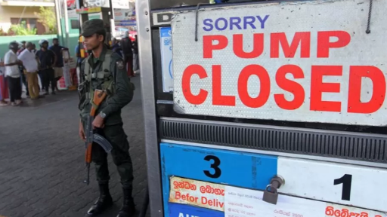
45%
(Getty Images)
of Sri Lanka’s wheat imports are
sourced from Russia and Ukraine

Slide 14
ACKNOWLEDGEMENTS
Music by VILLY & The Xtreme Volumes
Main (cover) photograph by Kevin Bückert
_______________________

Slide 15
Thank you for joining the conversation!
Stay tuned for more on
iss.nl/research-insights-live
To get our latest research InSightS, check out www.iss.nl/research-insights

