Slide 1
Information & academic skills e-modules
Gusta Drenthe & Heather Boet-Foley Erasmus University Library
The Graduate School, EUR Library & YOU

Slide 2

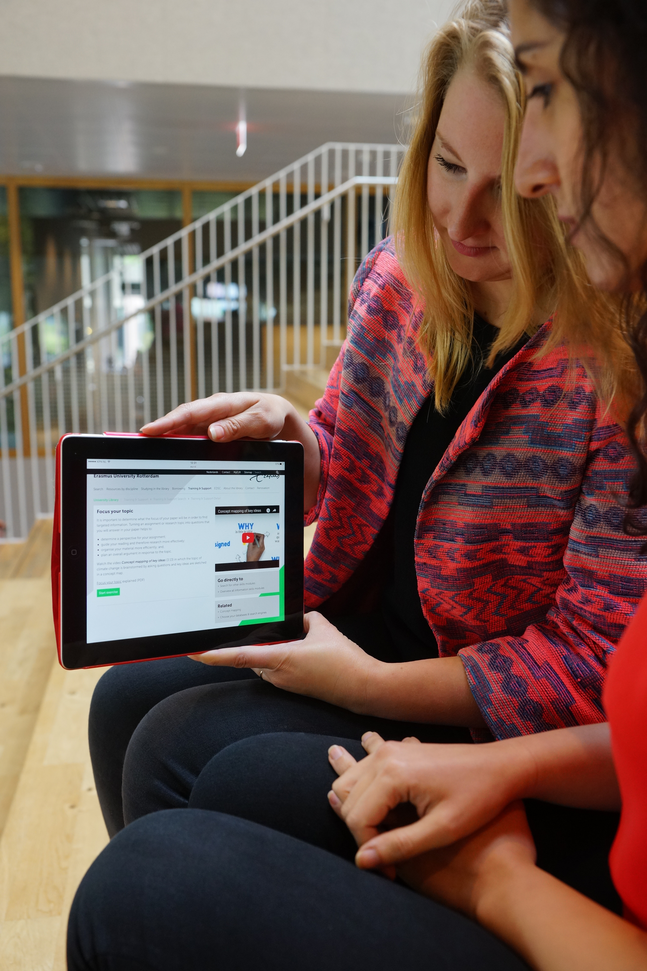
Why?
The University Library manages a broad collection of books, journals and data.
Knowing how to use these information sources effectively, that’s
information literacy!

Slide 3
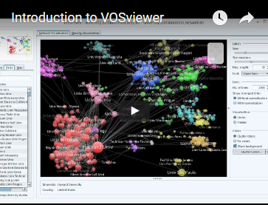
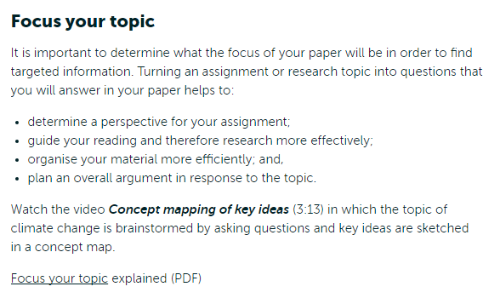
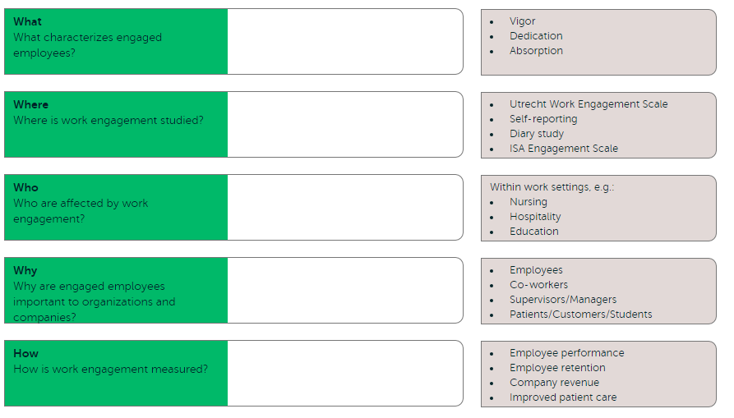
How?
Videos
How to’s:
Advanced search
Scopus
VOSviewer
The University Library offers a generic e-portfolio with a combination of:
SHORT
ACTIVATING
SHORT
VIDEOS
EXERCISES / ACTIVITIES
TEXTS
Texts
Exercises / activities

Slide 4
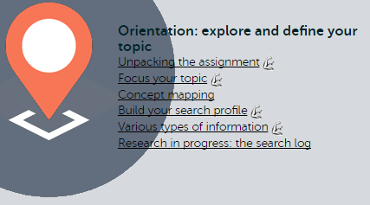
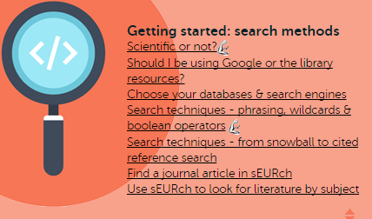
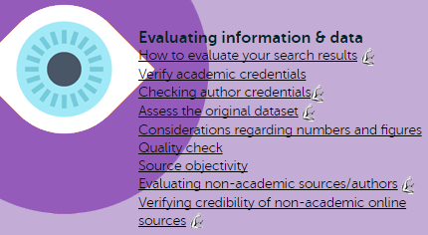
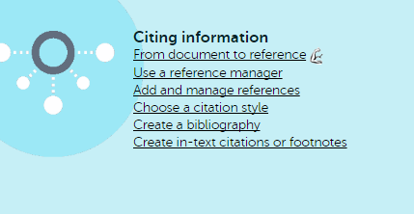
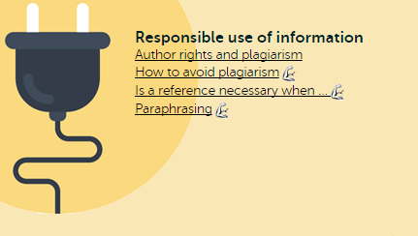
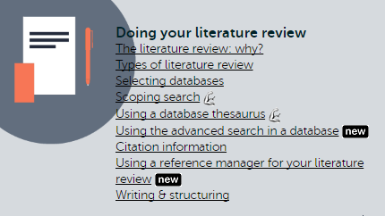
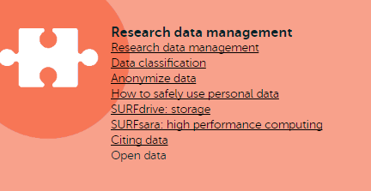

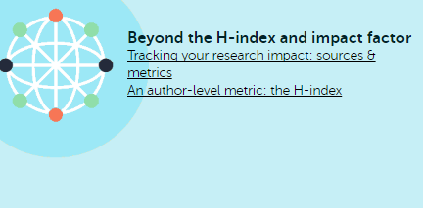
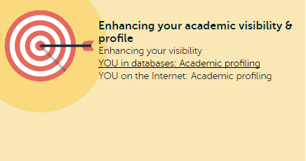
Information skills modules based on the pillars of a Research Cycle

Slide 5

Pillar 1 Orientation e-modules:

Slide 6
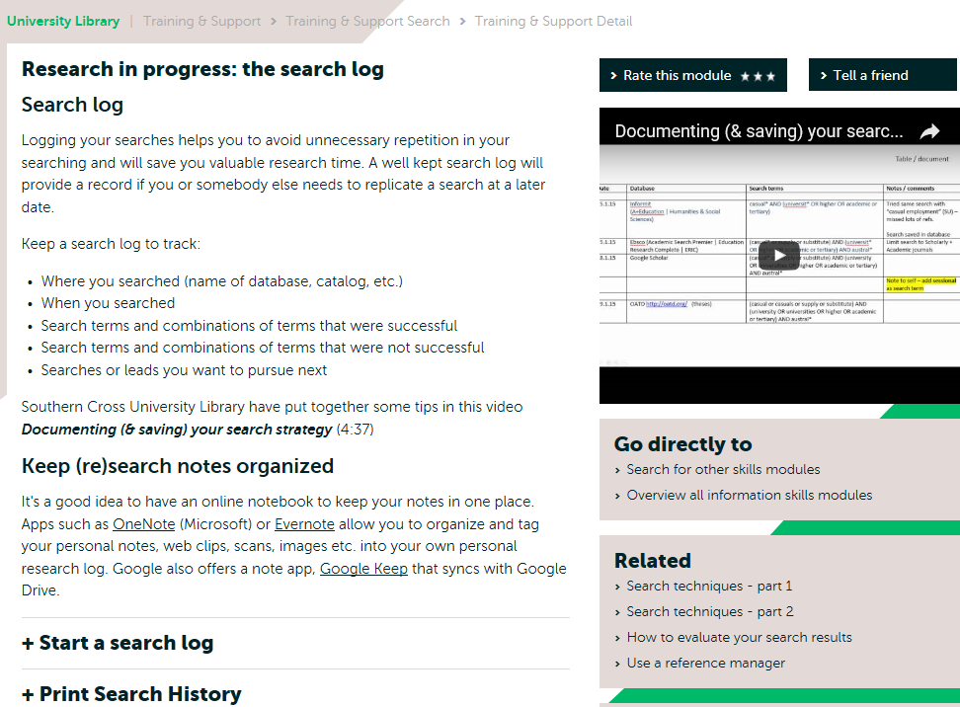
Short texts, video & links

Slide 7
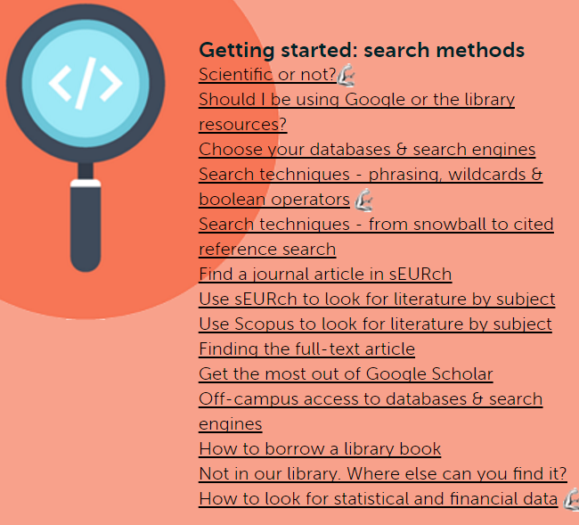
Pillar 2 Getting started e-modules:

Slide 8

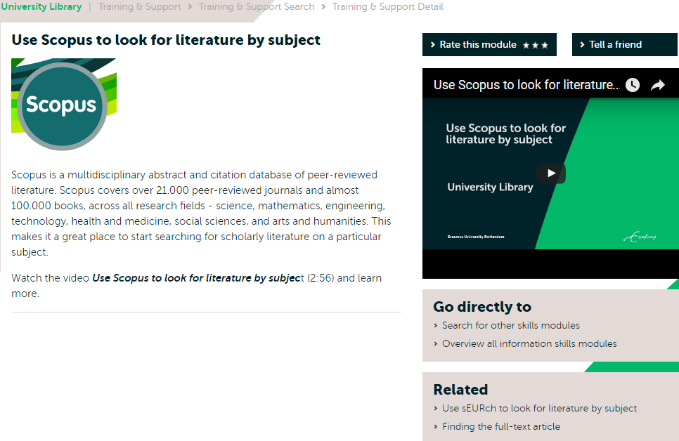
Short texts, video & links

Slide 9
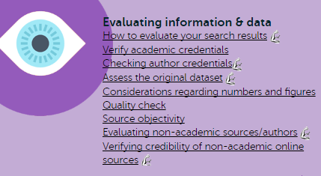
Pillar 3 Evaluating e-modules:

Slide 10
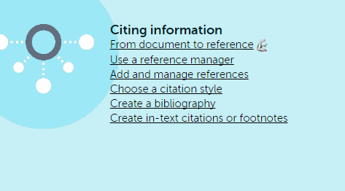
Pillar 4 Citing e-modules:

Slide 11
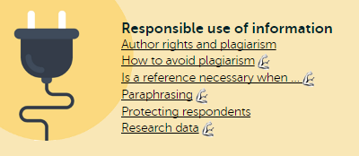
Pillar 5 Responsible use e-modules:

Slide 12
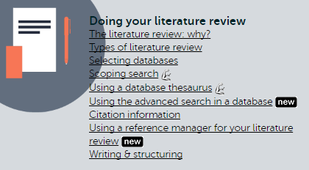
Pillar 6 Doing your literature review – PhD level e-modules:

Slide 13

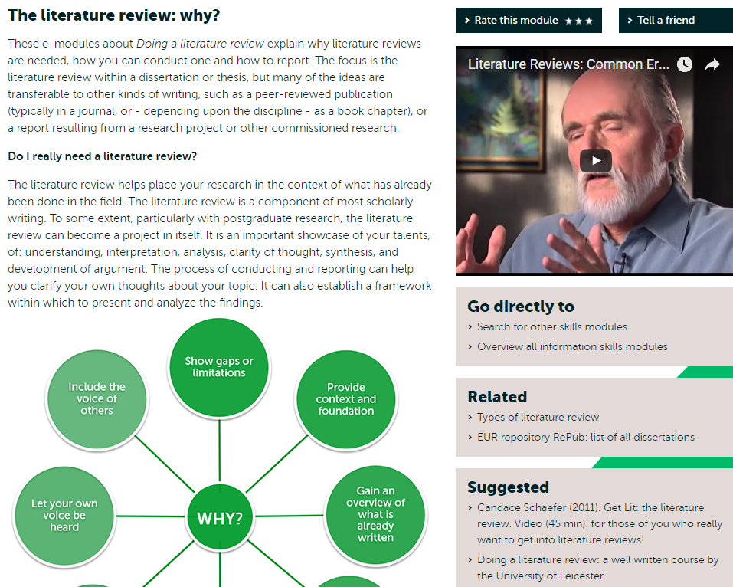
Short texts & video + links

Slide 14
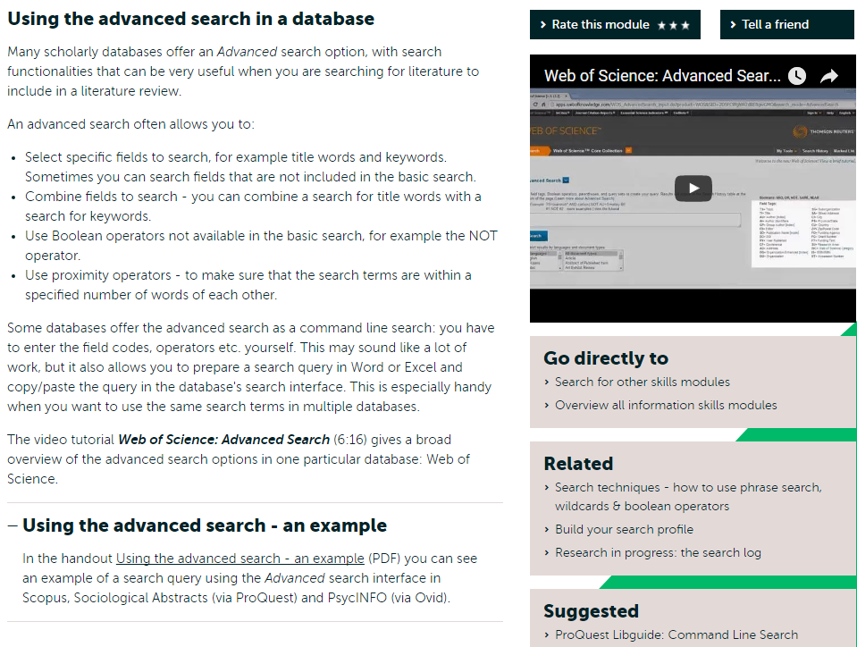
Short texts & video + links

Slide 15
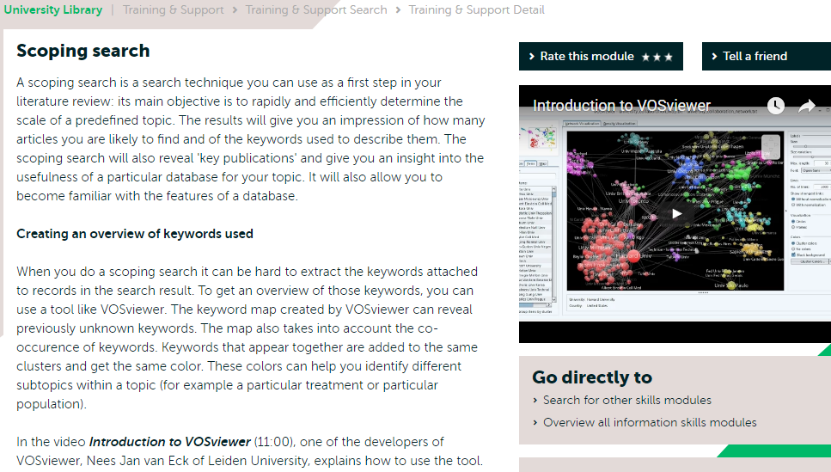
Short texts & video + links

Slide 16
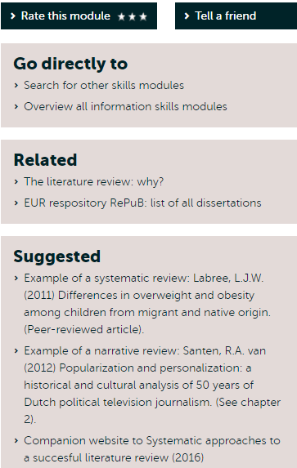
Links to other relevant documents

Slide 17
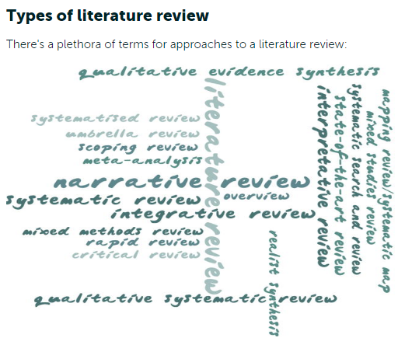
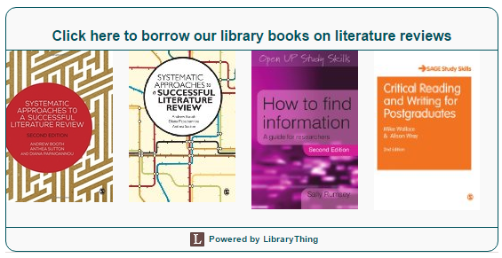
Want to borrow a book on literature reviews?

Slide 18

Pillar 8 Publication strategies & Open
Access e-modules:

Slide 19

Pillar 9 Beyond the h-index and impact factor e-modules:

Slide 20
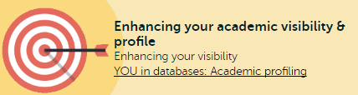
Pillar 10 Enhancing your academic visibility
& profile e-modules:

Slide 21



Where to find the e-modules
www.eur.nl/ub/en/
https://www.egsh.eur.nl/doctoral-education/online-information-skills-support/

Slide 22
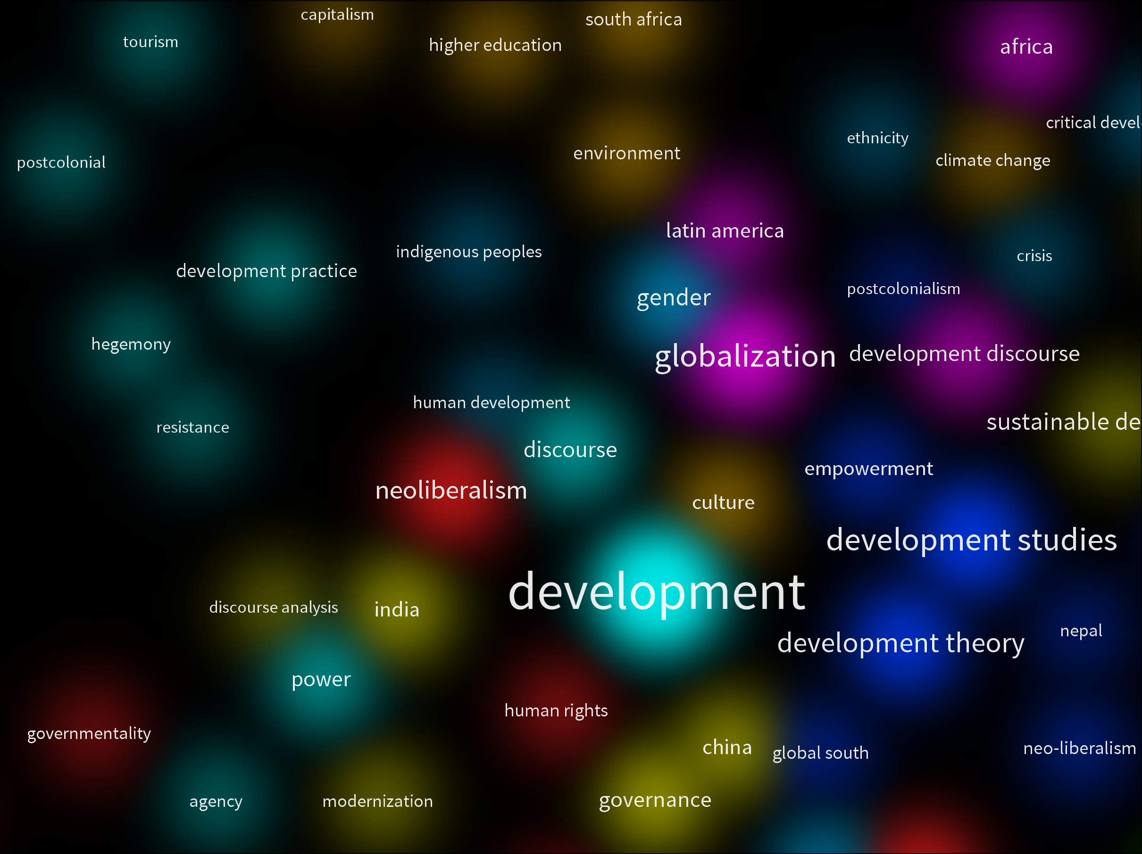
Scopus & VOSviewer
“Development studies
and the Global South”

Slide 23
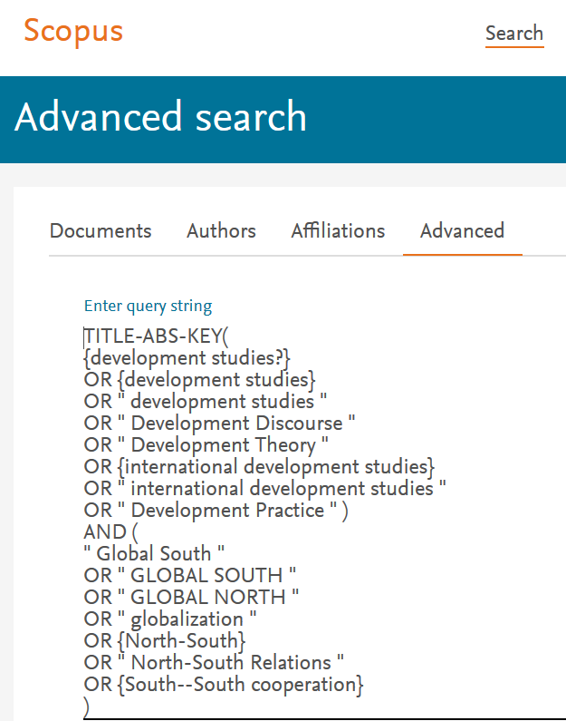
Scopus and VOSviewer
Scopus - search for literature
Custom build your query in Advanced Search
Select Field codes to search in
Type search terms
Use “ ” to search for words in a phrase
Use {} to search for an exact phrase e.g. {North-South}
Use ( ) to separate sets of search terms
Use operator AND to combine distinct concepts
Use operator OR to combine similar concepts

Slide 24
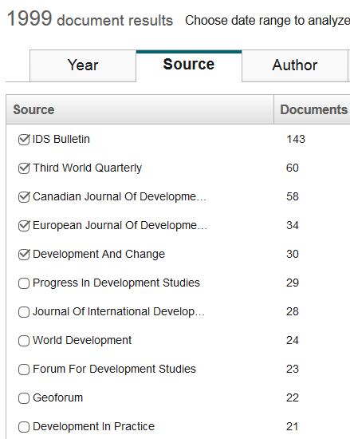
Scopus and VOSviewer
Scopus - analyze search results
View Source publications
(journals)

Slide 25
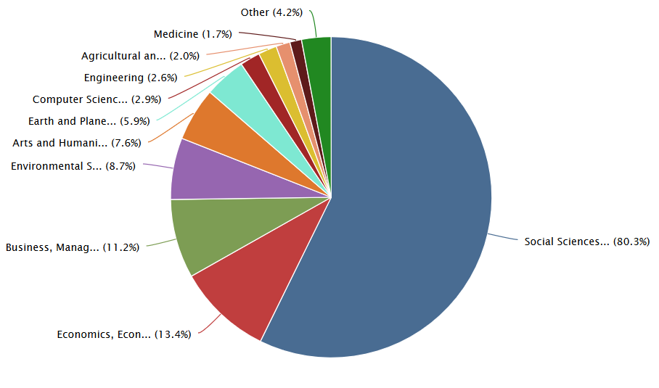
Scopus and VOSviewer
Scopus - analyze search results. View by Subject area

Slide 26
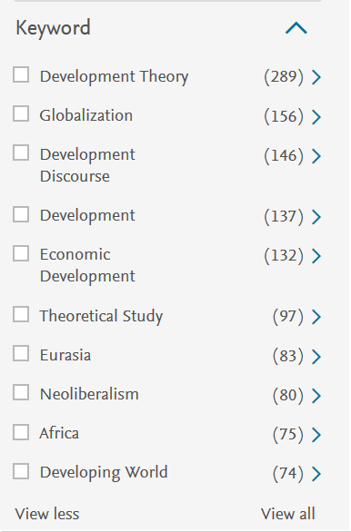
Scopus and VOSviewer
Scopus - search results
The Keyword filter in the panel left of the search result shows the 10 most used keywords
The number in brackets is the number of times the keyword appears in the result set.
Click View All to see all keywords in the result set.
Which keywords are the most/least relevant?

Slide 27
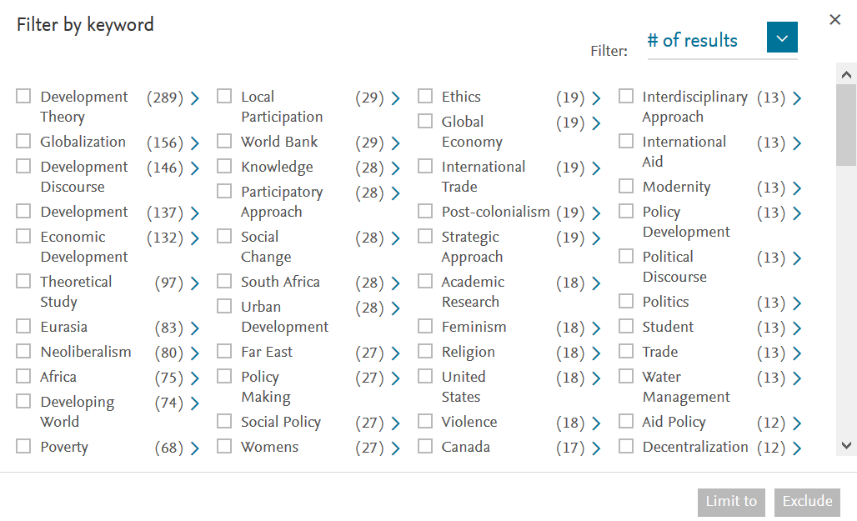
Scopus and VOSviewer
Scopus - search results. View All Keywords.

Slide 28
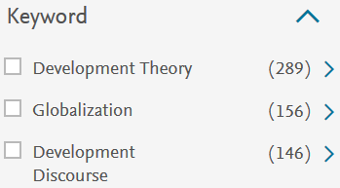
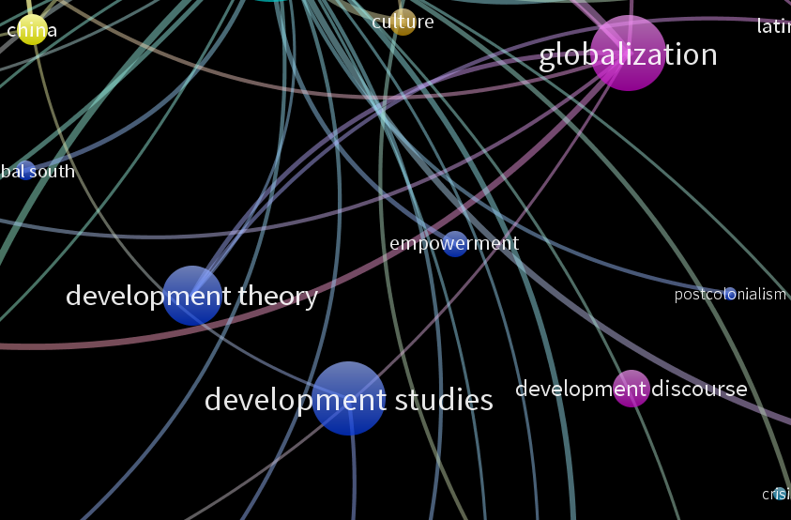
Scopus and VOSviewer
Visualize author keyword data from Scopus in VOSviewer
VOSviewer* is a software tool to visualize bibliographic and network data.
With it you can
  […] “visualize co-occurrence networks of important terms extracted from a body of scientific literature”
*Developed by Nees Jan van Eck and Ludo Waltman at Leiden University's Centre for Science and Technology Studies (CWTS).

Slide 29
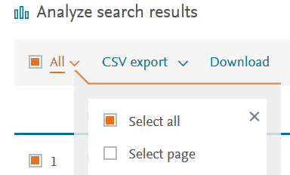
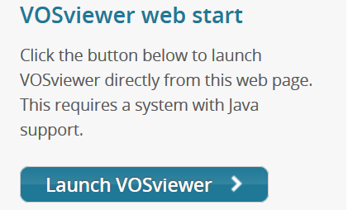
Scopus and VOSviewer
Export search result as CSV file
Select all titles in the search result.
Select CSV export - Include in the CSV file all available bibliographic data.
Save the Scopus CSV file to your PC or laptop.
Name the file and put it where you can browse to it easily.
Go to VOSviewer web start on the VOSviewer homepage to launch the web version …
…or Download VOSviewer to your own device.

Slide 30
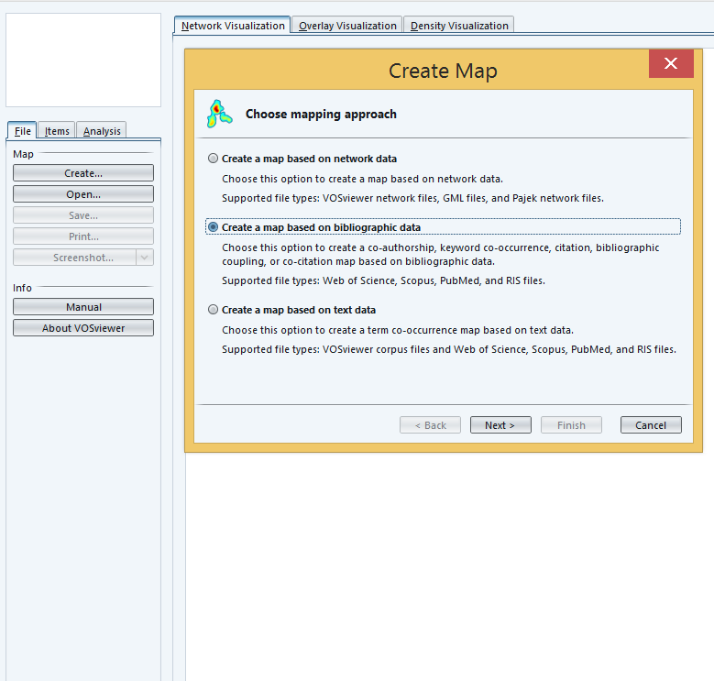
Scopus and VOSviewer
VOSviewer
Launch VOSviewer web start or …
Run VOSviewer on your own device.
Go to File > Create
Choose a mapping approach and click Next

Slide 31
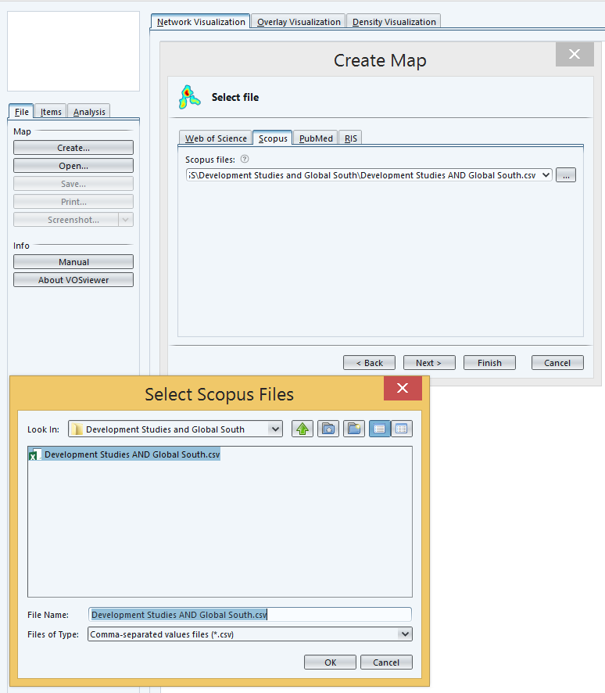
Scopus and VOSviewer
VOSviewer
Select tab Scopus
and click Next
Browse to your CSV file.
Select the CSV file and click OK

Slide 32
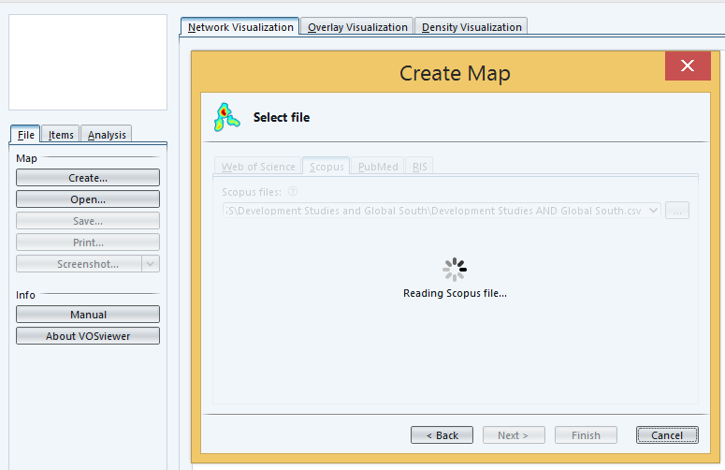
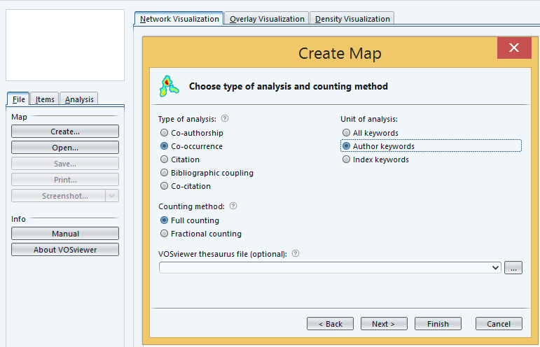
Scopus and VOSviewer
VOSviewer – read scopus file
Wait until the Scopus file is read.
Then click Next
Analysis and counting method - select:
- Co-occurrence
- Author keywords
- Full counting.
Then click Next

Slide 33
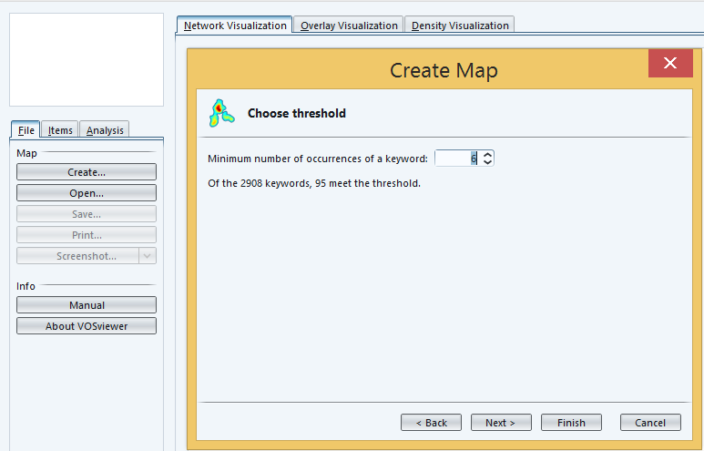
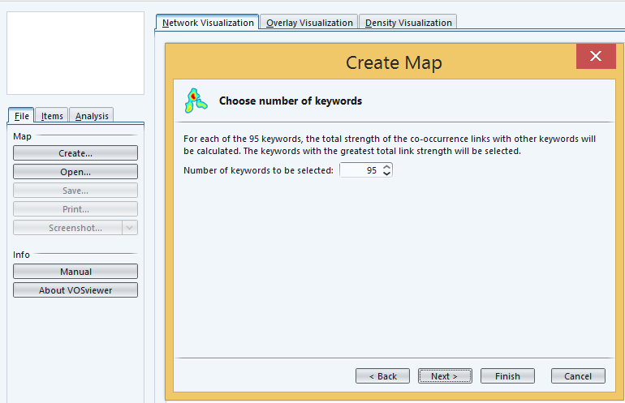
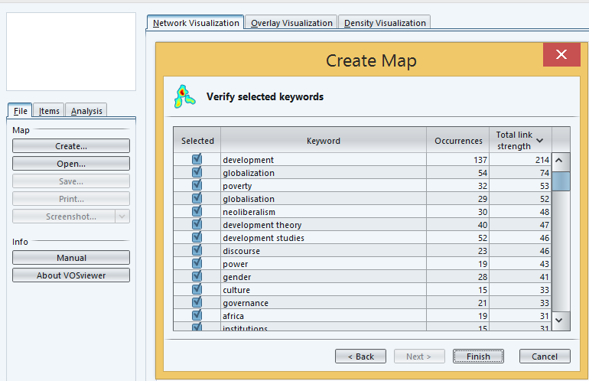
Scopus and VOSviewer
Set parameters in VOSviewer
Choose threshold
Minimum number of occurrences of a keyword: 6
> Click Next
Choose number of keywords
Of the 2908 keywords, 95 meet the threshold: 95
> Click Next
Verify selected keywords
Uncheck any keywords you don't want.
> Click Finish

Slide 34
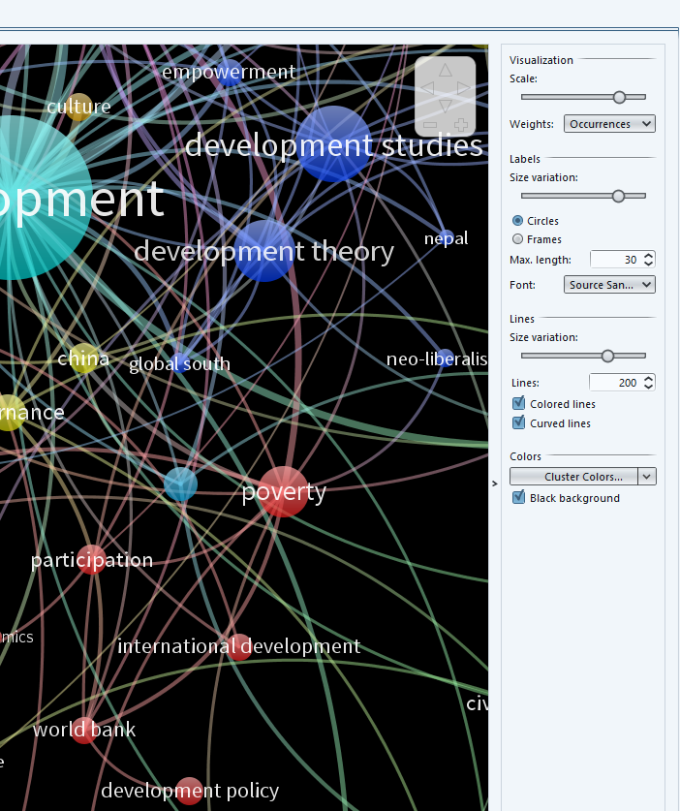
Scopus and VOSviewer
Options panel – on the right
Use options and sliders in the panel on the right to adjust the visualization.
NB. See slide note for options used in this demo
Notes:
Visualization options
Network and Overlay visualizations
Scale: move slider right to 1.70
weights - Occurrences
Labels:
Size variation: move slider righ to 0.79
- Circles
Max length: 30
Font: Source Sans Pro
Lines: 100 for first network/overlay views | 200 when zooming in network/overlay views
Size variation: 0.70
- colored lines
- curved lines
Colors
black background
Density visualization
Density cluster - reduce kernel width when zooming in.

Slide 35
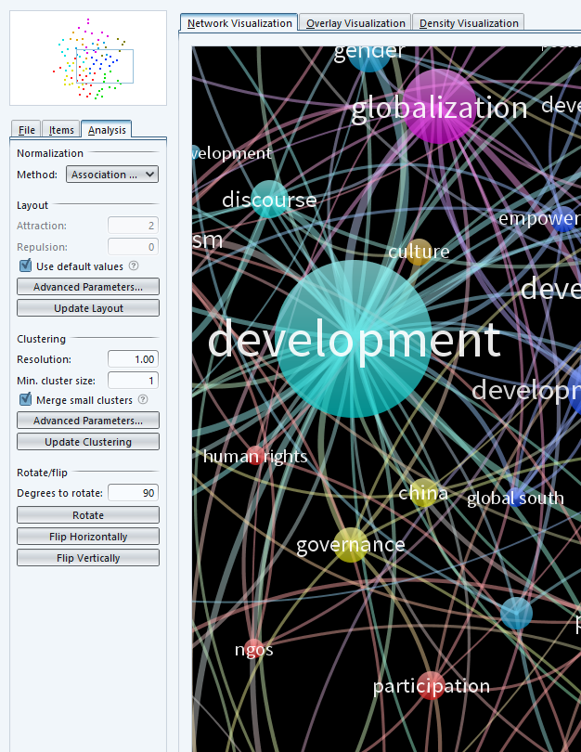
Scopus and VOSviewer
Action panel – on the left
Items
Click on Items to view the keywords in clusters
Double-click on a keyword to zoom in on that keyword in the visualization
Analysis
Click on Analysis to view parameter options.
Tip: try rotating the visualization to improve viewing of keyword labels
File
Here you can make screenshots or load a new file.
Notes:
Visualization options
Network and Overlay visualizations
Scale: move slider right to 1.70
weights - Occurrences
Labels:
Size variation: move slider righ to 0.79
- Circles
Max length: 30
Font: Source Sans Pro
Lines: 100 for first network/overlay views | 200 when zooming in network/overlay views
Size variation: 0.70
- colored lines
- curved lines
Colors
black background
Density visualization
Density cluster - reduce kernel width when zooming in.

Slide 36
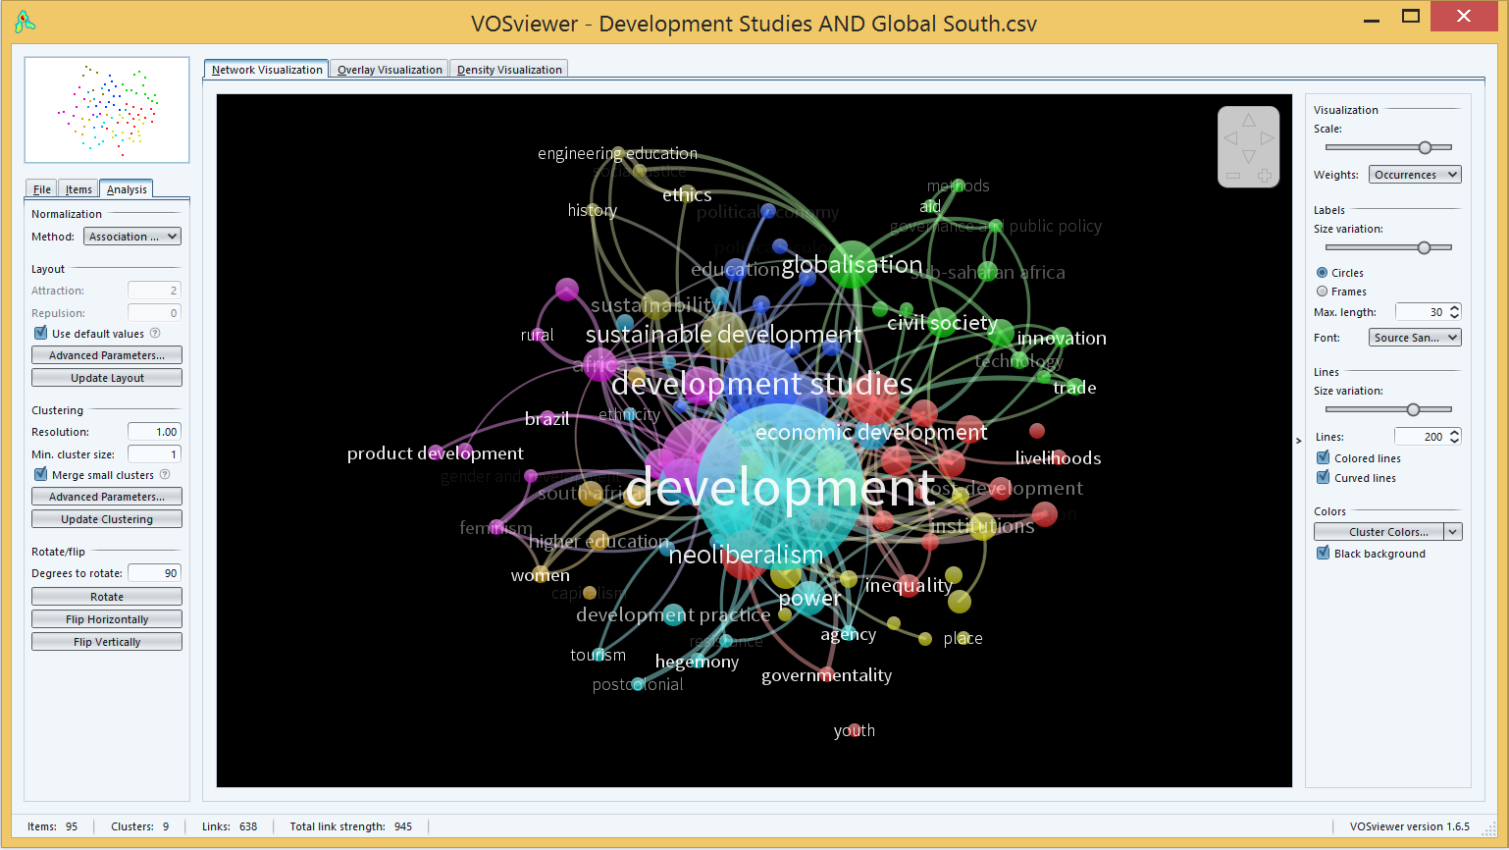
VOSviewer work space

Slide 37
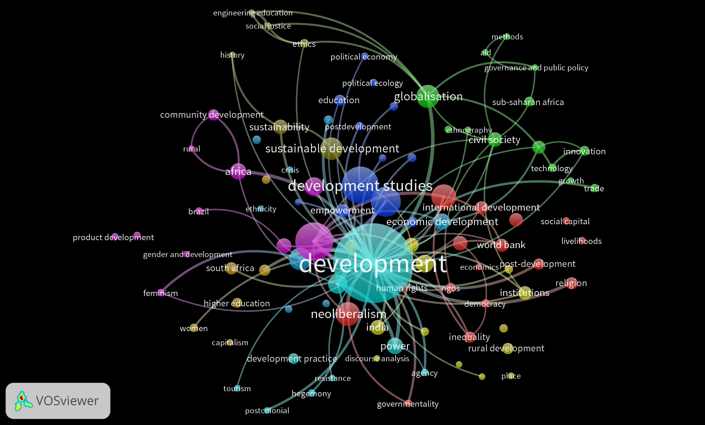
Query Development Studies AND Global South - threshold 6, 100 lines, Network visualization – original image

Slide 38
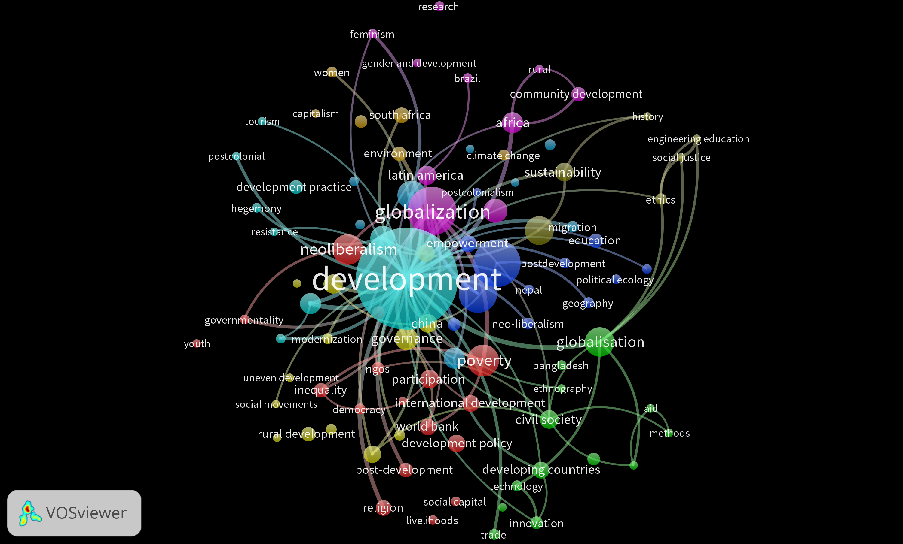
Query Development Studies AND Global South, threshold 6, 100 lines, Network, turned 90° clockwise

Slide 39
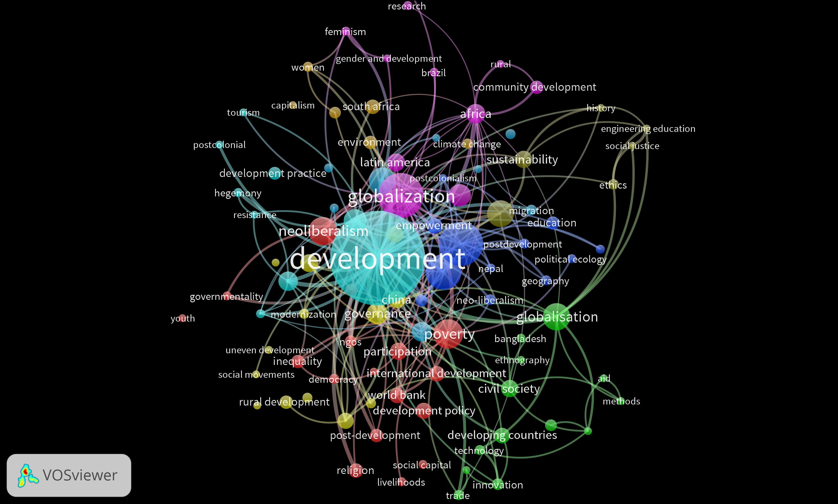
Query Development Studies AND Global South threshold 6, 200 lines, Network, turned 90° clockwise

Slide 40

Query Development Studies AND Global South threshold 6, 200 lines, Network, turned 90° clockwise, half zoom

Slide 41

Query Development Studies AND Global South threshold 6, 200 lines, Network, turned 90° clockwise, zoom

Slide 42

Query Development Studies AND Global South threshold 6, 200 lines, Overlay, turned 90° clockwise, time line colours

Slide 43

Query Development Studies AND Global South threshold 6, 200 lines, Overlay, turned 90° clockwise, half zoom, time line colours

Slide 44

Query Development Studies AND Global South threshold 6, 200 lines, Overlay, turned 90° clockwise, zoom, time line colours

Slide 45

Query Development Studies AND Global South threshold 6, Density cluster, kernel width small

Slide 46

Query Development Studies AND Global South threshold 6, Density cluster, kernel width small, half zoom

Slide 47

Query Development Studies AND Global South threshold 6, Density cluster, kernel width small, zoom

Slide 48

Query Development Studies AND Global South threshold 6, Density item (looks like heat map), kernel width small, zoom

Slide 49

Success in your studies!

