Slide 1

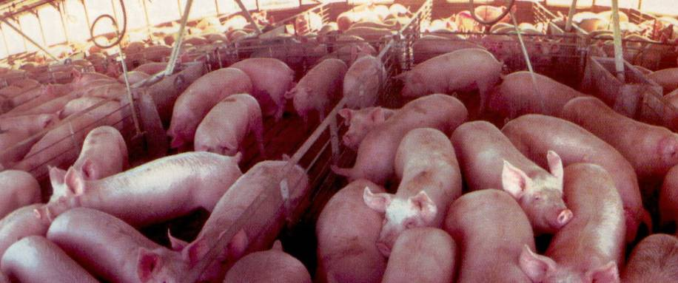
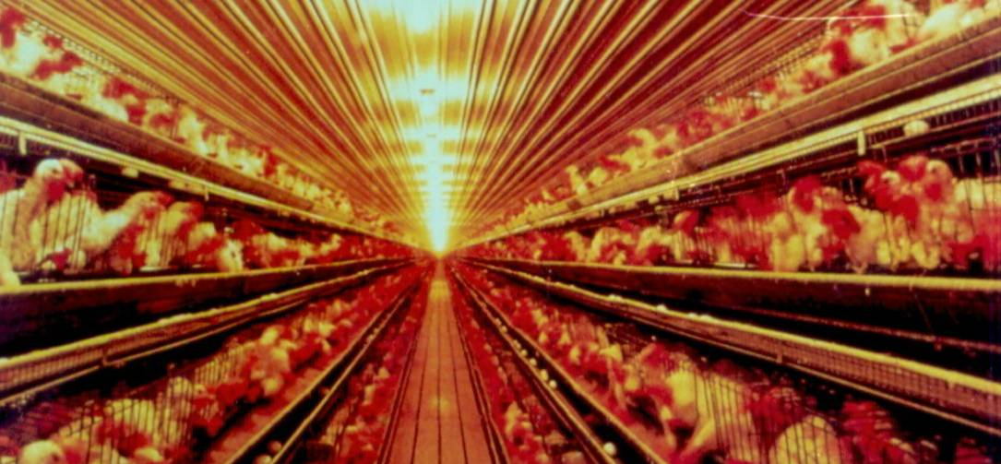
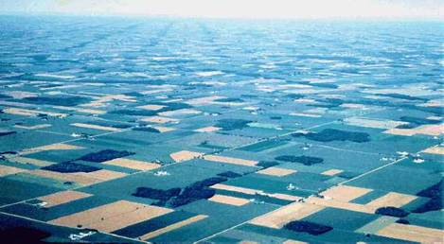

The meat of the food crisis
Tony Weis
UWO Geography
email: aweis@uwo.ca

Slide 2
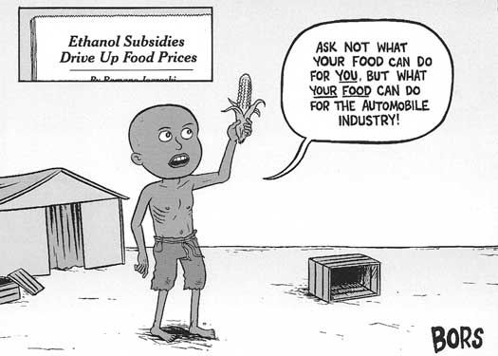
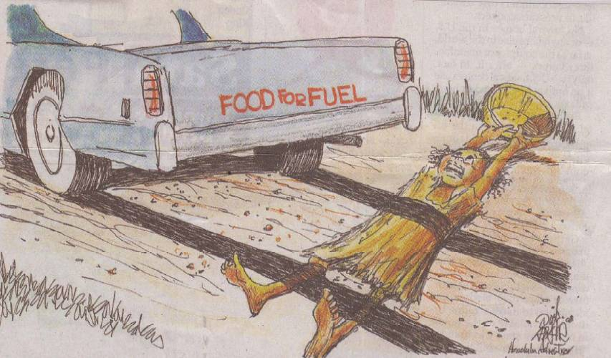
LESTER BROWN:
~ 800 M motorists
vs.
2 B poorest
Notes:
2

Slide 3

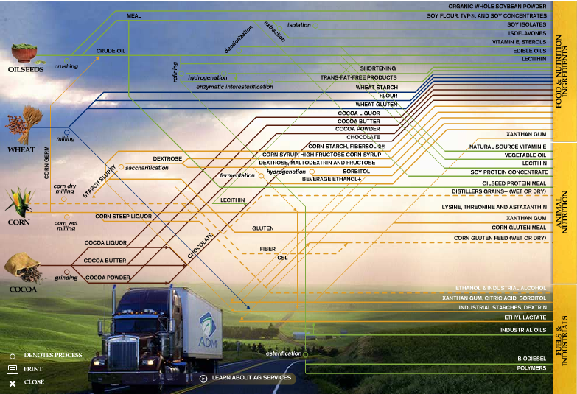
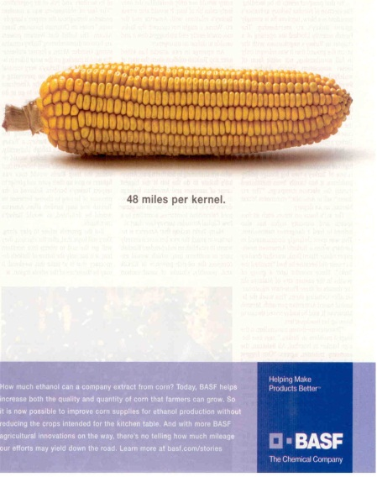
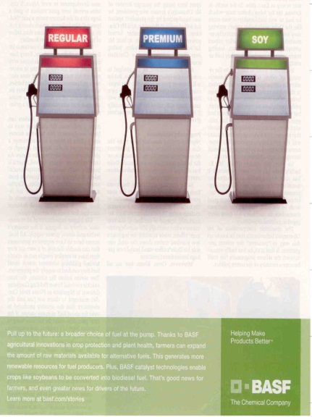
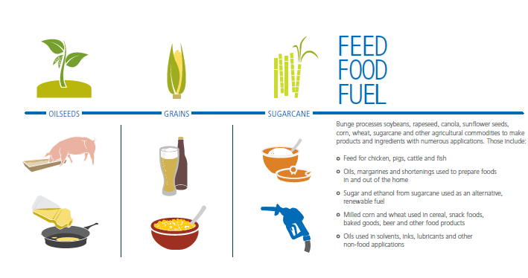

Notes:
3

Slide 4
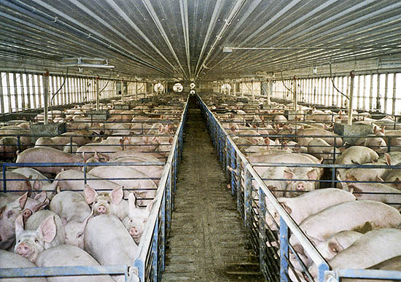
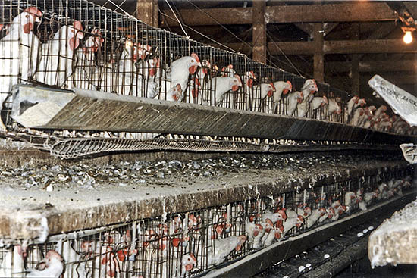
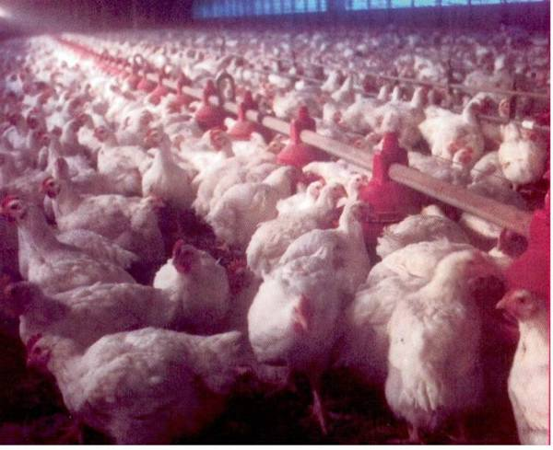
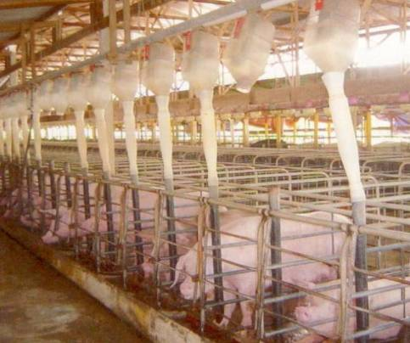
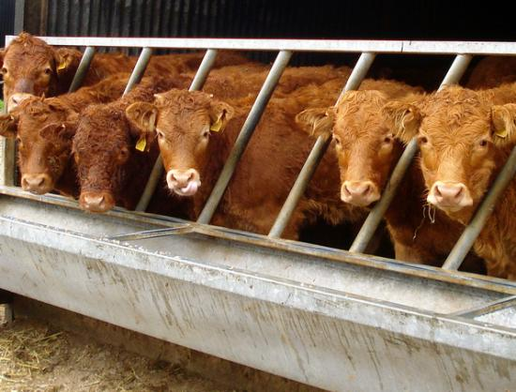
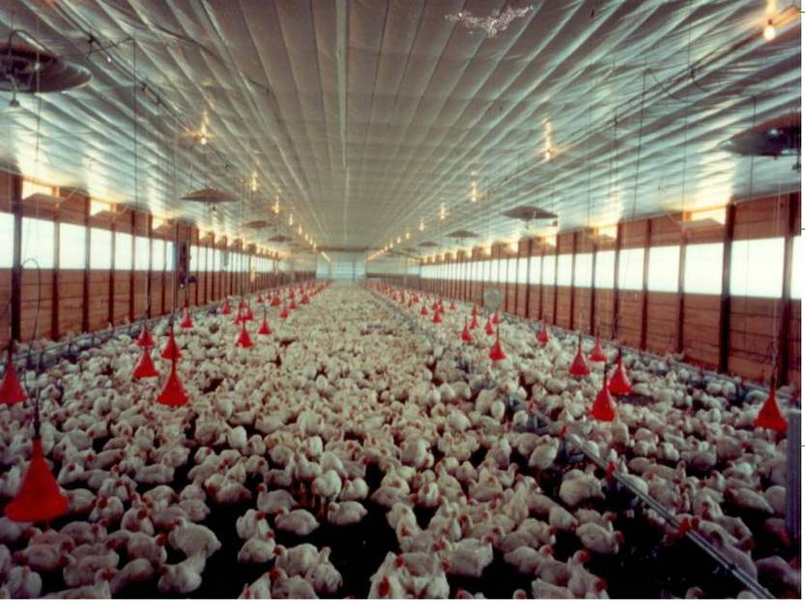
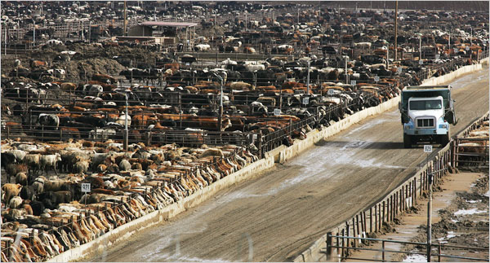
Notes:
4

Slide 5
challenging narratives…
an asymmetrically ‘meaty planet’ that needs to urgently reassess how efficiency is understood and reorganize how food is produced
a ‘hungry planet’ that needs improved yields
vs.

Slide 6
The Ecological Hoofprint
Scale
Inequality
Inefficiency
Notes:
6

Slide 7
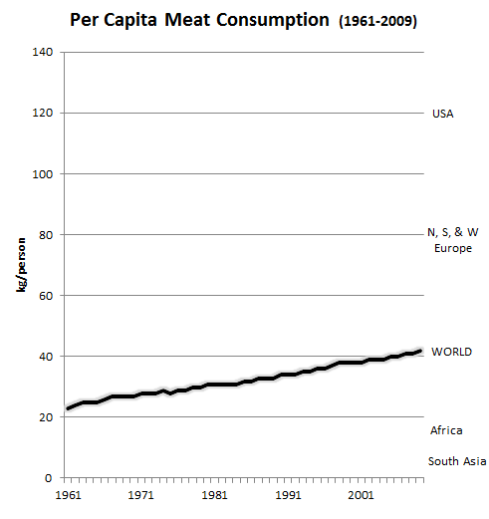
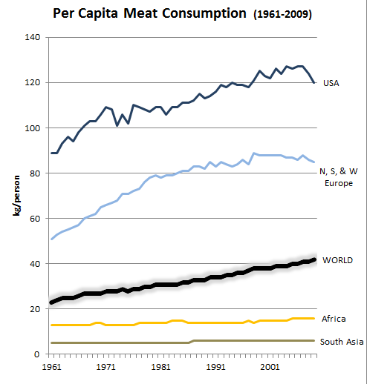
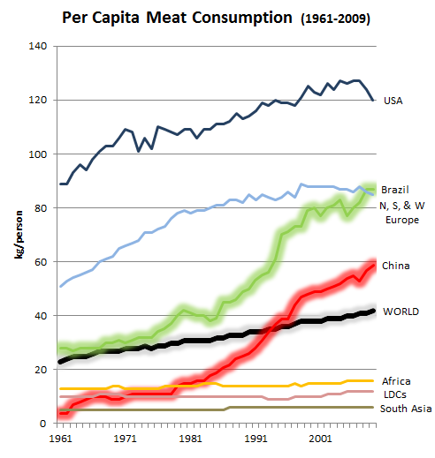
the ‘meatification’ of diets
?
vector of ‘development’ & inequality
+
class
disparities
data: FAOSTATS

Slide 8
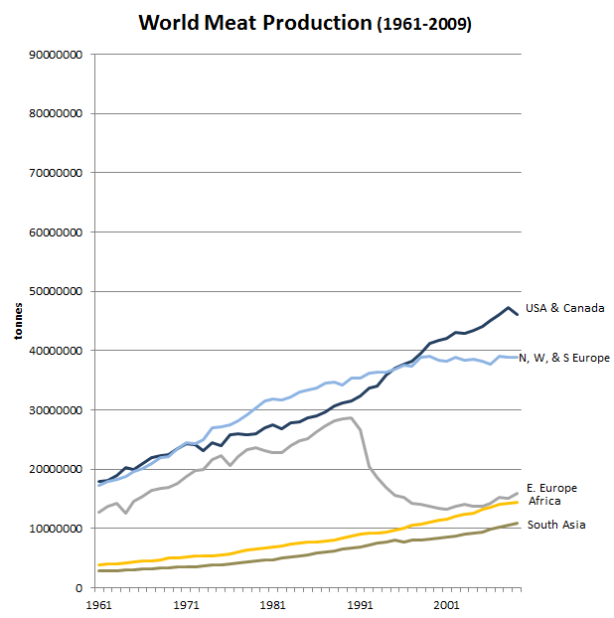
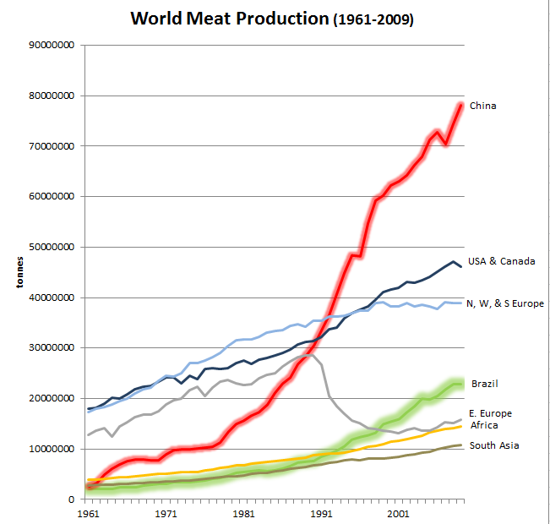
WORLD
POPULATION
20%
5%
6.4%
3%
15%
25%
data: FAOSTATS

Slide 9
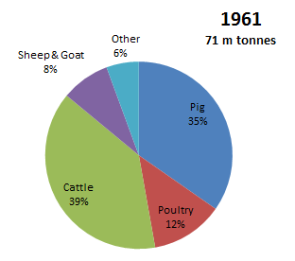
the ‘Big 3’
data: FAOSTATS

Slide 10
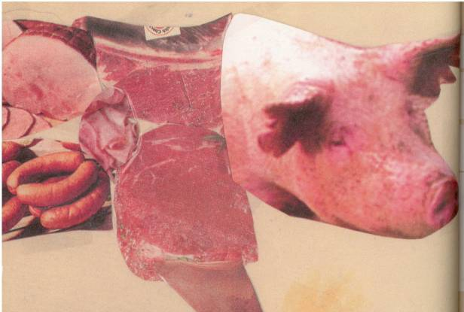
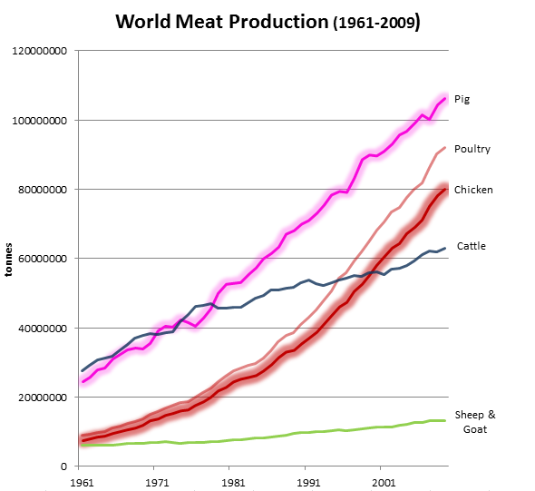
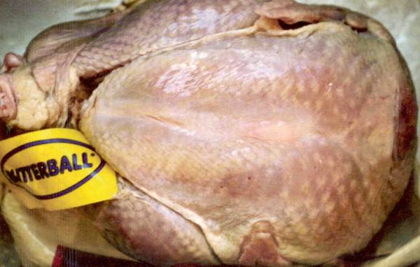
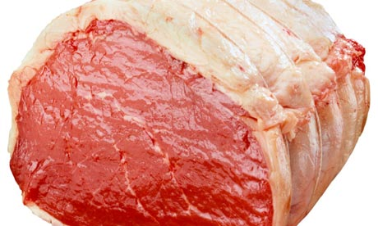
The Soaring 2
70%
> 2X
data: FAOSTATS

Slide 11
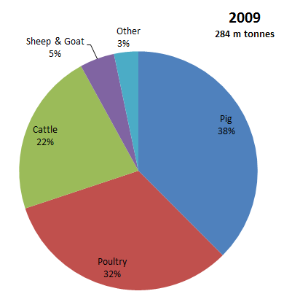
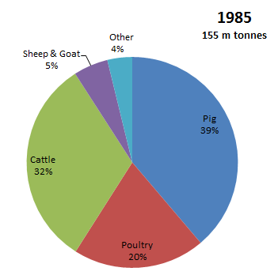
the ‘Big 3’
data: FAOSTATS

Slide 12
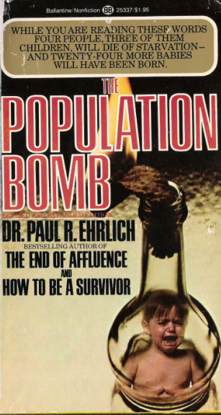
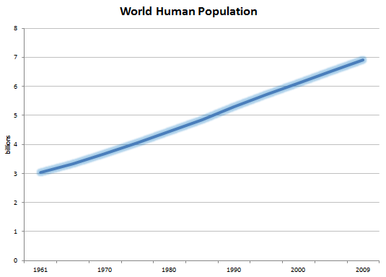
2.3 x
increase
data: FAOSTATS

Slide 13
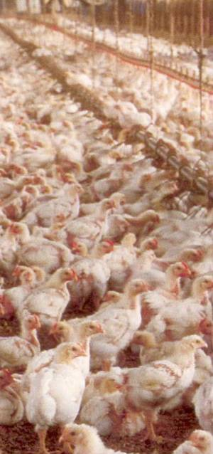
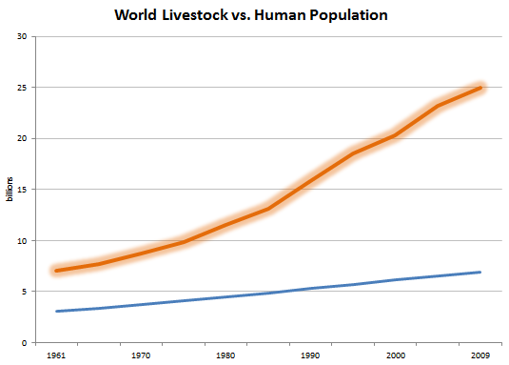
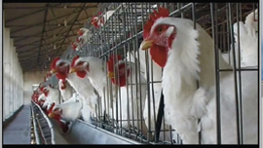
The other population bomb
3.6 x
increase
livestock
humans
data: FAOSTATS

Slide 14
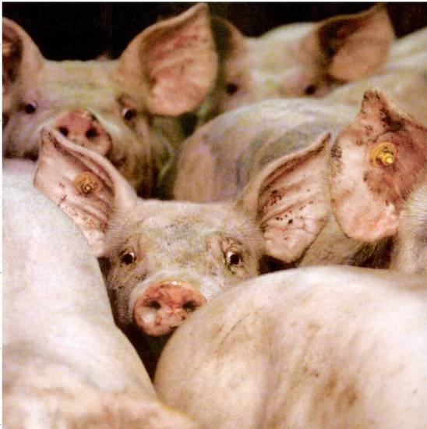
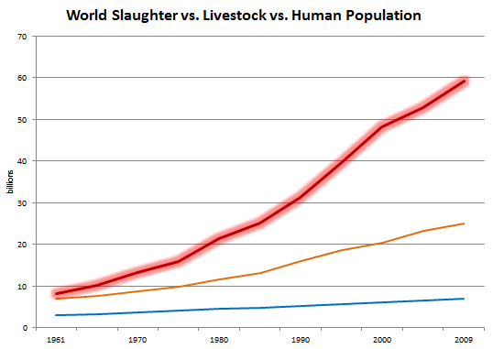
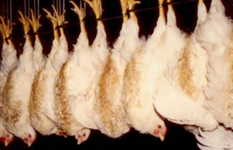
7.1 x
increase
slaughtered
livestock
humans
data: FAOSTATS

Slide 15

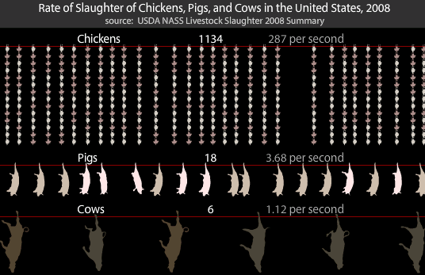
www.animalvisuals.org
  -in the US, more chickens killed in 1 day today than were killed all year in 1930

Slide 16
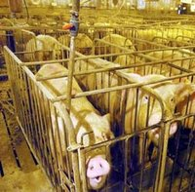
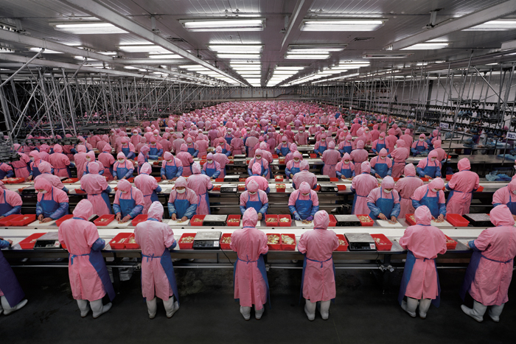
China today
~¹/₅ humanity
>½ world’s pigs
Edward Burtynsky

Slide 17
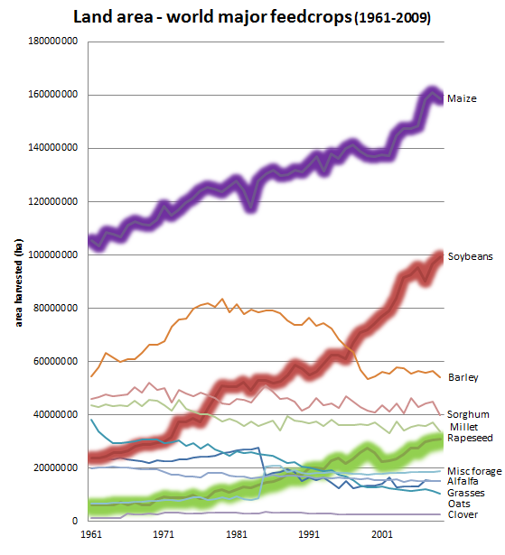
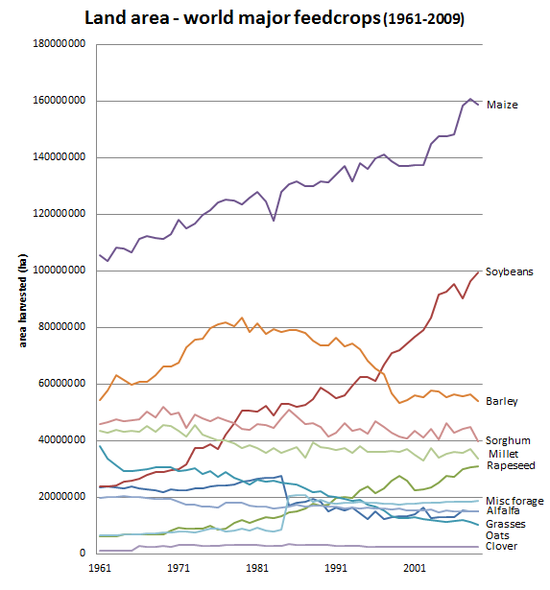
1.5 x
4.1 x
data: FAOSTATS

Slide 18
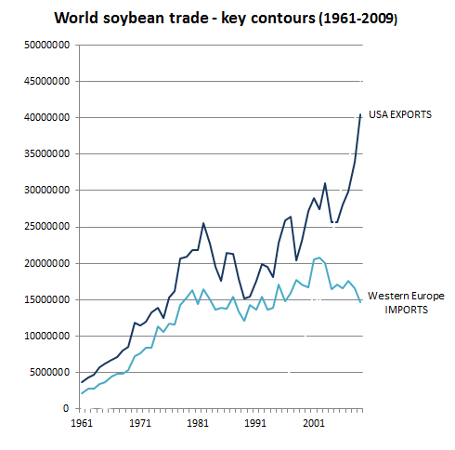
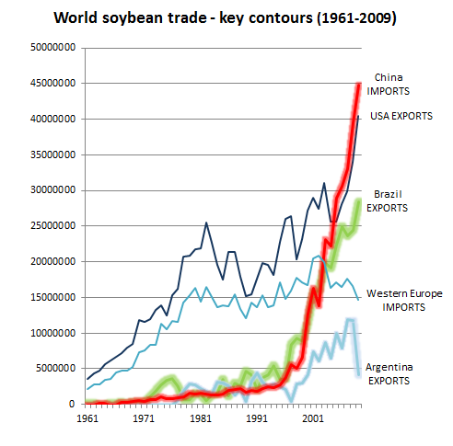
data: FAOSTATS

Slide 19
The Industrial
Grain-Oilseed-Livestock Complex
data: FAOSTATS

Slide 20
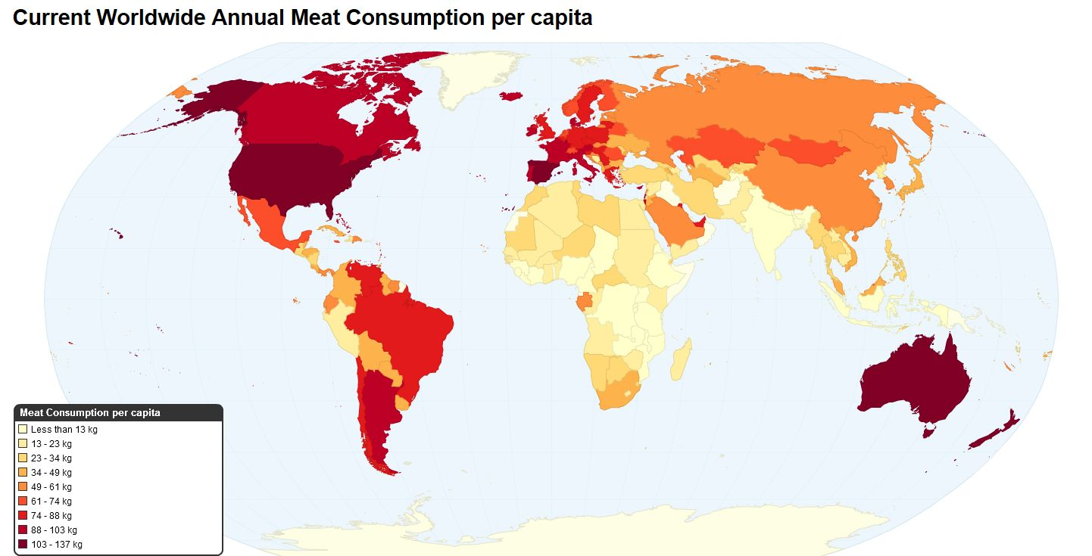
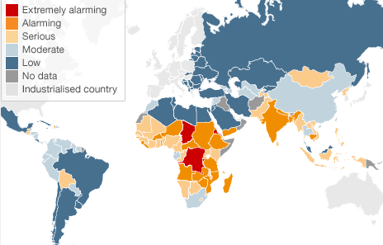
p.c. meat
source http://chartsbin.com/view/bhy
‘hunger hotspots’
source: Global Hunger Index (2010)

Slide 21
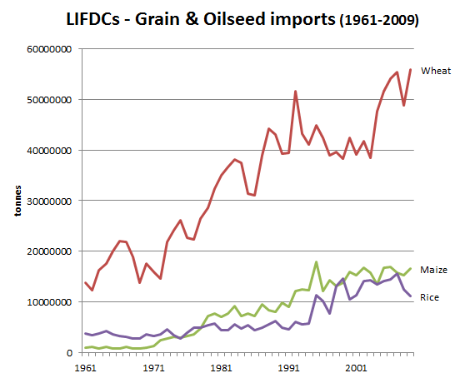
data: FAOSTATS

Slide 22
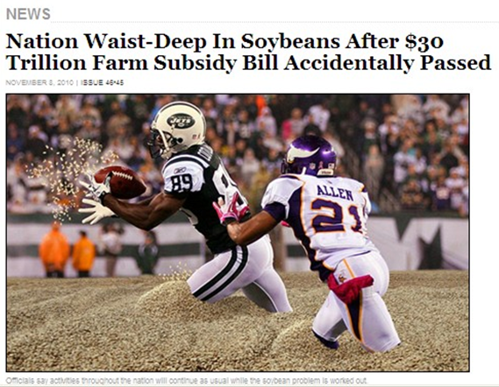

Soaking up the surplus

Slide 23
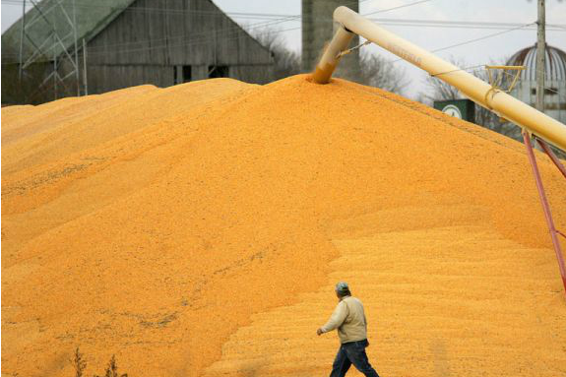
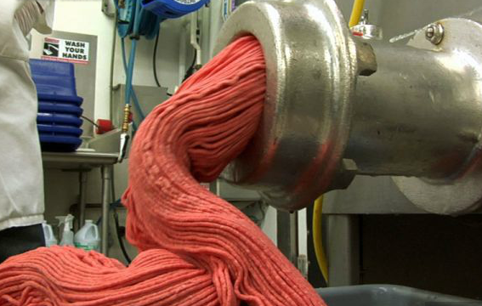
Soaking up the surplus
from a deflationary millstone…
…to a steadily growing source of low margin earnings
“Get big or get out”
large-scale farmers, processors, and traders

Slide 24
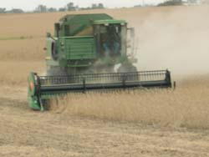




The Industrial Grain-Oilseed-Livestock Complex
industrial monocultures & animals both disarticulated and entwined

Slide 25




INEFFICIENCY:
‘biophysical overrides’
for scale & simplification
‘Modern agriculture has become the art of turning oil into food.’
  -B. Clark & R. York (2008:13)
Notes:
25

Slide 26




Our ‘Ecological Hoofprint’
Notes:
26

Slide 27




grain-fed livestock: “reverse protein factories” (Lappe)
Notes:
27

Slide 28





much useable nutrition lost in cycling grains and oilseeds through livestock
-intensification of livestock production
=extra land area + resources needed for agriculture
+ additional atmospheric & water
footprints
Notes:
28

Slide 29






Increasing attention…

Slide 30






the ‘Atmospheric Hoofprint’
- clearing forested land
- fertilizer (prod’n + transport)
- farm vehicles
- ruminant flatulence
Notes:
30

Slide 31


uneven ‘atmospheric footprints’
Sized by:
population
carbon footprint
Notes:
The global contributions to carbon emissions are severely uneven between the developing and the developed world. North America, for example, makes up only 5% of the populations, but is responsible for 25% of world carbon emissions. This map here shows the world according to aggregate carbon emissions. As you can see here, China and the US are the largest contributors, while most of Africa and South America shrink away to nothing.
31

Slide 32
Our Ecological Hoofprint
Scale
Inequality
Inefficiency
4. Inter-species relations
Notes:
32

Slide 33


the ‘intimate commodity’
“ethical dimensions of humanity’s footprint …[also] relate to how sentient life has been commodified; in other words, how the lives of individual animals are dominated to serve human economies and how extreme violence has been systematized and pushed into the unconscious.” (Weis 2007:40)
Notes:
33

Slide 35
‘biophysical overrides’
non-industrial agriculture:
relatively closed-loop cycles of biological and physical
materials and managed diversity
hinge on FOSSIL ENERGY & DERIVATIVES
Agriculture as through-flow process contingent on external inputs
carbon emissions
mechanization
increasing refining,
processing, and
‘food miles’
standardization /
biological
simplification
soil mining
increased
vulnerability to
insects, weeds,
fungus, disease
enhanced
seeds and
reduced
soil moisture
distance &
durability of food
inorganic
fertilizer
chemical
pesticides
‘Modern agriculture has become the art of turning oil into food.’
  -B. Clark & R. York (2008:13)
increased
irrigation
disarticulation of
livestock from land
+ speeding turnover
(factory farming)
pharmaceuticals
& mutilations
increased
water
INPUTS
OUTPUTS

Slide 36

Phil Testamale

Slide 37
non-industrial agriculture:
relatively closed-loop cycles of biological and physical
materials and managed diversity
mechanization
standardization /
biological
simplification
soil mining
increased
vulnerability to
insects, weeds,
fungus, disease
enhanced
seeds and
reduced
soil moisture
inorganic
fertilizer
N, P, K
chemical
pesticides
insecticides,
herbicides,
fungicides,
disinfectants
increased
irrigation
disarticulation of
livestock from land
+ speeding turnover
(factory farming)
pharmaceuticals
& mutilations

