Slide 1
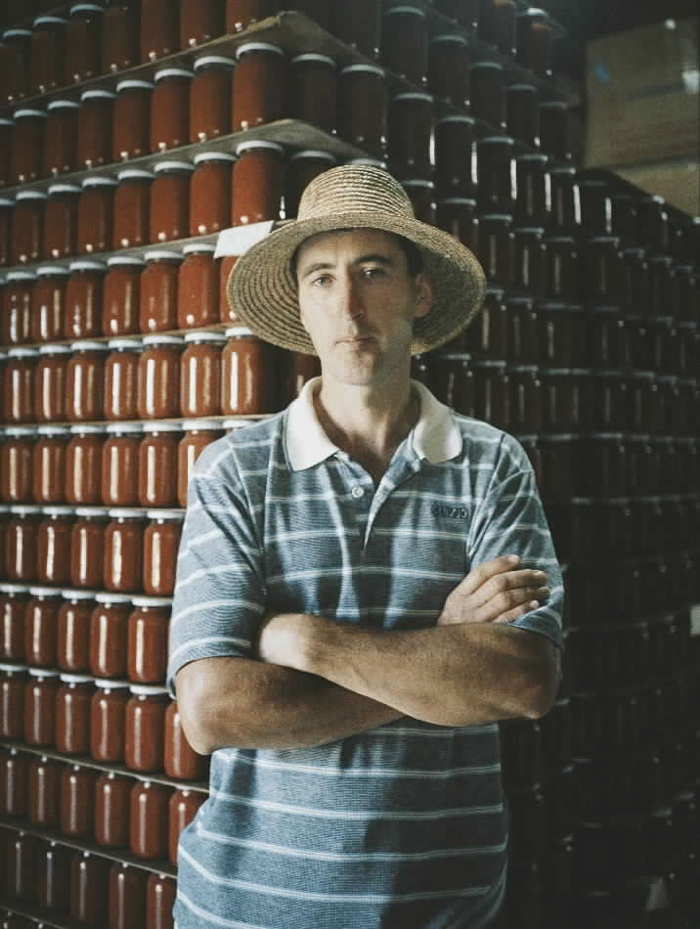
The construction of new markets: China, Brazil and the EU
Jan Douwe van der Ploeg

Slide 2
Self organized transport lines (‘rotas’)
Feiras
2
3
1
Feiras
4
5
ECOVIDA, Brazil

Slide 3
NESTED MARKET

Slide 4
What is a nested market?
A specific segment of a wider market: it is nested
It is having particular characteristics
It is delineated by specific boundaries
It is grounded on particular resources
It is having a unique, and distinctly different infrastructure

Slide 5
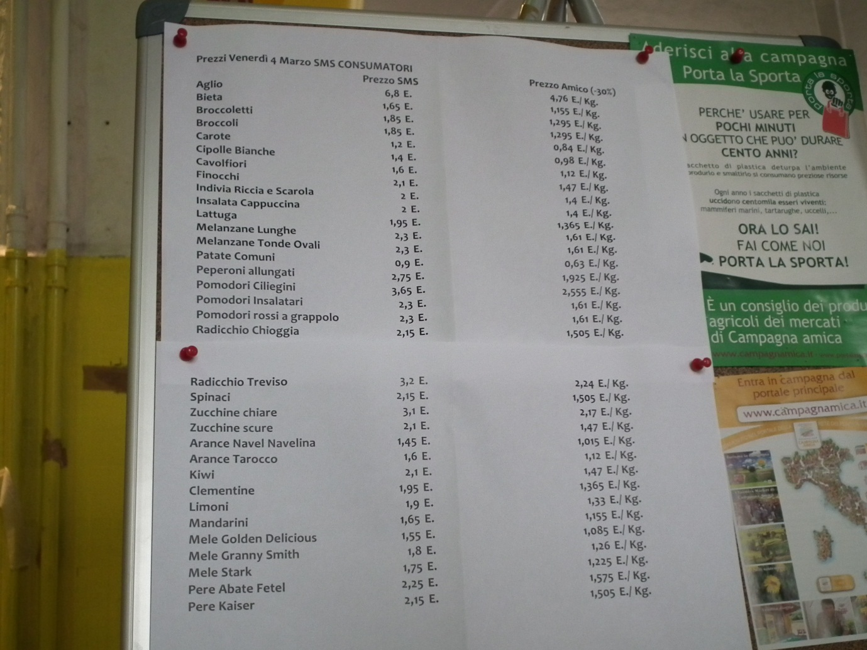
Roma: Mercato Contadino

Slide 6
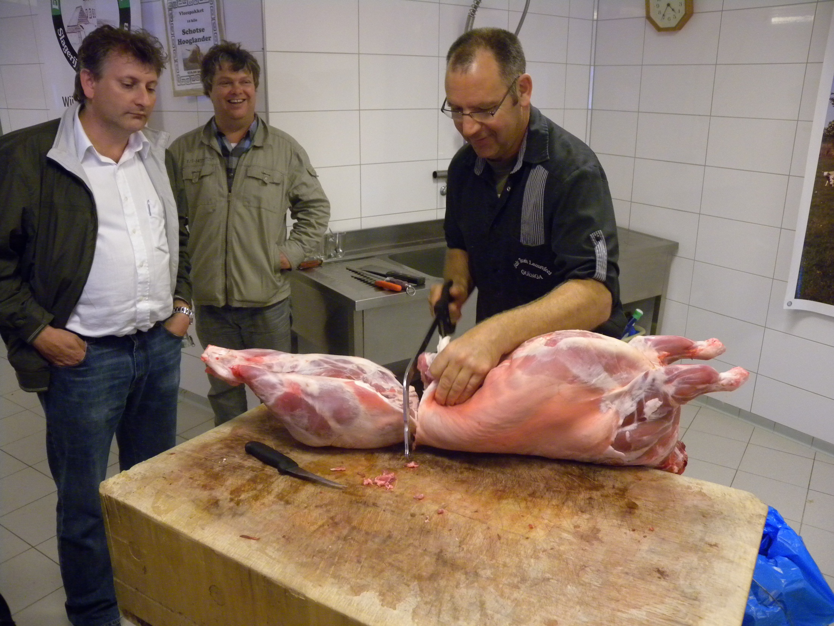

Slide 7
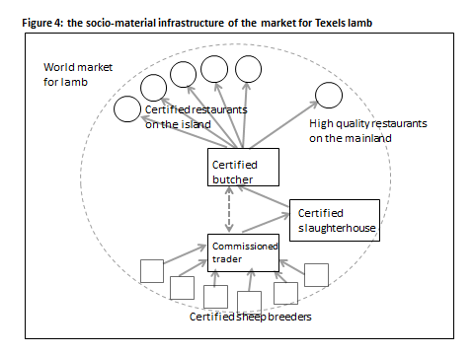

Slide 8
Economic impact of high quality food production
(∆ NVA; EU-7, 1998 data)
HQ
€2.3 billion
Total additional NVA
€ 5.2 billion
Organic
€0.4 billion
Short supply
chains
€2.5 billion

Slide 9
There is – also in China – an emergence of nested markets. Ye, Rao and Wu (2010) refer a.o. to the following ones:
(1) the market for organic produce (that currently embraces more than 500 different products that are mostly exported; the export value is about 400 million US dollars);
(2) the Green Food market that channels certified food within China (total market sales currently equal 19 billion Euros/year);
(3) the market for eco-agriculture that strongly builds on ancient agricultural traditions;
(4) the markets associated with “One Village, One Product” (these markets centre mostly on typical regional or local products, as e.g. high quality toufu or handpicked organic apples);
(5) the markets for agro-tourism (there are five different types of agro-tourism in China; together they attended 335 million tourists in 2007; they generate an income of some 5 billion Euros/year).

Slide 10
Social relations → structural patterns
10
2
7
1
5
3
8
4
6
9

Slide 11
10
2
7
1
5
3
8
4
6
But also: structural holes
9

Slide 12
Barriers for newcomers
Exclusion of certain consumer groups
Excluding authenticity, locality, quality
Blocking innovations
Following established routines
Specific organization of time and space
Prescribing particular forms of production, excluding others,
Etc.
10
2
7
1
5
3
8
4
6
But also: structural holes
9

Slide 13
Barriers for newcomers
Exclusion of certain consumer groups
Excluding authenticity, locality, quality
Blocking innovations
Following established routines
Specific organization of time and space
Prescribing particular forms of production, excluding others,
Etc.
10
2
7
1
5
3
8
4
6
But also: structural holes
Structural holes that might be bridged
9

Slide 14
Barriers for newcomers
Exclusion of certain consumer groups
Excluding authenticity, locality, quality
Blocking innovations
Following established routines
Specific organization of time and space
Prescribing particular forms of production, excluding others,
Etc.
10
2
7
1
5
3
8
4
6
But also: structural holes
Structural holes that might be bridged through the construction of nested markets
9

Slide 15
Producers
The creation of bridges or by-passes
Food Empires
Peasant
markets
Consumers

Slide 16
INFRASTRUCTURE
Urban farmers’ market
Dairy products
Fruits and vegetables
eggs
bread
chutneys
Ordering through internet
Meat products
Wine import
farm shop
Box scheme
other farms
mutual delivery
additional delivery

Slide 17
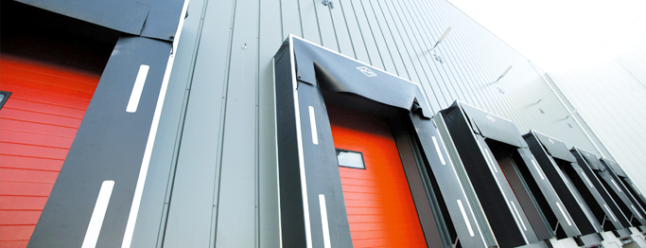
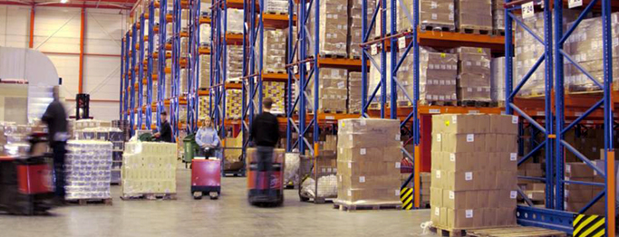
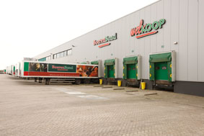

Slide 18
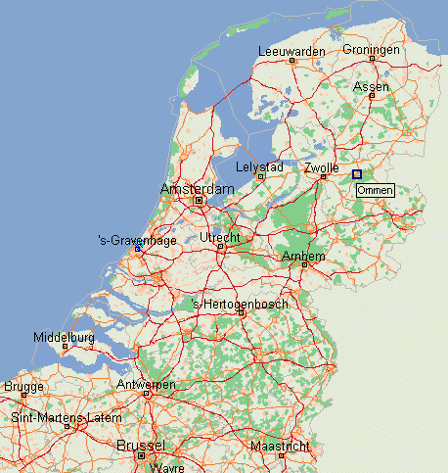

Slide 19
INFRASTRUCTURE
Urban farmers’ market
Dairy products
Fruits and vegetables
eggs
bread
chutneys
Ordering through internet
Meat products
Wine import
farm shop
Box scheme
other farms
mutual delivery
additional delivery

Slide 20
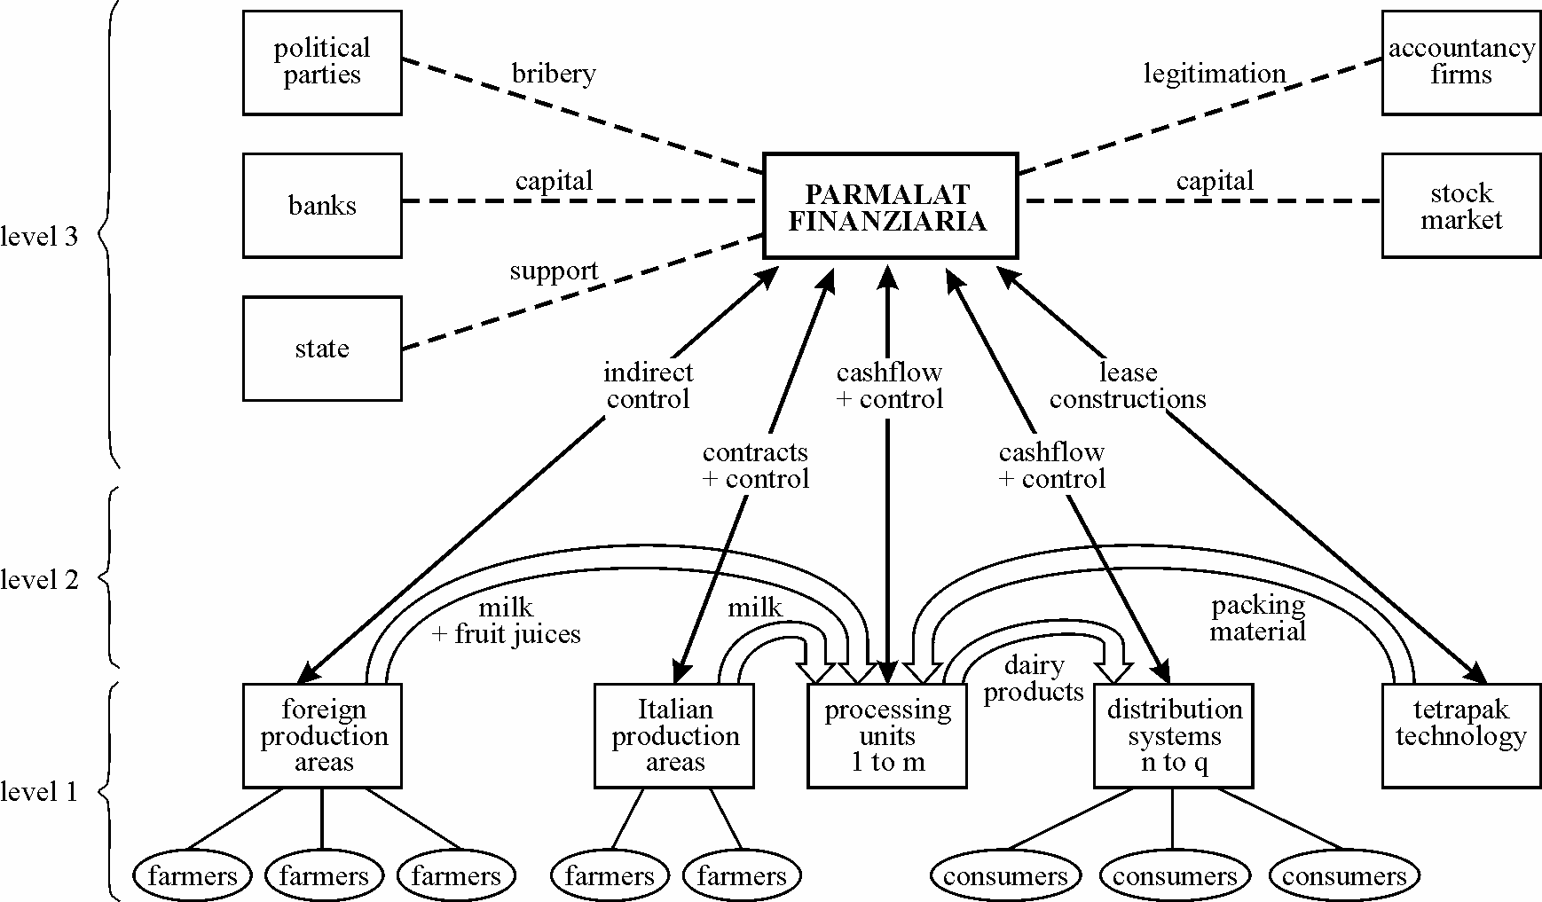

Slide 21
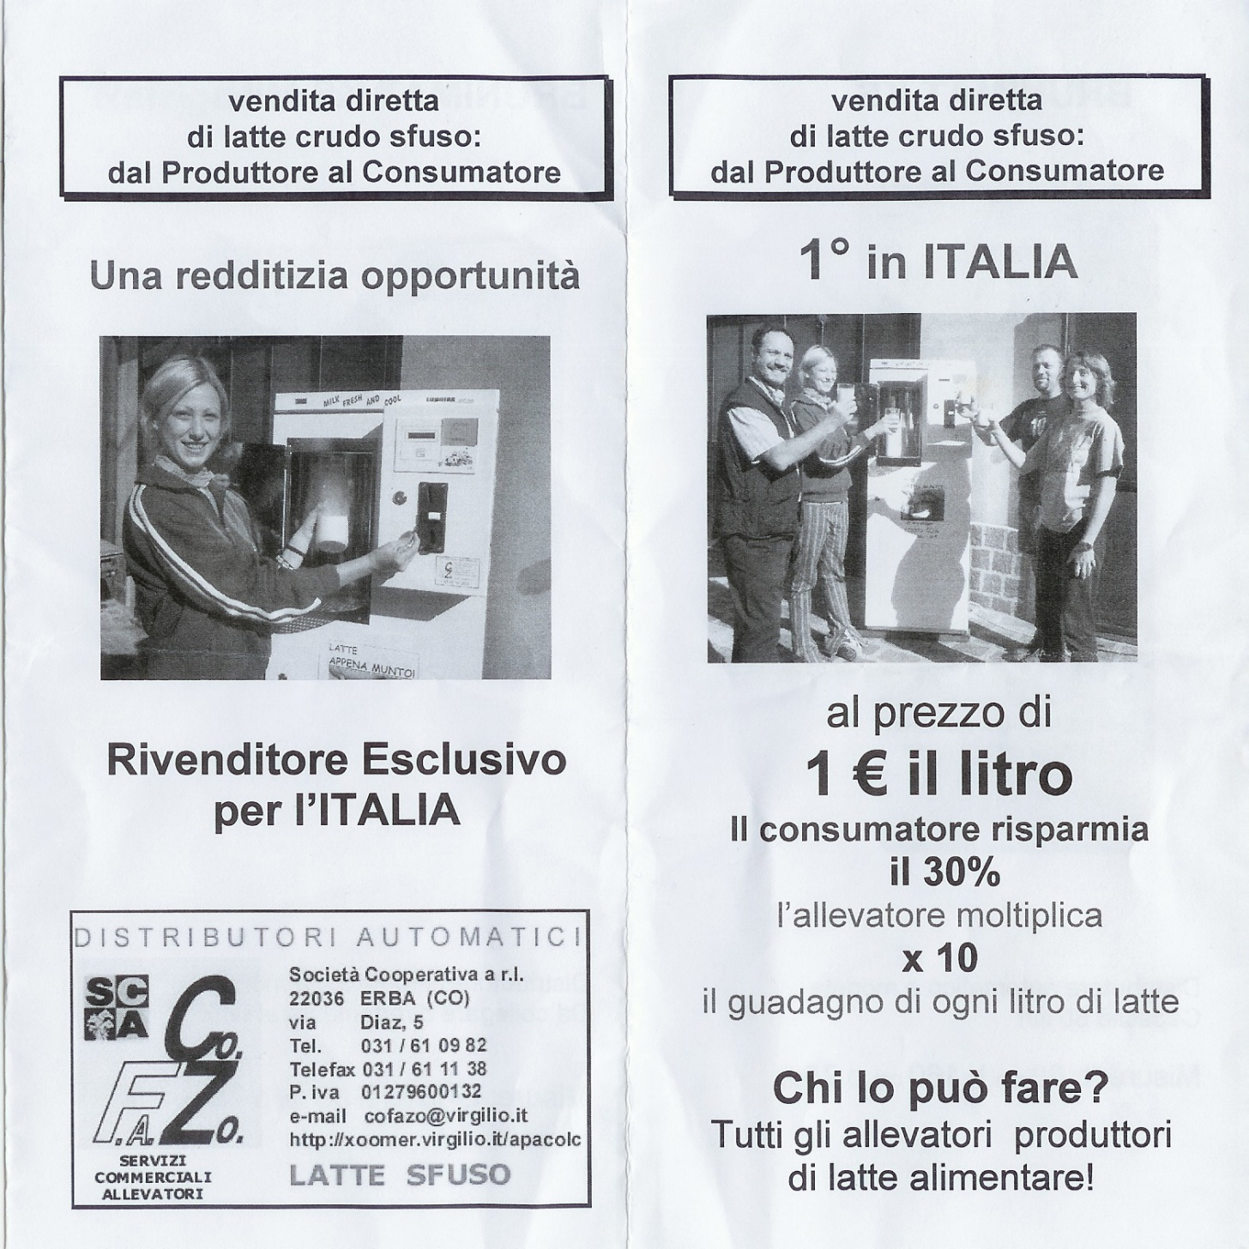
The construction of new nested markets is the outcome of social struggles

Slide 22
Everyday politics of the ‘modification type’ (Kerkvliet);
Rightful resistance (O’Brien)
The construction of new nested markets is the outcome of social struggles

Slide 23
a comparison of the general agricultural and food markets and the newly emerging markets
 | General agricultural and food markets | Newly emerging markets
Who owns what?
Who does what?
Who gets what?
What is done with the surpluses?
Henry Bernstein

Slide 24
a comparison of the general agricultural and food markets and the newly emerging markets
 | General agricultural and food markets | Newly emerging markets
Who owns what? | Most linkages between production, processing, distribution and consumption of food are controlled by food empires | Short circuits are interlinking the production and consumption of food. These short circuits are owned or co-owned by farmers
Who does what?
Who gets what?
What is done with the surpluses?
Table 2: a schematic comparison of the general agricultural and food markets and the newly emerging markets
General agricultural and food markets
Newly emerging markets
Who owns what?
Most linkages between production, processing, distribution and consumption of food are controlled by food empires
Short circuits are interlinking the production and consumption of food. These short circuits are owned or co-owned by farmers
Who does what?
The role of farmers is limited to the delivery of raw materials for the food industry
The role of farmers is extended to embrace on-farm processing, direct selling and the redesign of production processes that better meet consumer expectations
Who gets what?
The distribution of Value Added is highly skewed; most wealth is accumulated in food empires
Farmers get a far higher share of the total Value Added
What is done with the surpluses?
Accumulated wealth is used to finance the ongoing imperial conquest (take-over of other enterprises, etc)
Extra income is used to increase the resilience of food production, to strengthen multifunctional farming and to improve livelihoods

Slide 25
a comparison of the general agricultural and food markets and the newly emerging markets
 | General agricultural and food markets | Newly emerging markets
Who owns what?
Who does what? | The role of farmers is limited to the delivery of raw materials for the food industry | The role of farmers is extended to embrace on-farm processing, direct selling and the redesign of production processes that better meet consumer expectations
Who gets what?
What is done with the surpluses?
Table 2: a schematic comparison of the general agricultural and food markets and the newly emerging markets
General agricultural and food markets
Newly emerging markets
Who owns what?
Most linkages between production, processing, distribution and consumption of food are controlled by food empires
Short circuits are interlinking the production and consumption of food. These short circuits are owned or co-owned by farmers
Who does what?
The role of farmers is limited to the delivery of raw materials for the food industry
The role of farmers is extended to embrace on-farm processing, direct selling and the redesign of production processes that better meet consumer expectations
Who gets what?
The distribution of Value Added is highly skewed; most wealth is accumulated in food empires
Farmers get a far higher share of the total Value Added
What is done with the surpluses?
Accumulated wealth is used to finance the ongoing imperial conquest (take-over of other enterprises, etc)
Extra income is used to increase the resilience of food production, to strengthen multifunctional farming and to improve livelihoods

Slide 26
a comparison of the general agricultural and food markets and the newly emerging markets
 | General agricultural and food markets | Newly emerging markets
Who owns what?
Who does what?
Who gets what? | The distribution of Value Added is highly skewed; most wealth is accumulated in food empires | Farmers get a far higher share of the total Value Added
What is done with the surpluses?
Table 2: a schematic comparison of the general agricultural and food markets and the newly emerging markets
General agricultural and food markets
Newly emerging markets
Who owns what?
Most linkages between production, processing, distribution and consumption of food are controlled by food empires
Short circuits are interlinking the production and consumption of food. These short circuits are owned or co-owned by farmers
Who does what?
The role of farmers is limited to the delivery of raw materials for the food industry
The role of farmers is extended to embrace on-farm processing, direct selling and the redesign of production processes that better meet consumer expectations
Who gets what?
The distribution of Value Added is highly skewed; most wealth is accumulated in food empires
Farmers get a far higher share of the total Value Added
What is done with the surpluses?
Accumulated wealth is used to finance the ongoing imperial conquest (take-over of other enterprises, etc)
Extra income is used to increase the resilience of food production, to strengthen multifunctional farming and to improve livelihoods

Slide 27
a comparison of the general agricultural and food markets and the newly emerging markets
 | General agricultural and food markets | Newly emerging markets
Who owns what?
Who does what?
Who gets what?
What is done with the surpluses? | Accumulated wealth is used to finance the ongoing imperial conquest (take-over of other enterprises, etc) | Extra income is used to increase the resilience of food production, to strengthen multifunctional farming and to improve livelihoods
Table 2: a schematic comparison of the general agricultural and food markets and the newly emerging markets
General agricultural and food markets
Newly emerging markets
Who owns what?
Most linkages between production, processing, distribution and consumption of food are controlled by food empires
Short circuits are interlinking the production and consumption of food. These short circuits are owned or co-owned by farmers
Who does what?
The role of farmers is limited to the delivery of raw materials for the food industry
The role of farmers is extended to embrace on-farm processing, direct selling and the redesign of production processes that better meet consumer expectations
Who gets what?
The distribution of Value Added is highly skewed; most wealth is accumulated in food empires
Farmers get a far higher share of the total Value Added
What is done with the surpluses?
Accumulated wealth is used to finance the ongoing imperial conquest (take-over of other enterprises, etc)
Extra income is used to increase the resilience of food production, to strengthen multifunctional farming and to improve livelihoods

Slide 28
a comparison of the general agricultural and food markets and the newly emerging markets
 | General agricultural and food markets | Newly emerging markets
Who owns what?
Who does what?
Who gets what?
What is done with the surpluses? | Accumulated wealth is used to finance the ongoing imperial conquest (take-over of other enterprises, etc) | Extra income is used to increase the resilience of food production, to strengthen multifunctional farming and to improve livelihoods
Table 2: a schematic comparison of the general agricultural and food markets and the newly emerging markets
General agricultural and food markets
Newly emerging markets
Who owns what?
Most linkages between production, processing, distribution and consumption of food are controlled by food empires
Short circuits are interlinking the production and consumption of food. These short circuits are owned or co-owned by farmers
Who does what?
The role of farmers is limited to the delivery of raw materials for the food industry
The role of farmers is extended to embrace on-farm processing, direct selling and the redesign of production processes that better meet consumer expectations
Who gets what?
The distribution of Value Added is highly skewed; most wealth is accumulated in food empires
Farmers get a far higher share of the total Value Added
What is done with the surpluses?
Accumulated wealth is used to finance the ongoing imperial conquest (take-over of other enterprises, etc)
Extra income is used to increase the resilience of food production, to strengthen multifunctional farming and to improve livelihoods
Slot in ecology &
Slot in CPR

Slide 29
