Slide 1
The agroecological revolution in Latin America: towards resiliency and food sovereingty
Miguel A Altieri
University of California, Berkeley
And
Sociedad Cientifica LatinoAmwericana de Agroecologia (SOCLA)
www.agroeco.org

Slide 2
Historical Flawed Assumptions about hunger and rural poverty
People starve because there is not enough food and populations grow exponentially
Hunger is solved increasing food production with high input technology from the North
Progress requires replacement of local varieties for improved ones
Peasants need to be modernized, and those lagging behind are inefficient and condemned to migrate to cities or work in rural areas in Maquilas
Notes:
2

Slide 3
Transfer of labor and land saving technologies
Notes:
3

Slide 4
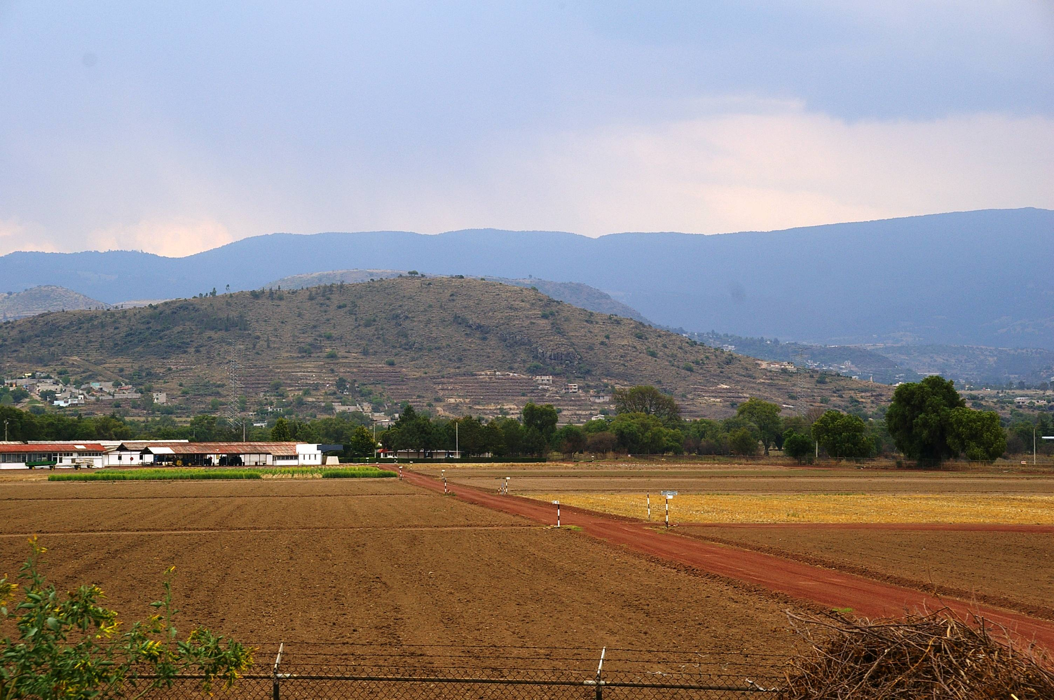
La Purificación
CIMMYT: flat soils, irrigation, HYVs, fertilizers, genetic and crop homogeneity,

Slide 5
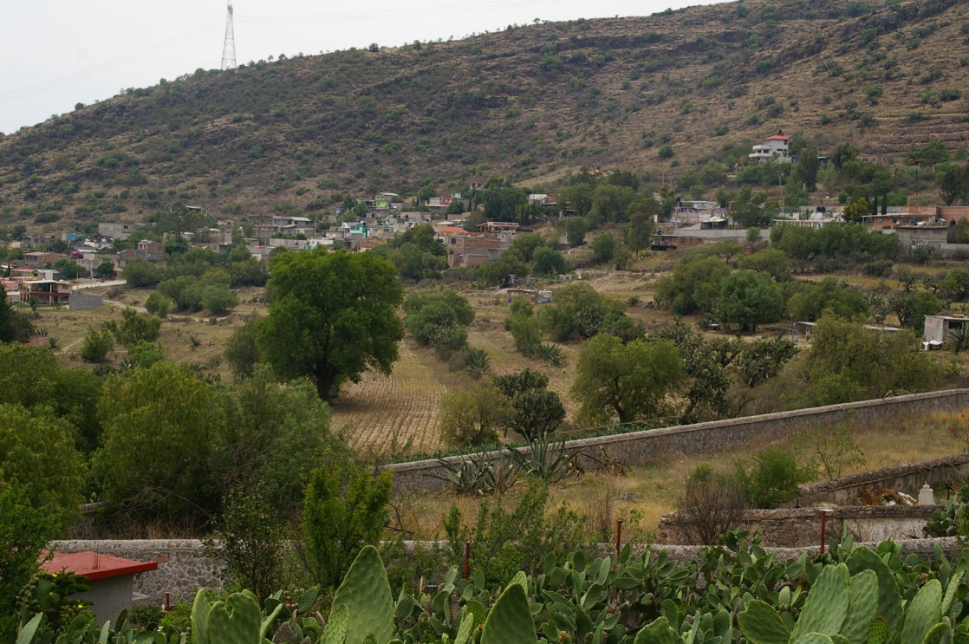
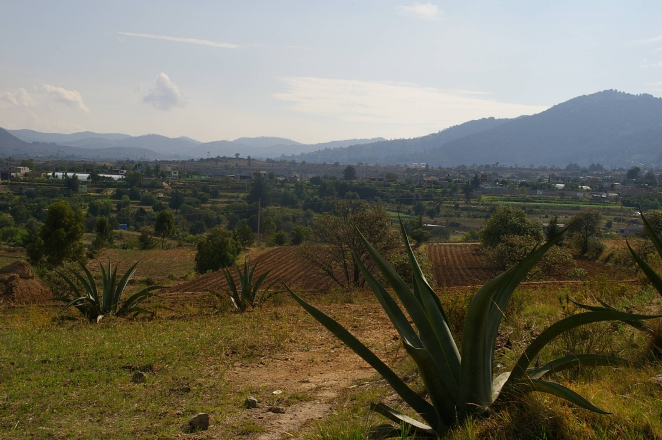
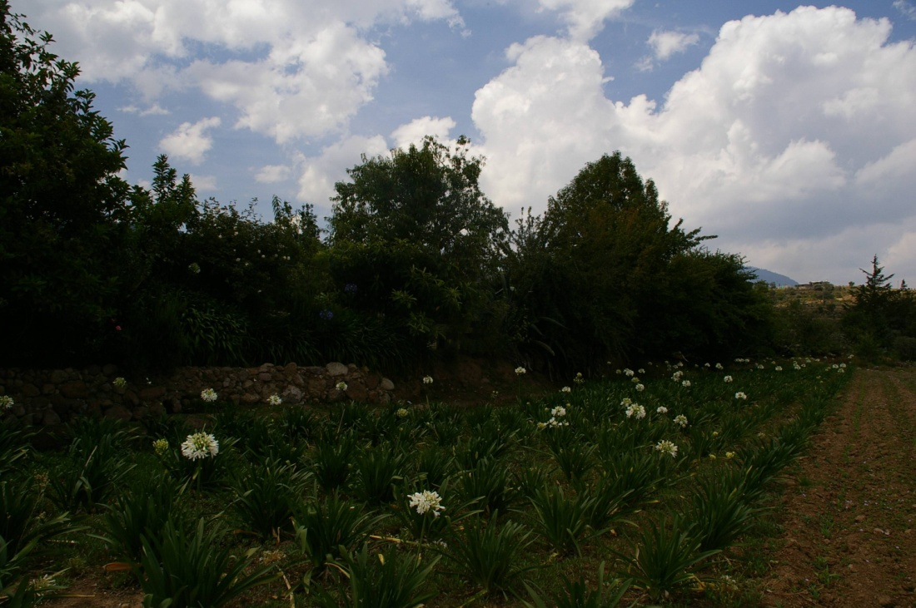
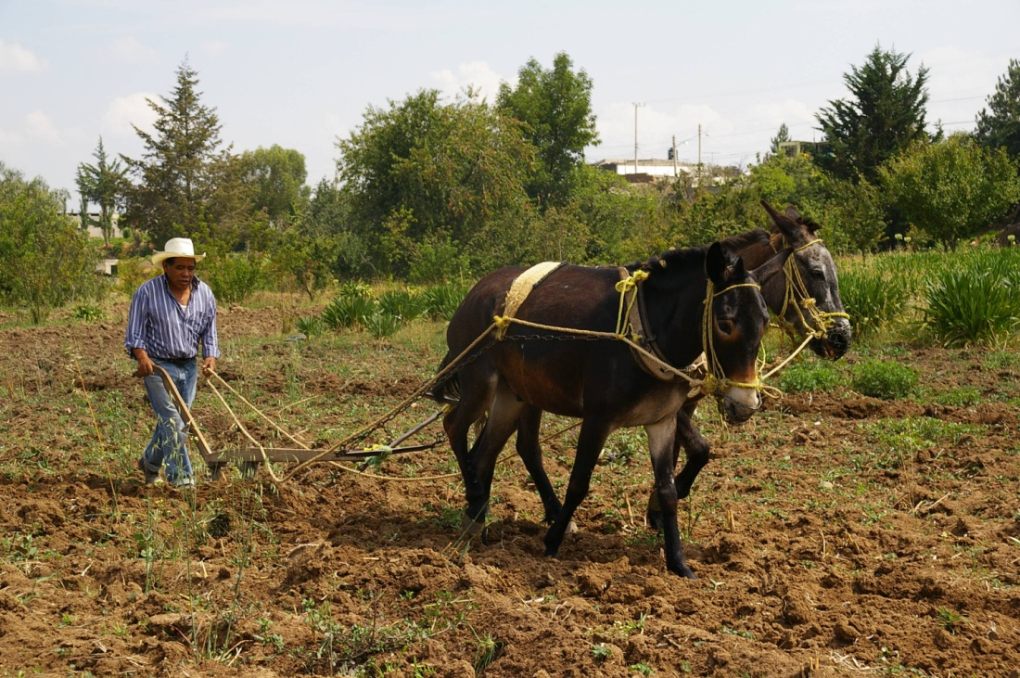
Small farms, heterogeneity, crop diversity,animal traction, organic management

Slide 6
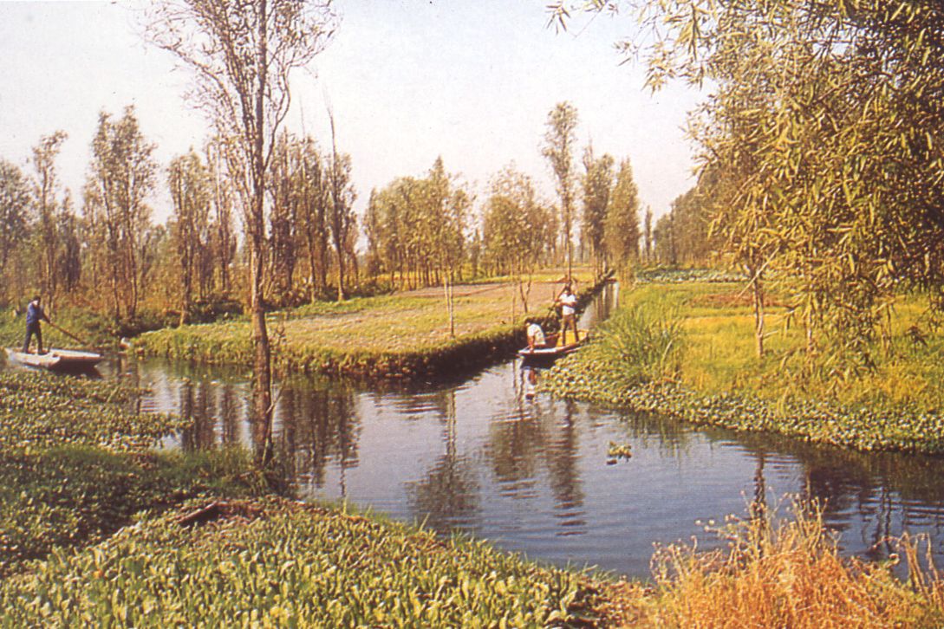

Slide 7
Productivity of Chinampas
Maize yields in 1950: 3,5-6,3 t/ha ( average US yields in 1955~2,3t/ha and went up >4 t/ha after 1965).
One hectare could produce enough food for 15-20 persons
One chinampero can successfully farm 0,75 ha, producing food for 12-15 people

Slide 8
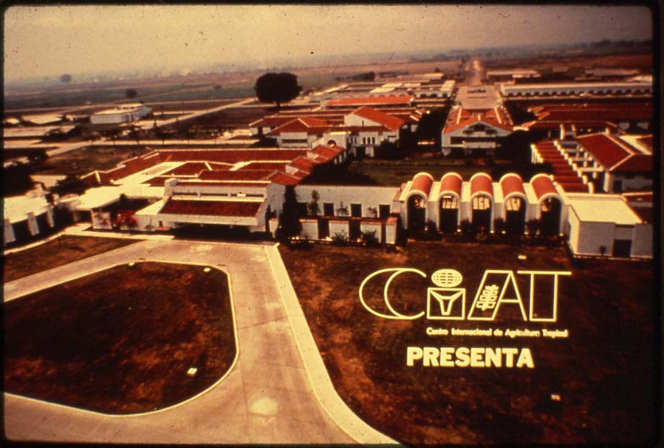

Slide 9
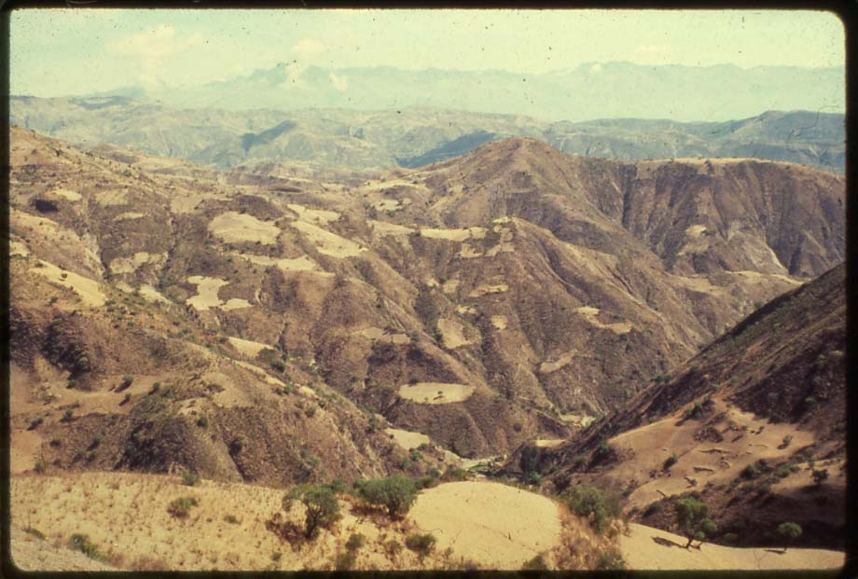

Slide 10
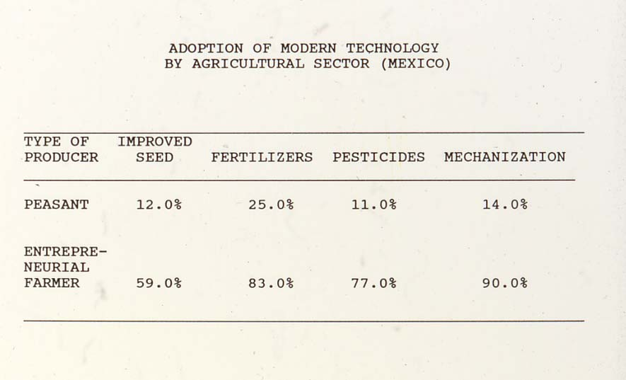

Slide 11
Peasants were bypassed by agricultural modernization
Technologies were imposed and did not emerge from a participatory process
Technologies were not appropriate to the needs and circumstances of peasants
Technologies were not scale neutral (favored larger farmers or those with access to capital, credit, best lands, etc)

Slide 12
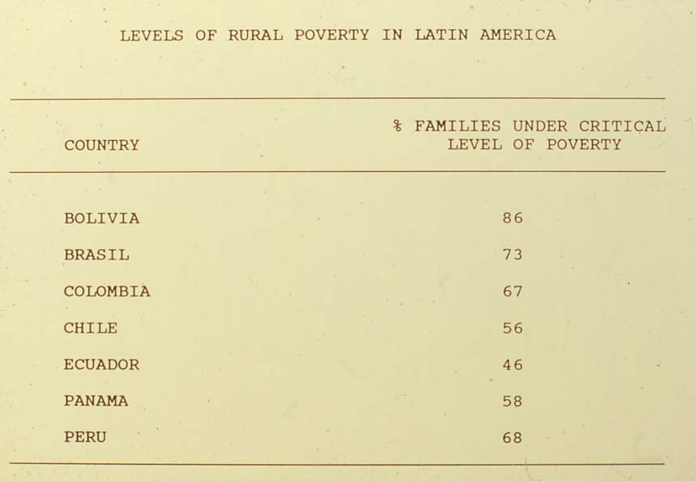

Slide 13
Flawed assumption cont.
The economic integration of traditional agroecosystems into the global system is a positive step that enables increased production, income and well being
With the right incentives small farmers will become more competitive , export more and make a profit and solve the problem of food insecurity
Notes:
13

Slide 14
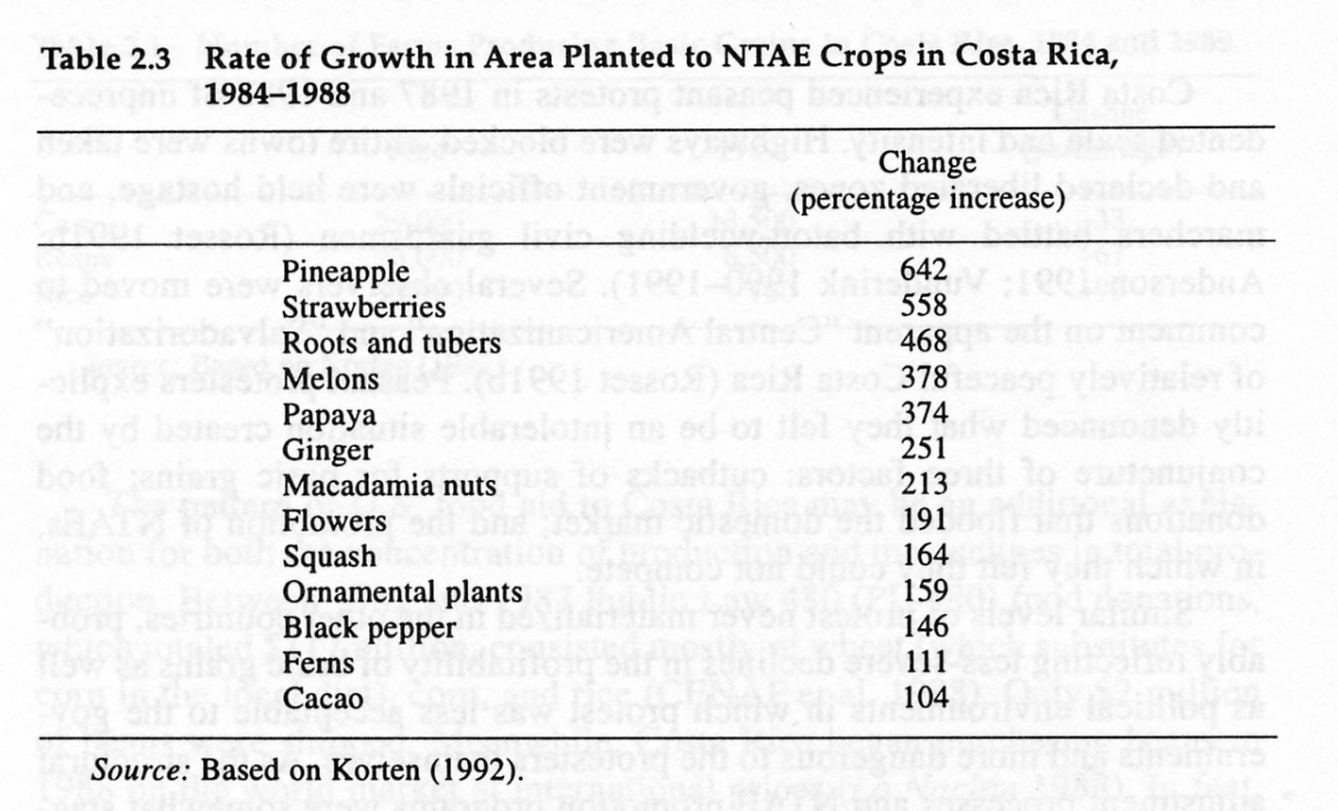

Slide 15
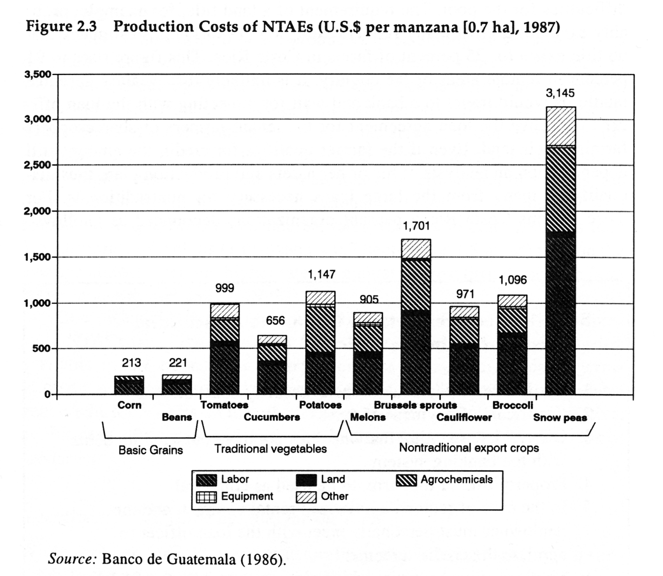

Slide 16
Flawed assumption 3
Biotechnology will dramatically increase production
transgenic crops will allow farmers to control pests without agrochemicals and overcome soil fertility problems
biotechnology is essential to feeding the world
transgenic crops will enhance biodiversity and are ecologically safe
Notes:
16

Slide 17
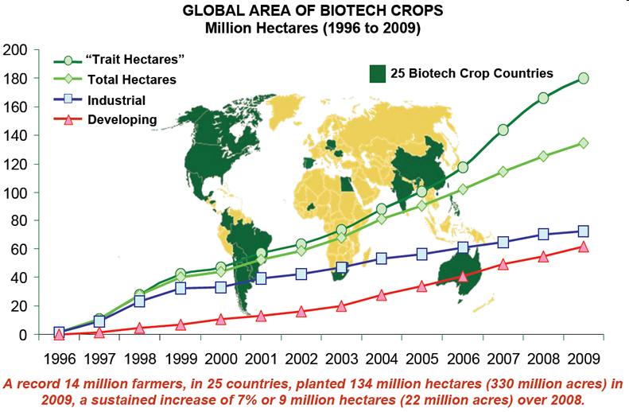

Slide 20
Soybean in Argentina (tons-red, has-blue)

