Slide 1
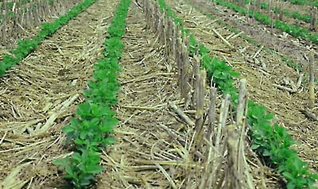

Slide 5
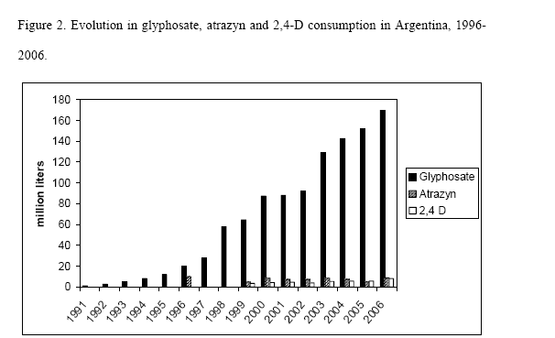

Slide 6
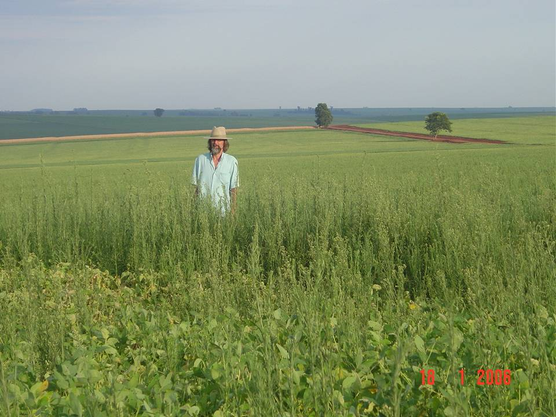
Foto: Robinson Osipe

Slide 7
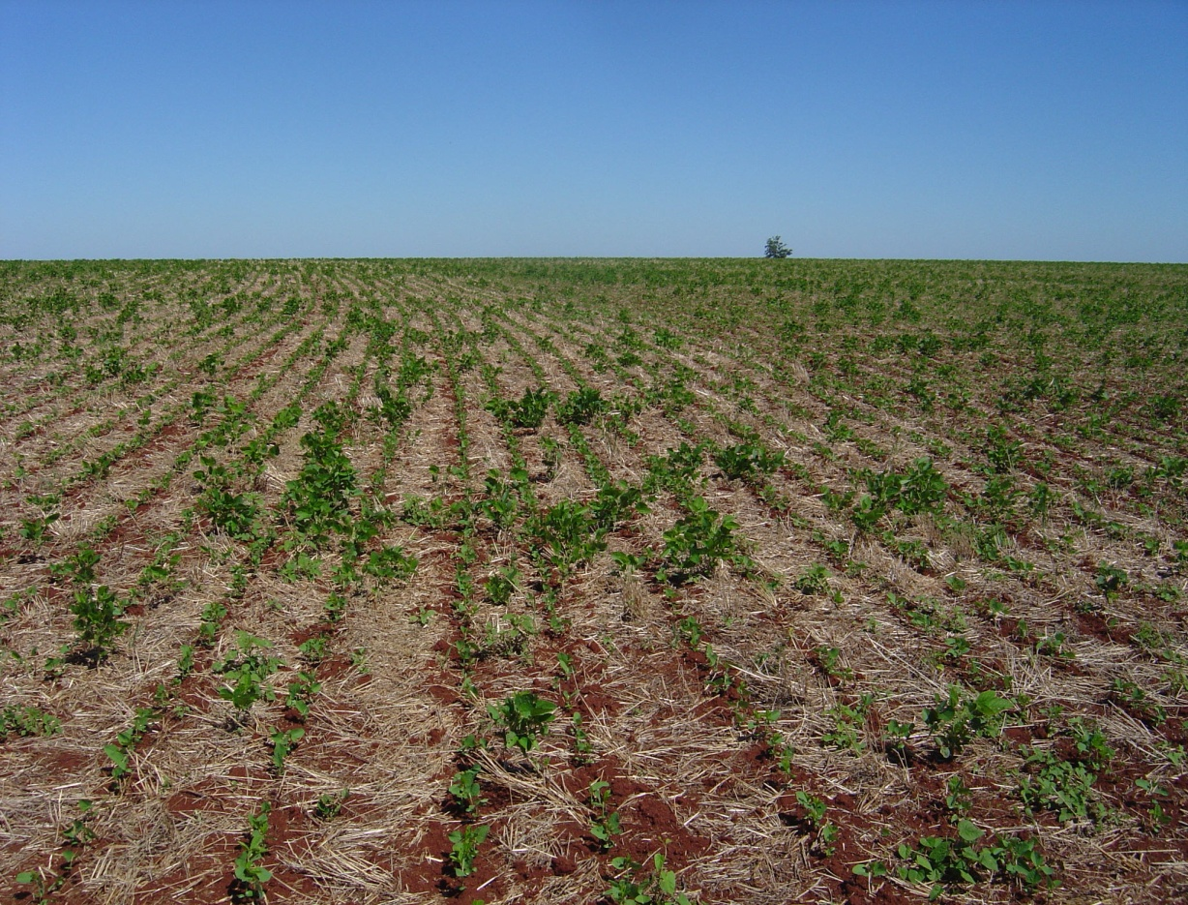
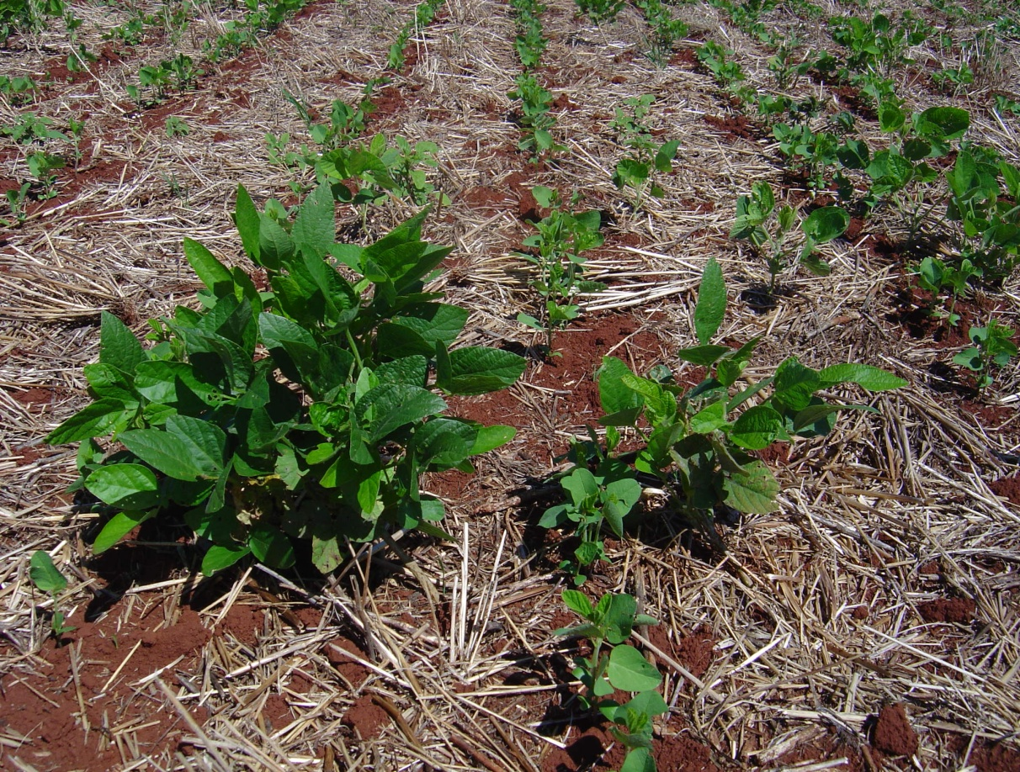
Fotos: Robinson Osipe

Slide 8
The agricultural challenge for the next decades
Food production must increase substantially and sustainably but using the same arable land base, with less petroleum, less water and nitrogen, within a scenario of climate change, social unrest and financial crisis.
This challenge cannot be met with the existing industrial agricultural model and its biotechnological derivations

Slide 9
Features of an agriculture for the future
De-coupled from fossil fuel dependence
Agroecosystems of low environmental impact, nature friendly
Resilient to climate change and other shocks
Multifunctional ( ecosystem, social, cultural and economic services)
Foundation of local food systems

Slide 10
Low external inputs, high recylcling rates, crop –livestock integration
High
High inputs, industrial monocultures
Low
Alta
Productivity
Eficiency
Low external inputs, diversified with low levels of integration
Medium-Low
Specialized systems with low external inputs
Medium
Baja
Alta
Baja
Agroecosystem Diversity

Slide 11
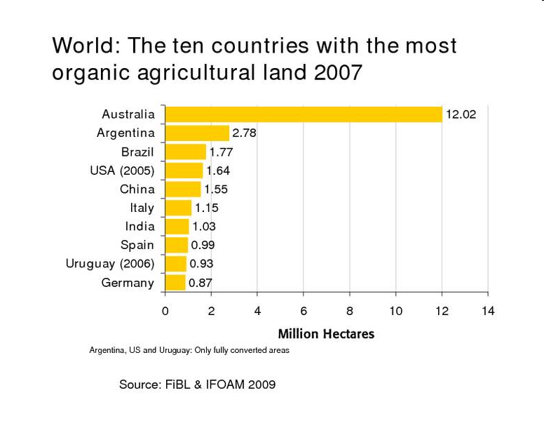

Slide 12
Organic for export
Chile: Certified organic crops took up a total of 151,097 hectares in 2009-2010 .
8961 tons of apples, kiwifruit, avocados, berries and asparragus were exported
Colombia: 37000 has organically certified devoted to coffee, palm oil, sugar cane, coconut, cocoa, organic fruits (mango, bananas, raspberries), flowers and ornamental plants
Value of organic exports > 20 million/year

Slide 13
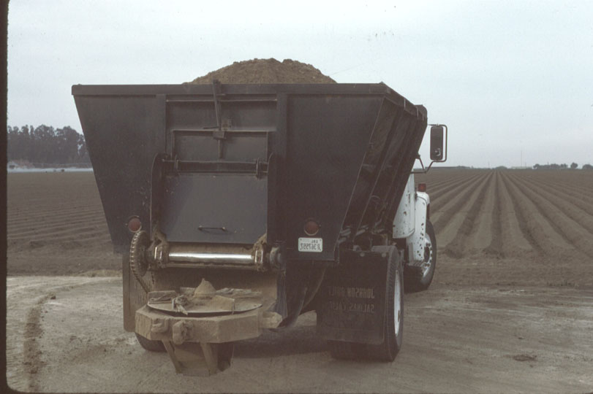

Slide 14
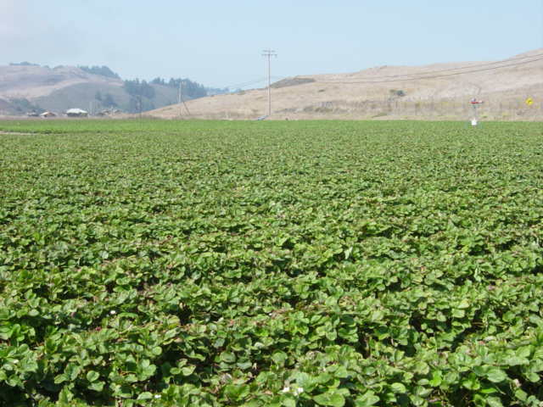

Slide 15
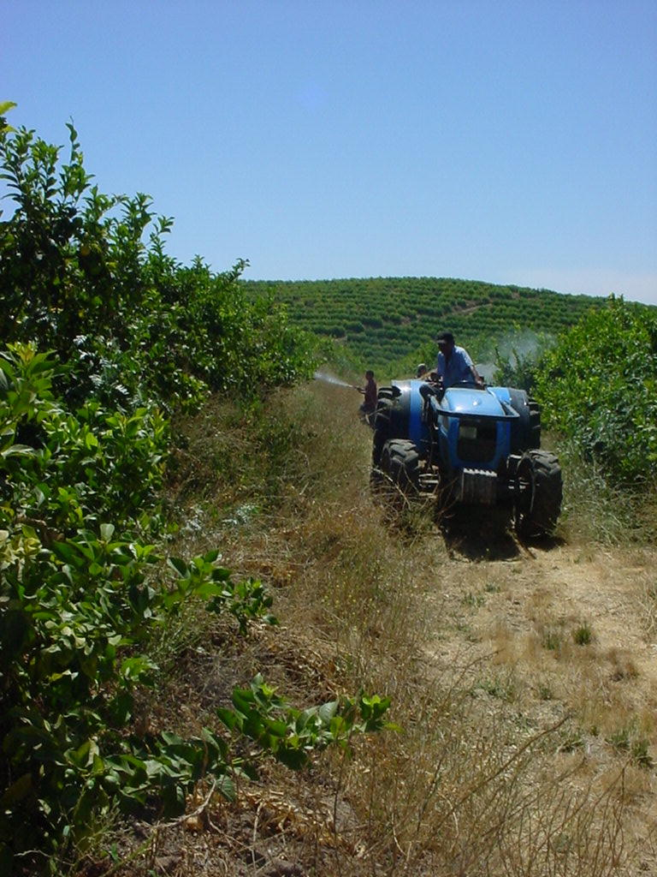

Slide 16
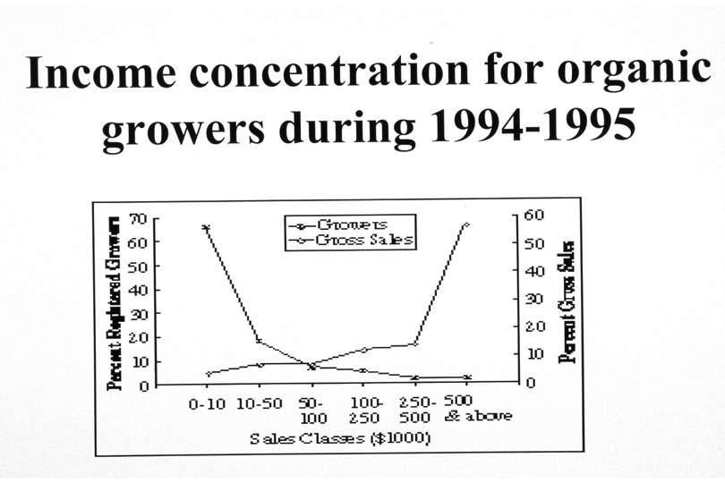

Slide 17
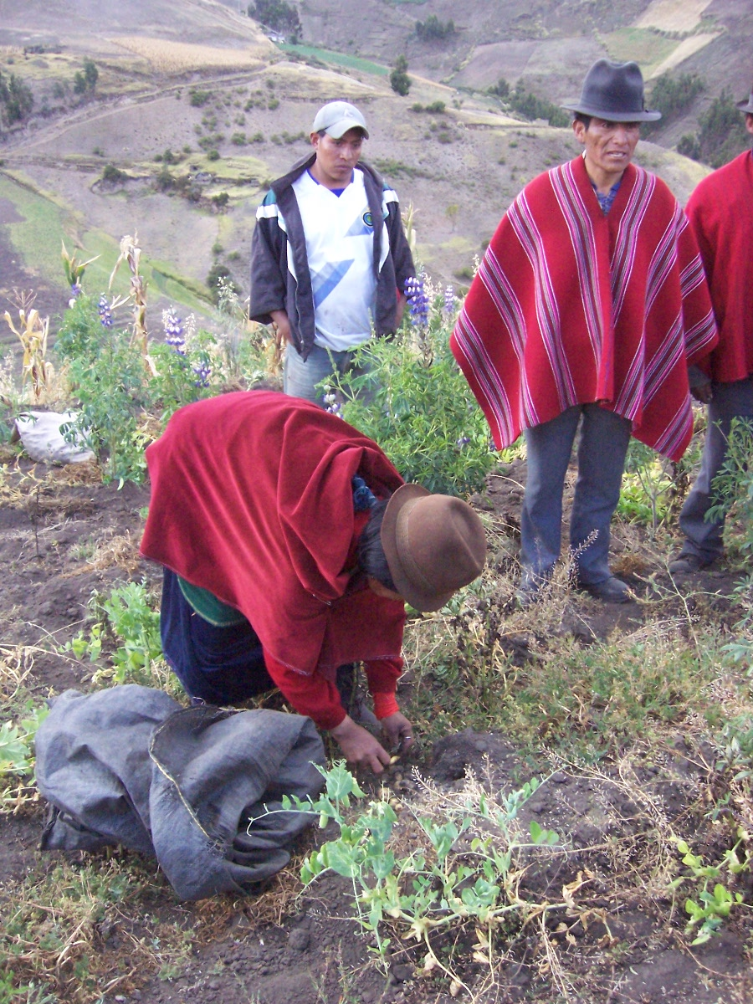
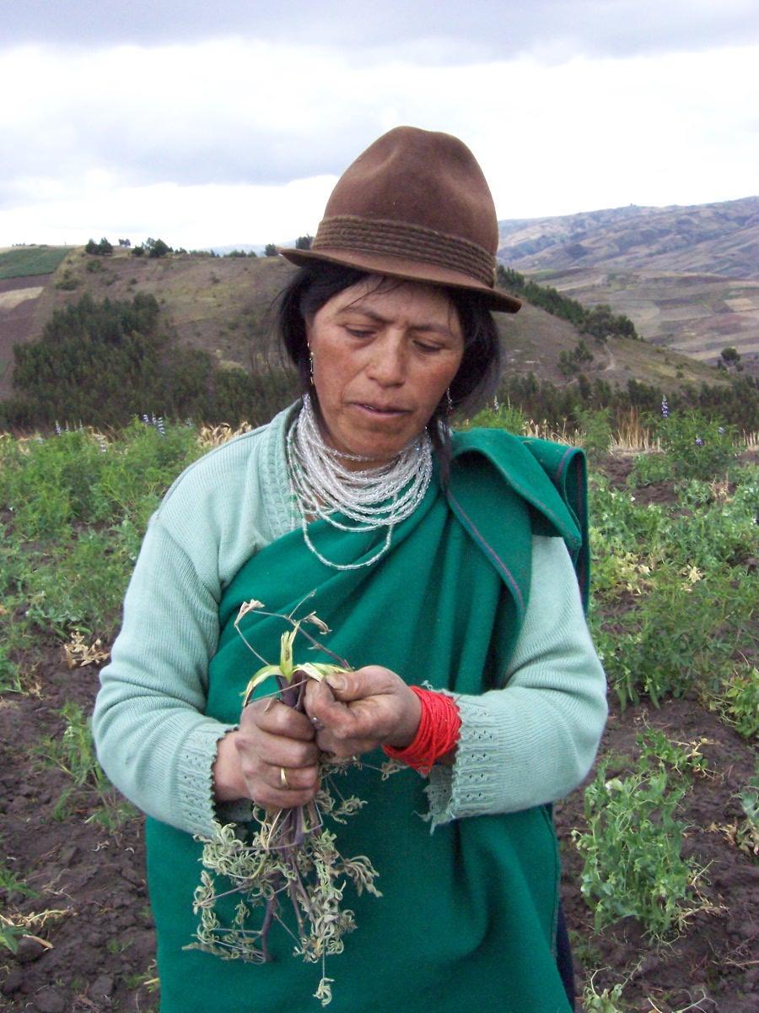

Slide 18
How many peasants there are in the world? (ETC 2009)
1, 5 billion peasants in 380 million small farms
At least 370 million of these are also indigenous peoples occupying 92 million farms
17 million peasant farms in Latin America grow between a half to two-thirds of staple foods
Africa’s 33 million peasant farms (mostly female-led) account for 80% of farms and most of the domestic food consumption
Asia’s 200 million peasant rice farms produce most of its harvest

Slide 19
PEASANT
AGROINDUSTRIAL
Energy
Scale
Self-sufficiency
Work force
Labor productivity
Total Output
Diversity
Knowledge
Cosmovision
0Ag 1Ag 2Ag 3Ag 4Ag 5Ag 6Ag 7Ag 8Ag 9Ag

Slide 20
