Slide 1
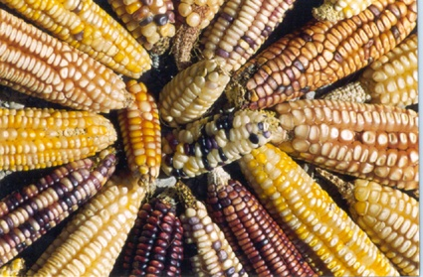
Los maíces indígenas de México
Notes:
1

Slide 2
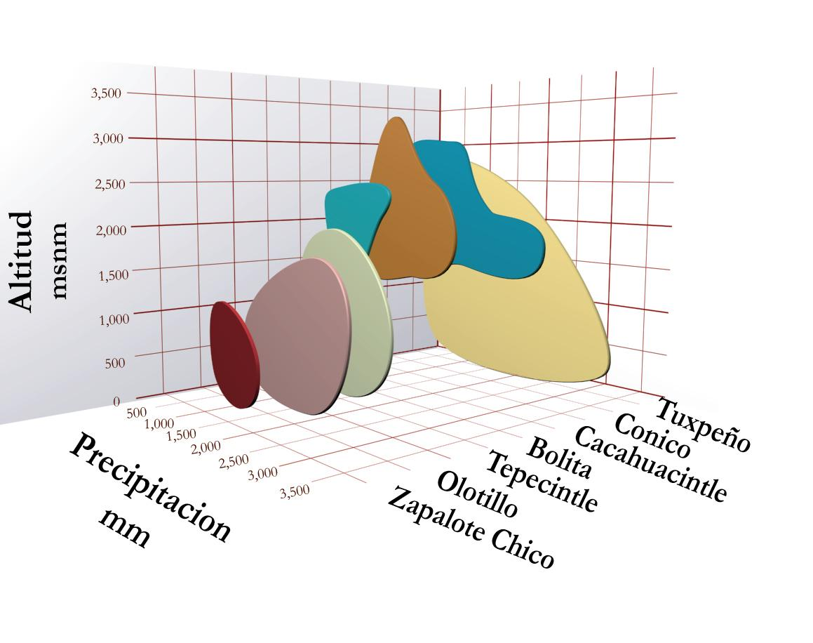
Mexican maize landraces and their distribution according to altitude and precipitation
45
Notes:
2

Slide 3
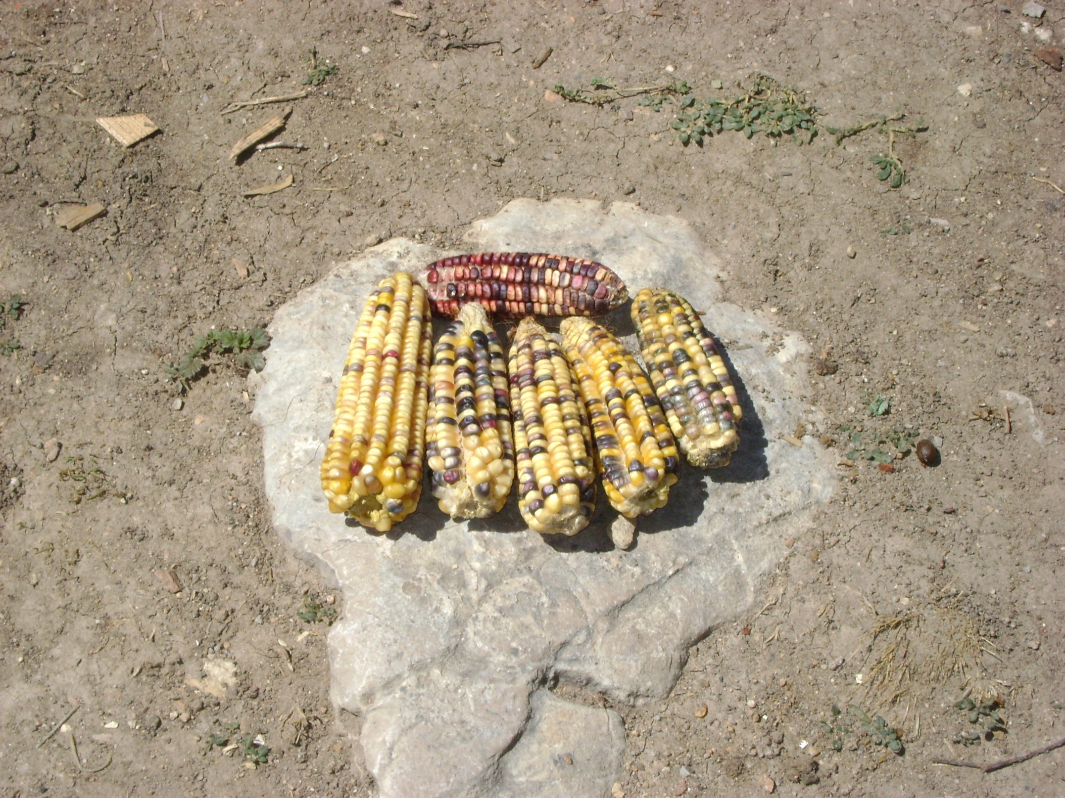
Maiz de cajete
Notes:
3

Slide 4
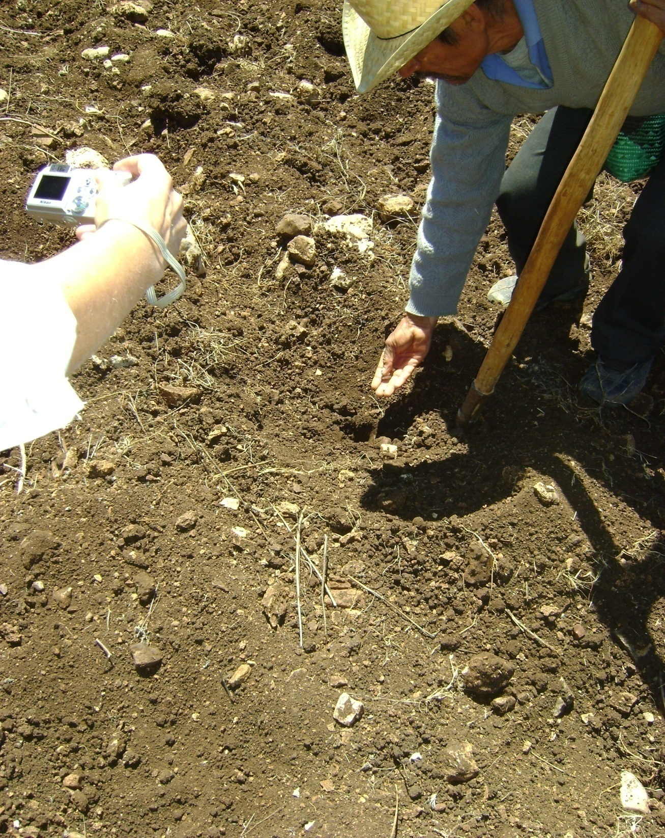
Notes:
4

Slide 5
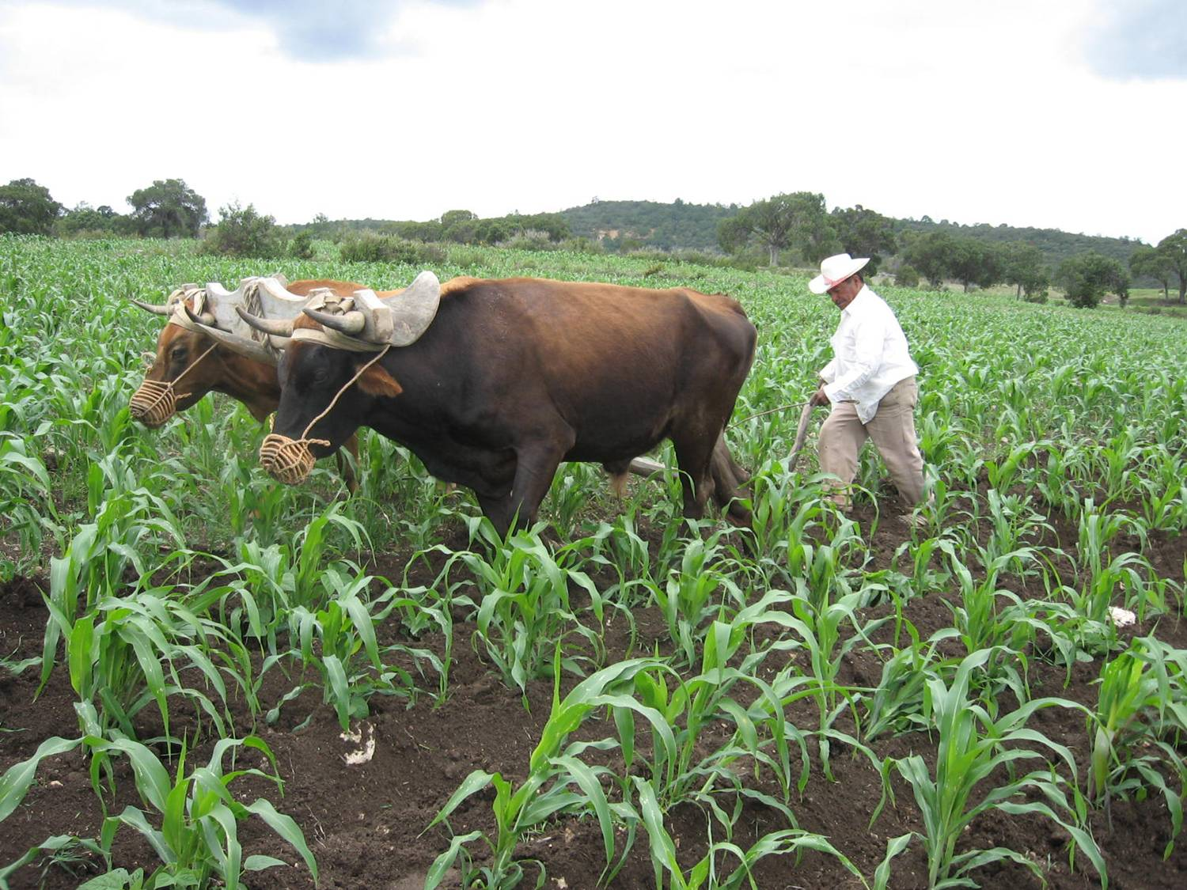

Slide 6
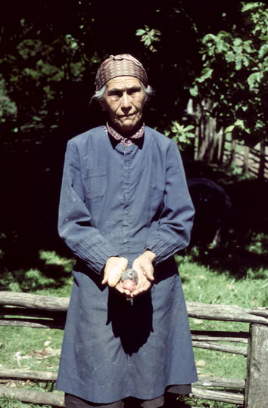

Slide 7
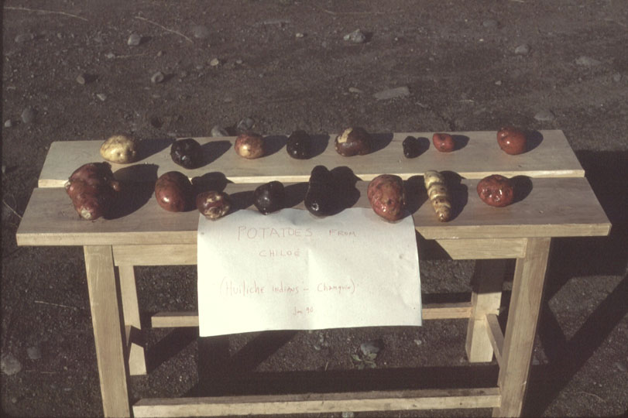

Slide 8
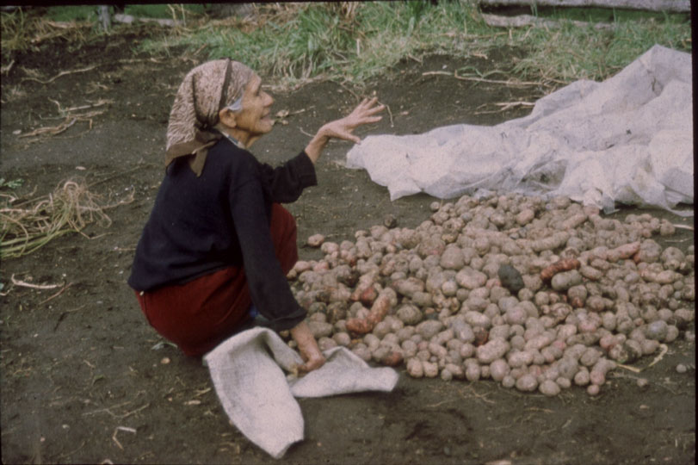

Slide 9
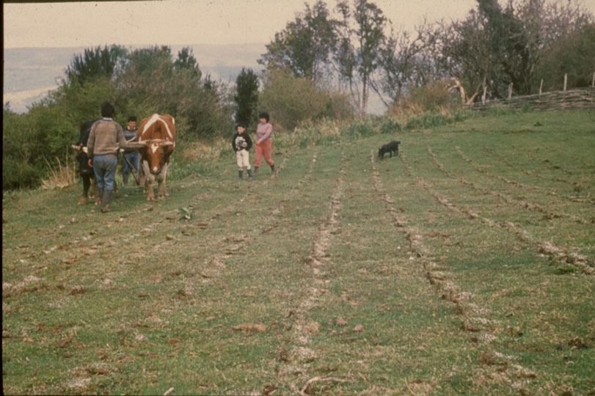

Slide 10
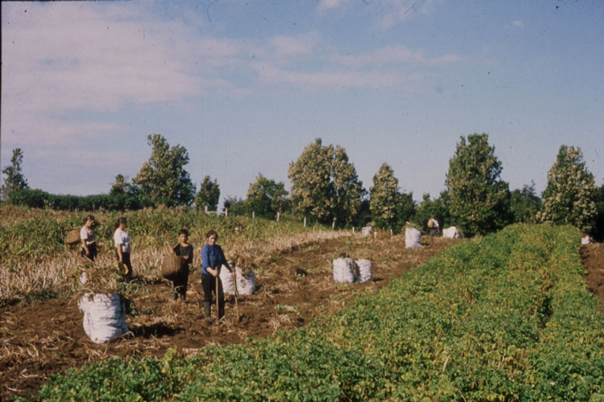

Slide 11
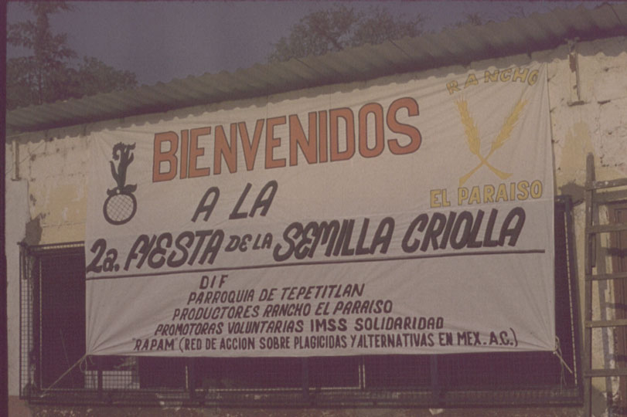

Slide 12
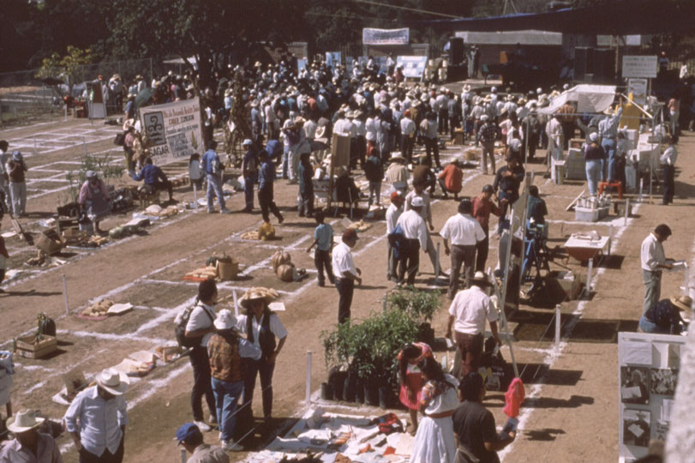

Slide 13
Ecology
Anthropology
Sociology
Etnoecology
AGROECOLOGY
Traditional Farmers’ knowledge
Biological Control
Ecological economics
Participatory research in farmers’ fields
Basic agricultural sciences
Principles
Specific technological forms

Slide 14
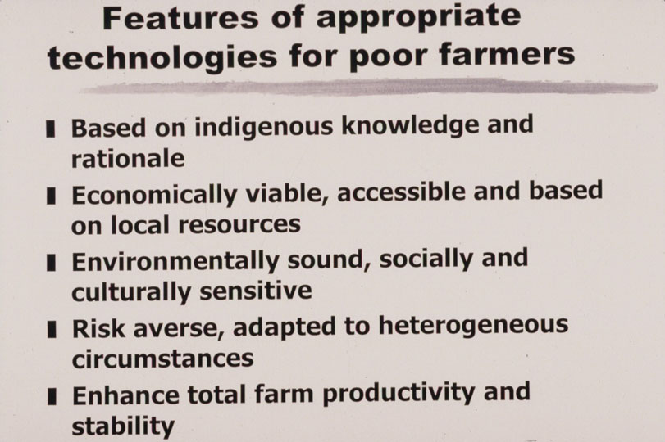

Slide 15
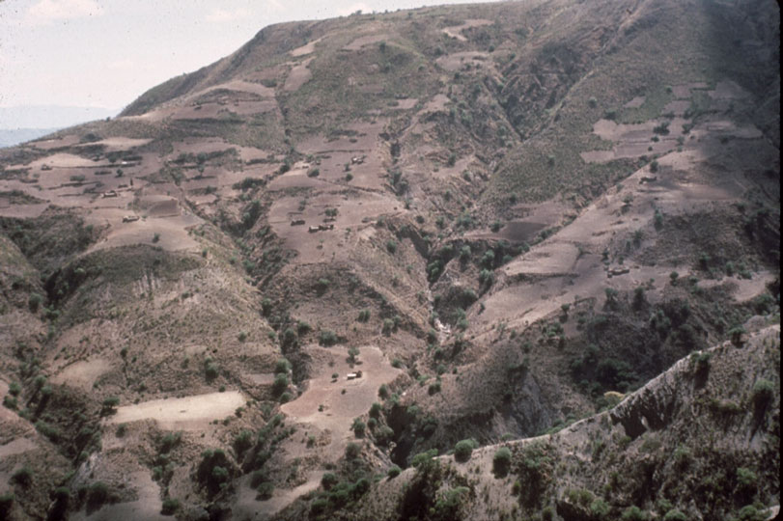

Slide 16
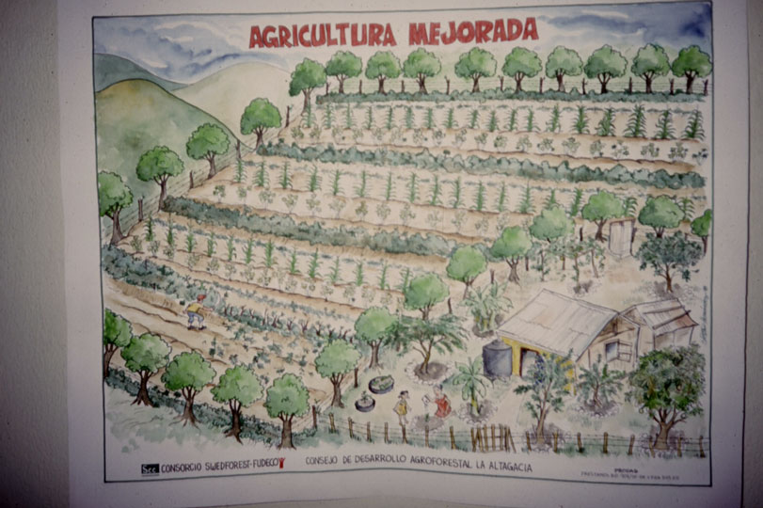

Slide 17
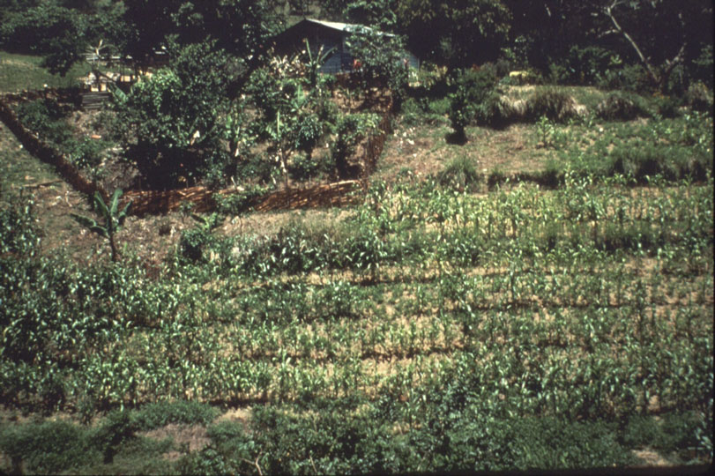

Slide 18
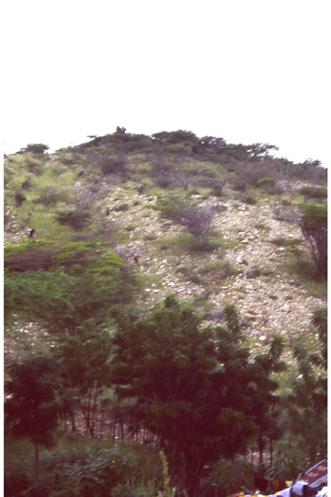
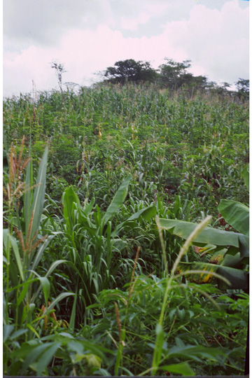

Slide 19
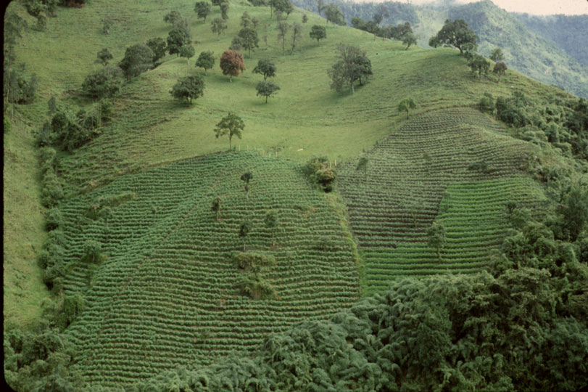

Slide 20
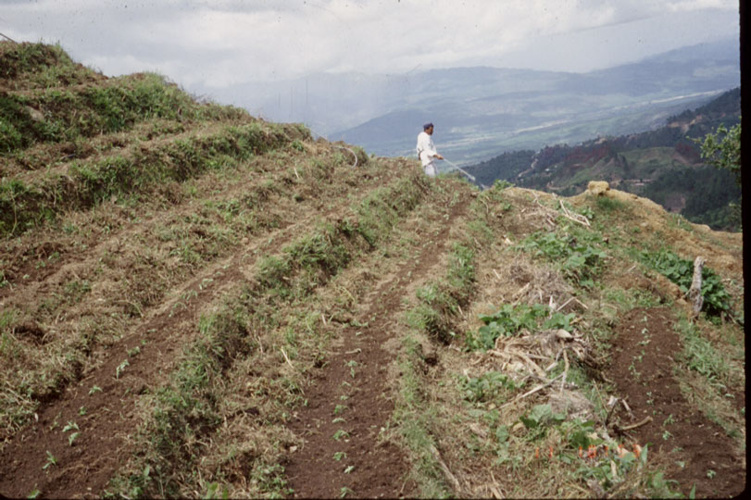

Slide 21
Velvetbean in Central America
Mucuna fixes 150 Kg N/ha/year, produces 30-50 tonnes of biomass/ha/yr
45,000 familes growing Mucuna
crop yields up from 400-600 Kg/ha to 2000-2500 kg/ha while conserving/regenerating soil in hillsides

Slide 22
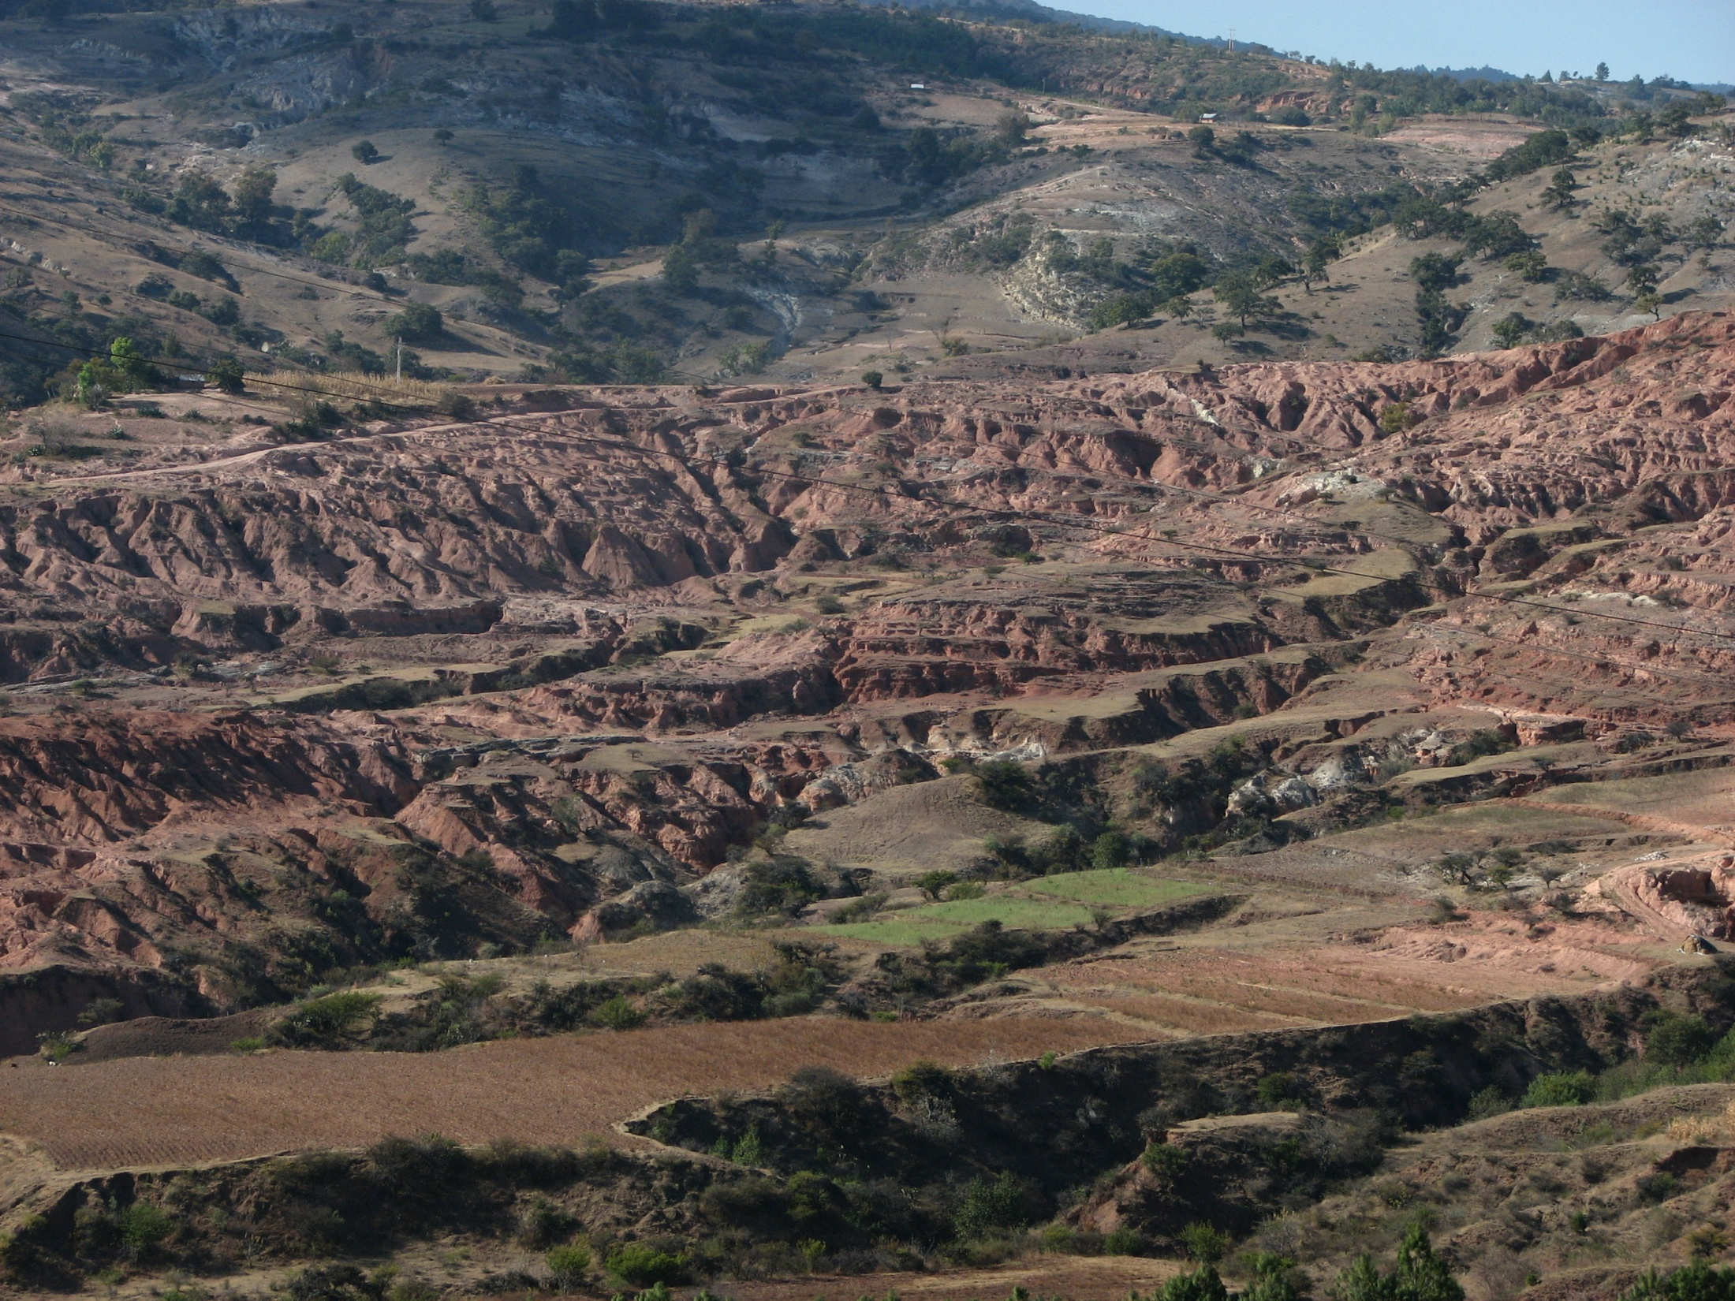

Slide 23
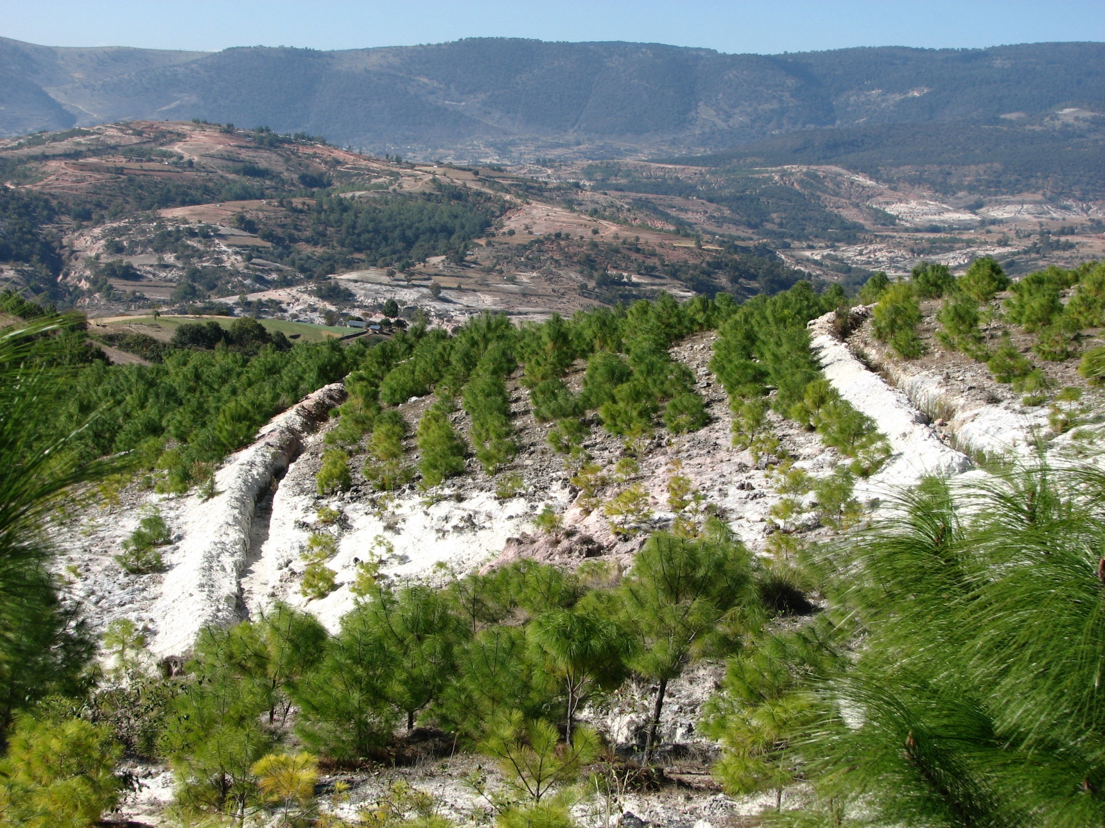

Slide 24
