Slide 1
The Campesino a Campesino Movement
The Campesino a Campesino movement is an extensive grassroots movement in Central America and Mexico.
It is a cultural phenomenon, a broad-based movement with campesinos as the main actors"
The Campesino a Campesino movement is an excellent example of how alternative technologies and practices can be disseminated bypassing "official channels".

Slide 2
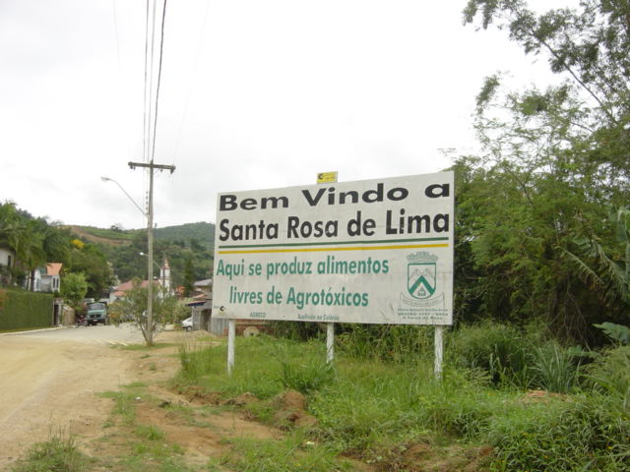

Slide 3
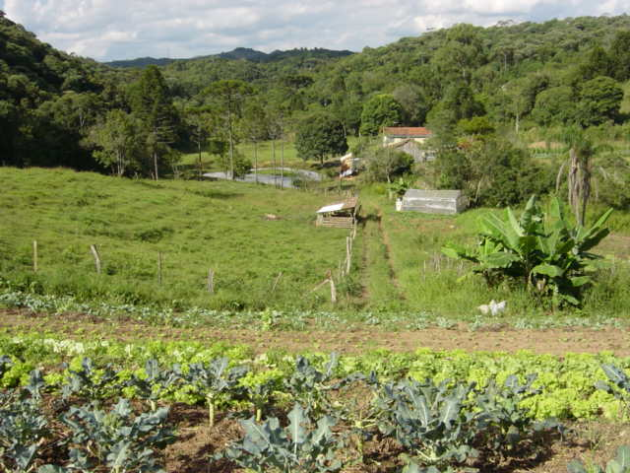

Slide 4
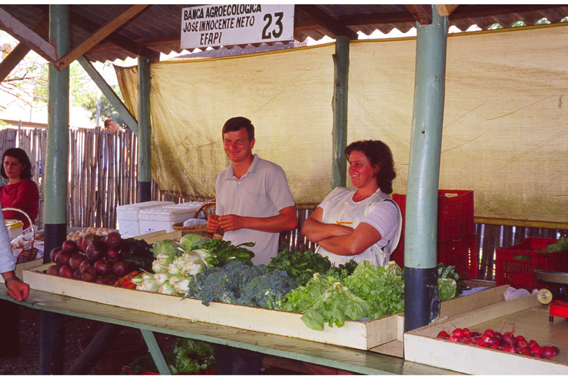

Slide 5
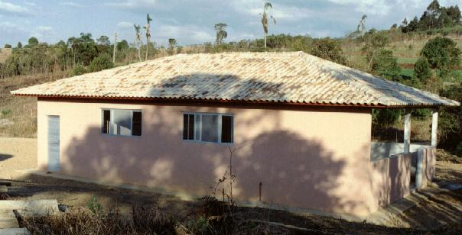
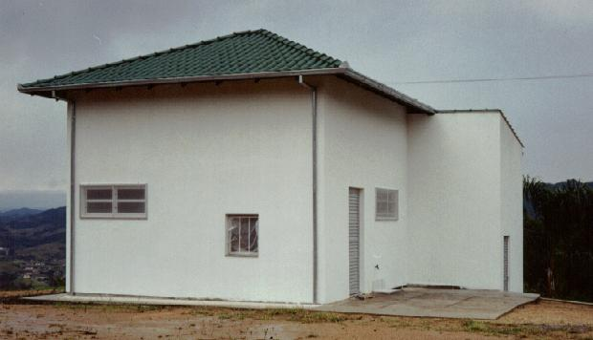
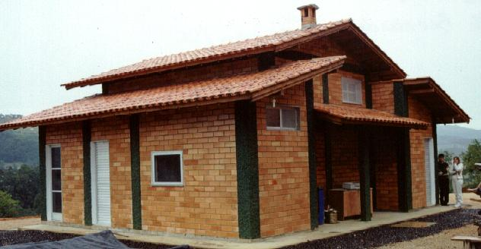
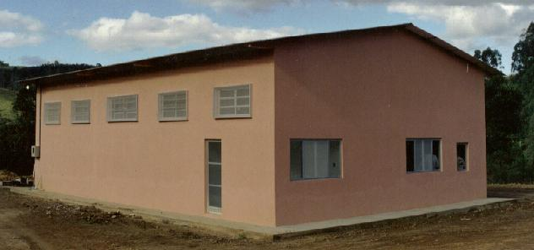
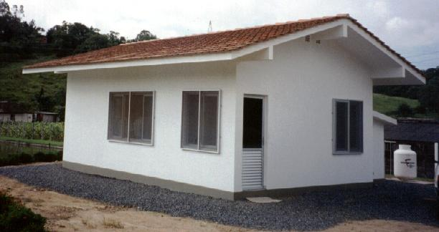
PROJETO AGROINDÚSTRIAS (PRONAF)
Pequeno porte,
Associativas,
Localizadas no espaço rural,
Articuladas em rede.

