Slide 1
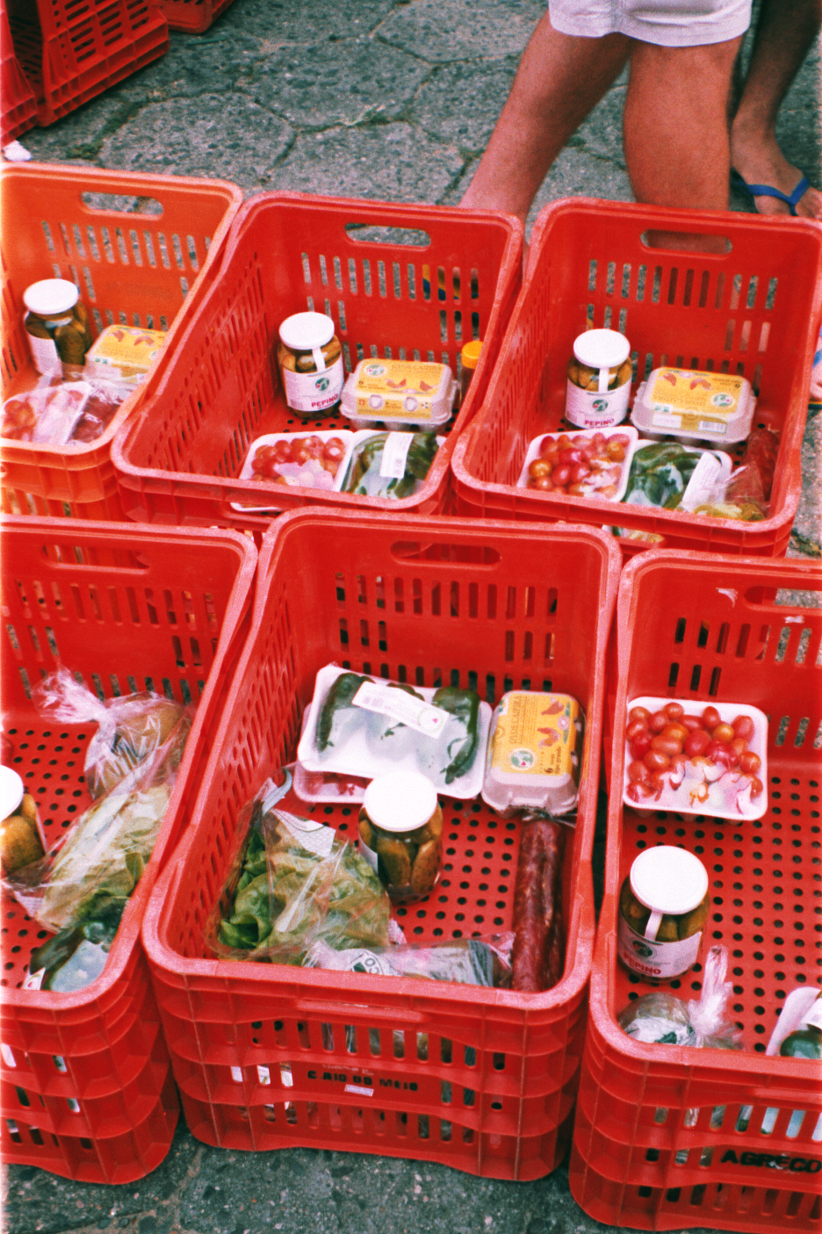

Slide 2


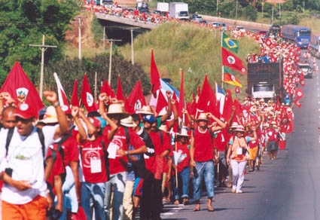

Slide 3
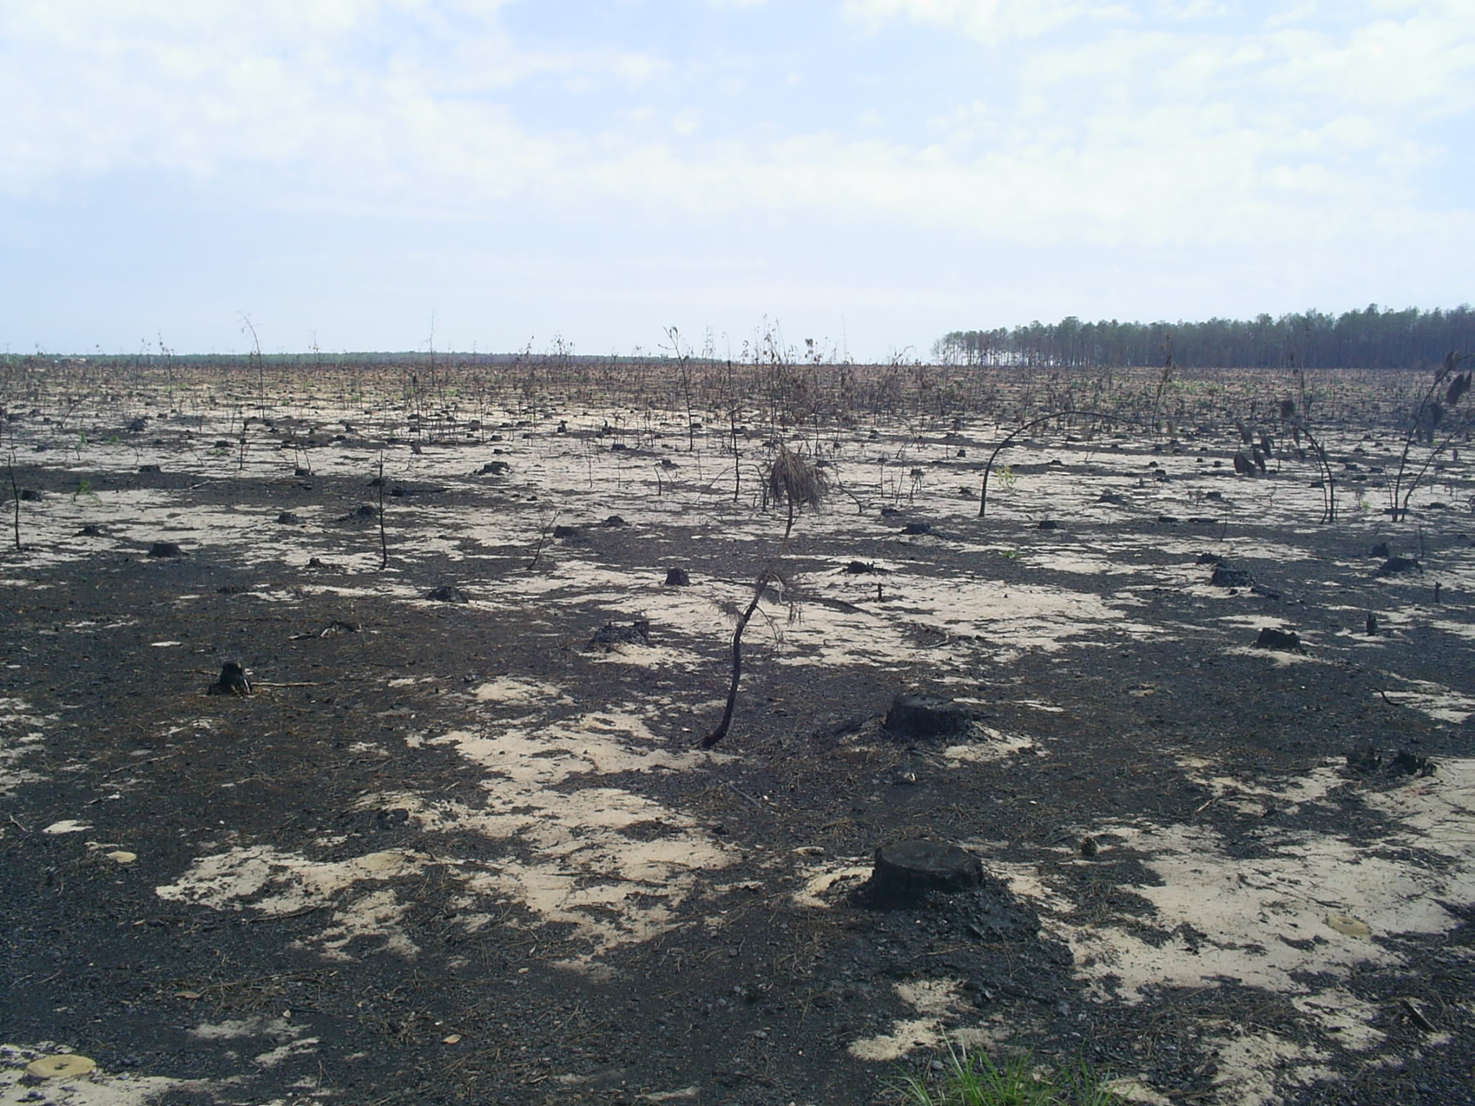

Slide 4
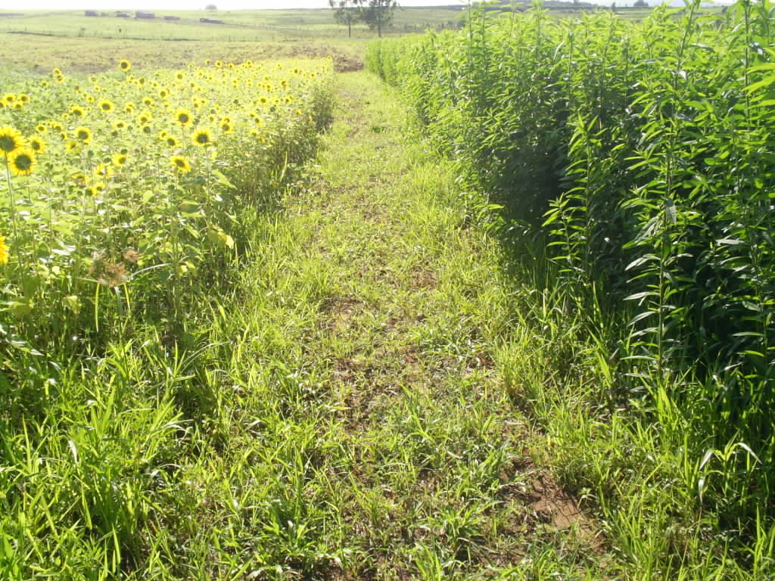

Slide 5
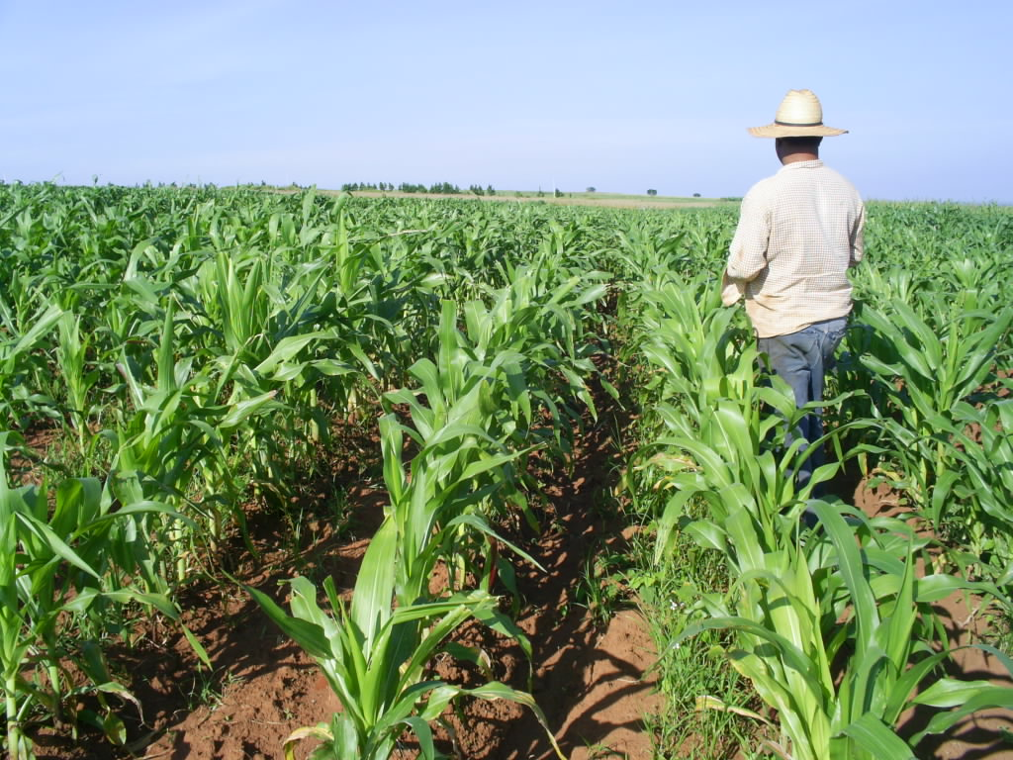

Slide 6
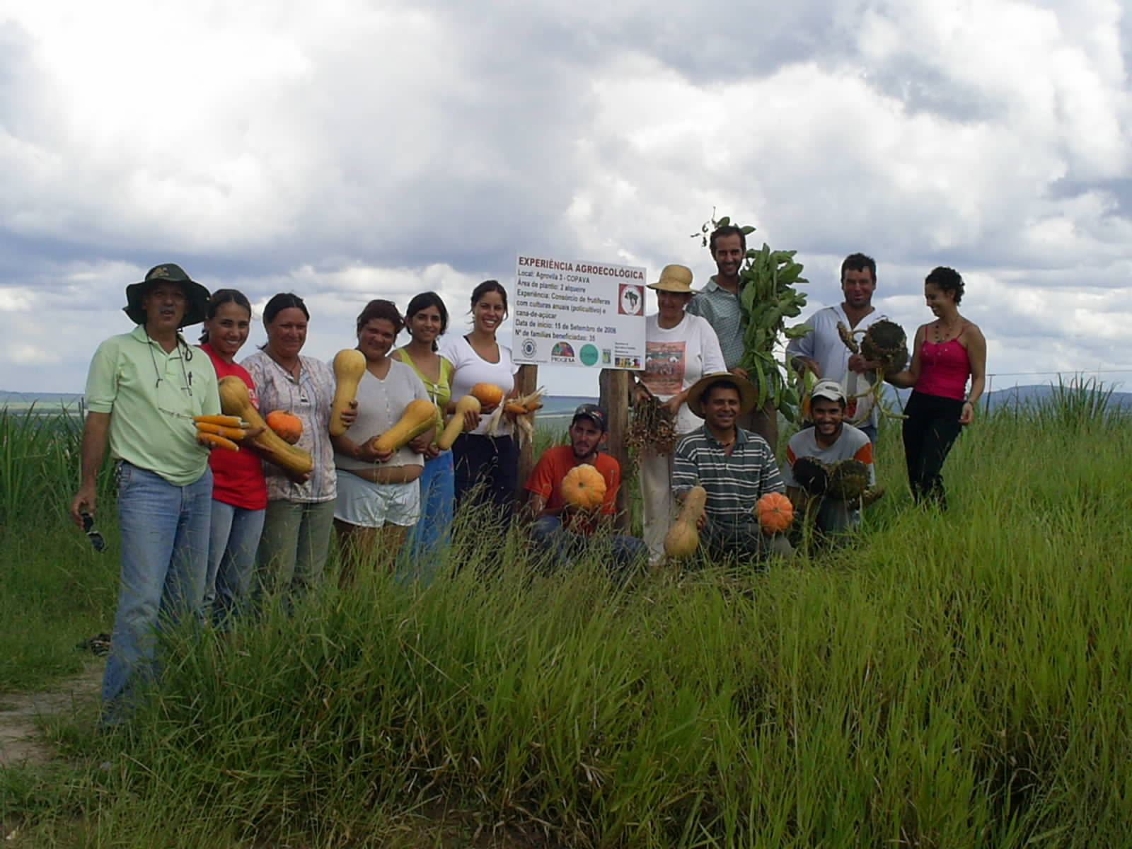

Slide 7
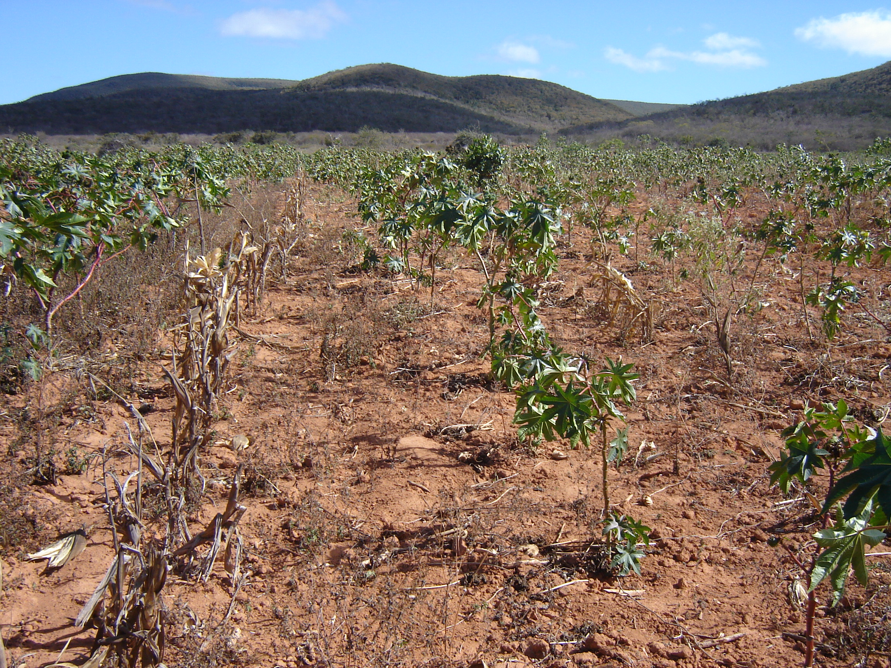

Slide 8
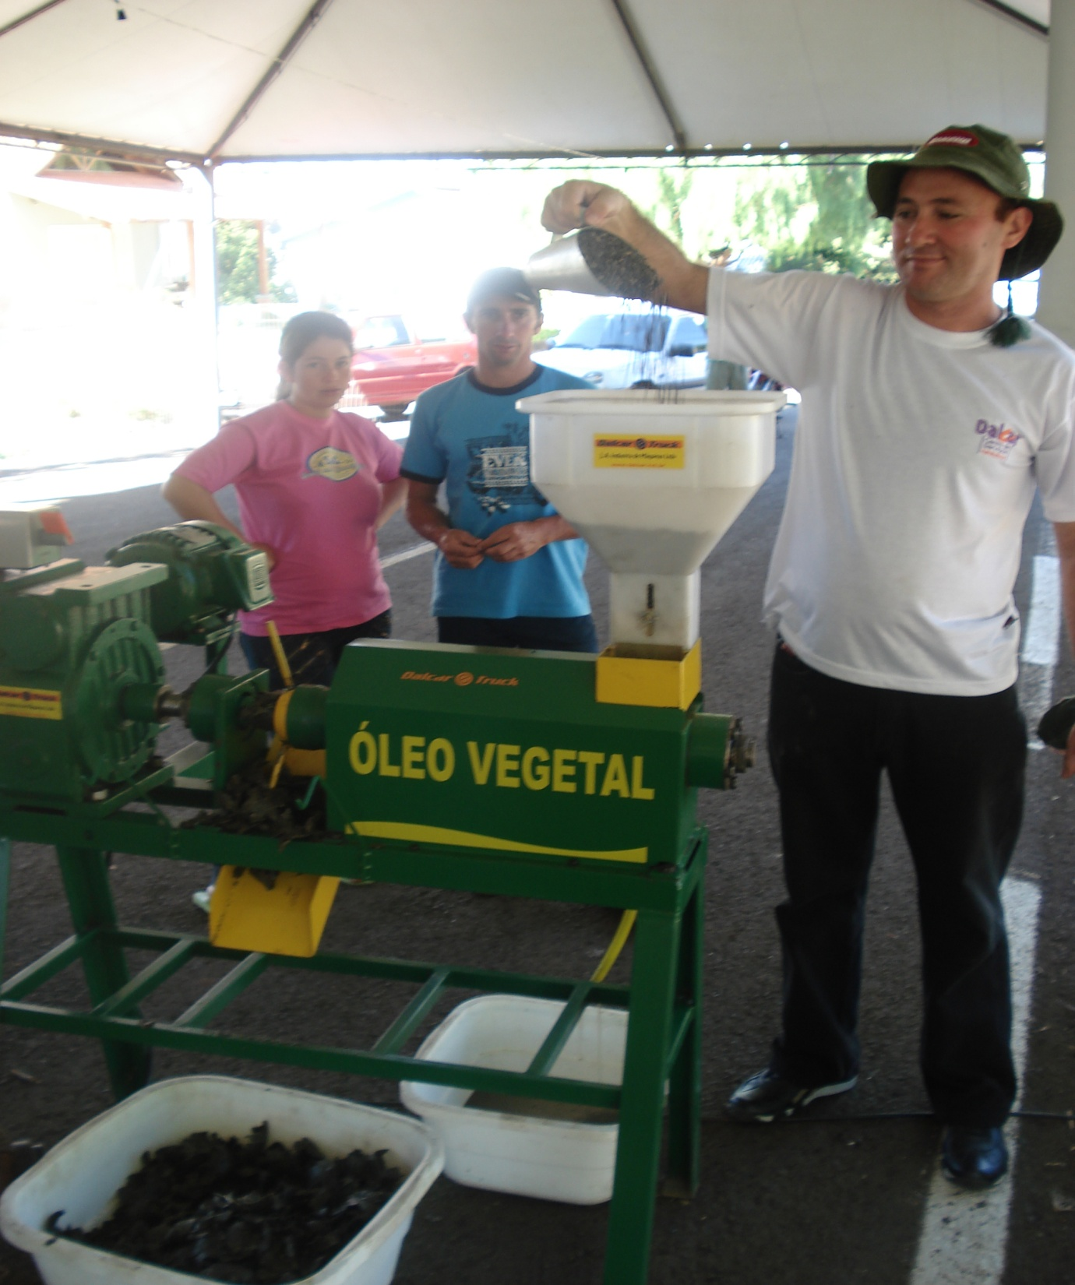

Slide 9
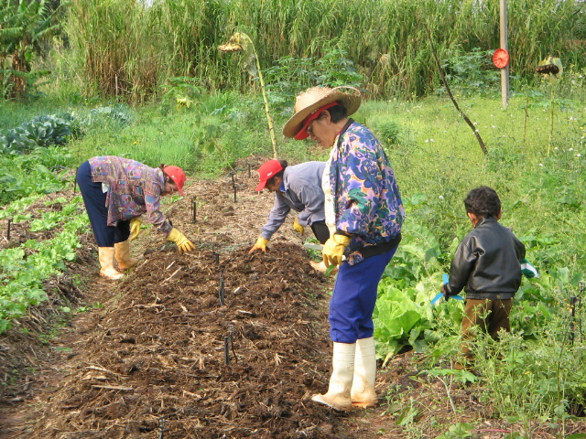
COOPAVI - Paraná

Slide 10
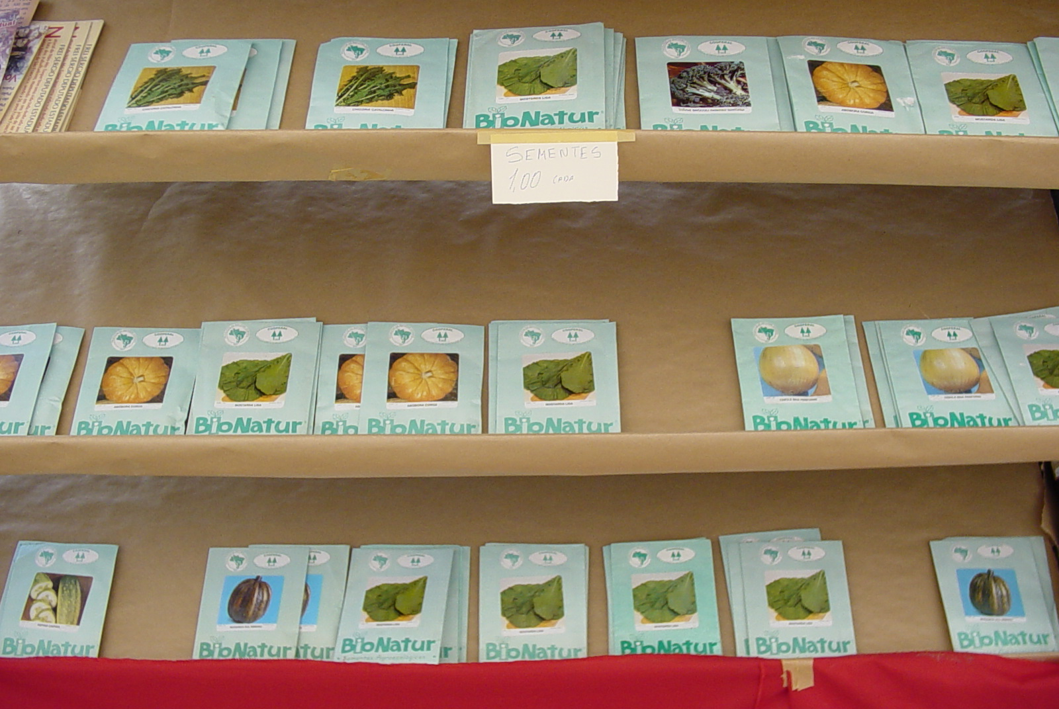

Slide 11
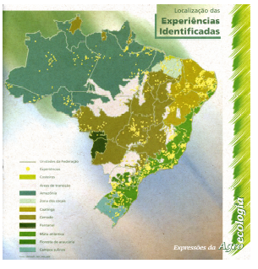

Slide 12
LAC countries legal initiatives
Ecuador (2008) and Bolivia (2009) recognize food sovereignty in constitution
Guatemala (2005)-Food security and nutrition law
Brazil- National system of food and nutrition security (SISAN)
Venezuela (2008)-Organic Law and Food security and Food Sovereignty-Article 8

Slide 13
The pillars of food sovereignity
Protección contra Dumping
Agroecological strategies
Land reform
Access to land, water
seeds
State support
Markets. Credit, extension
Research, etc.
Social
movements
Notes:
13

Slide 14
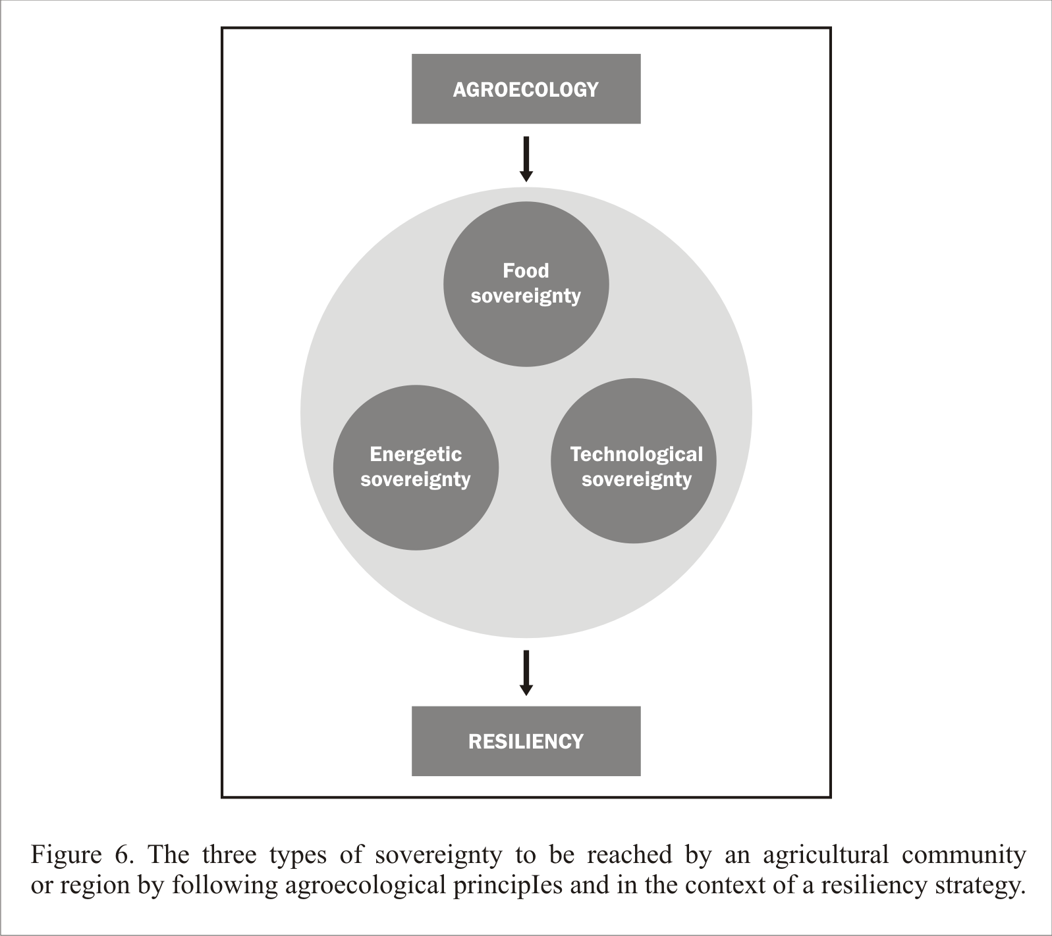

Slide 15
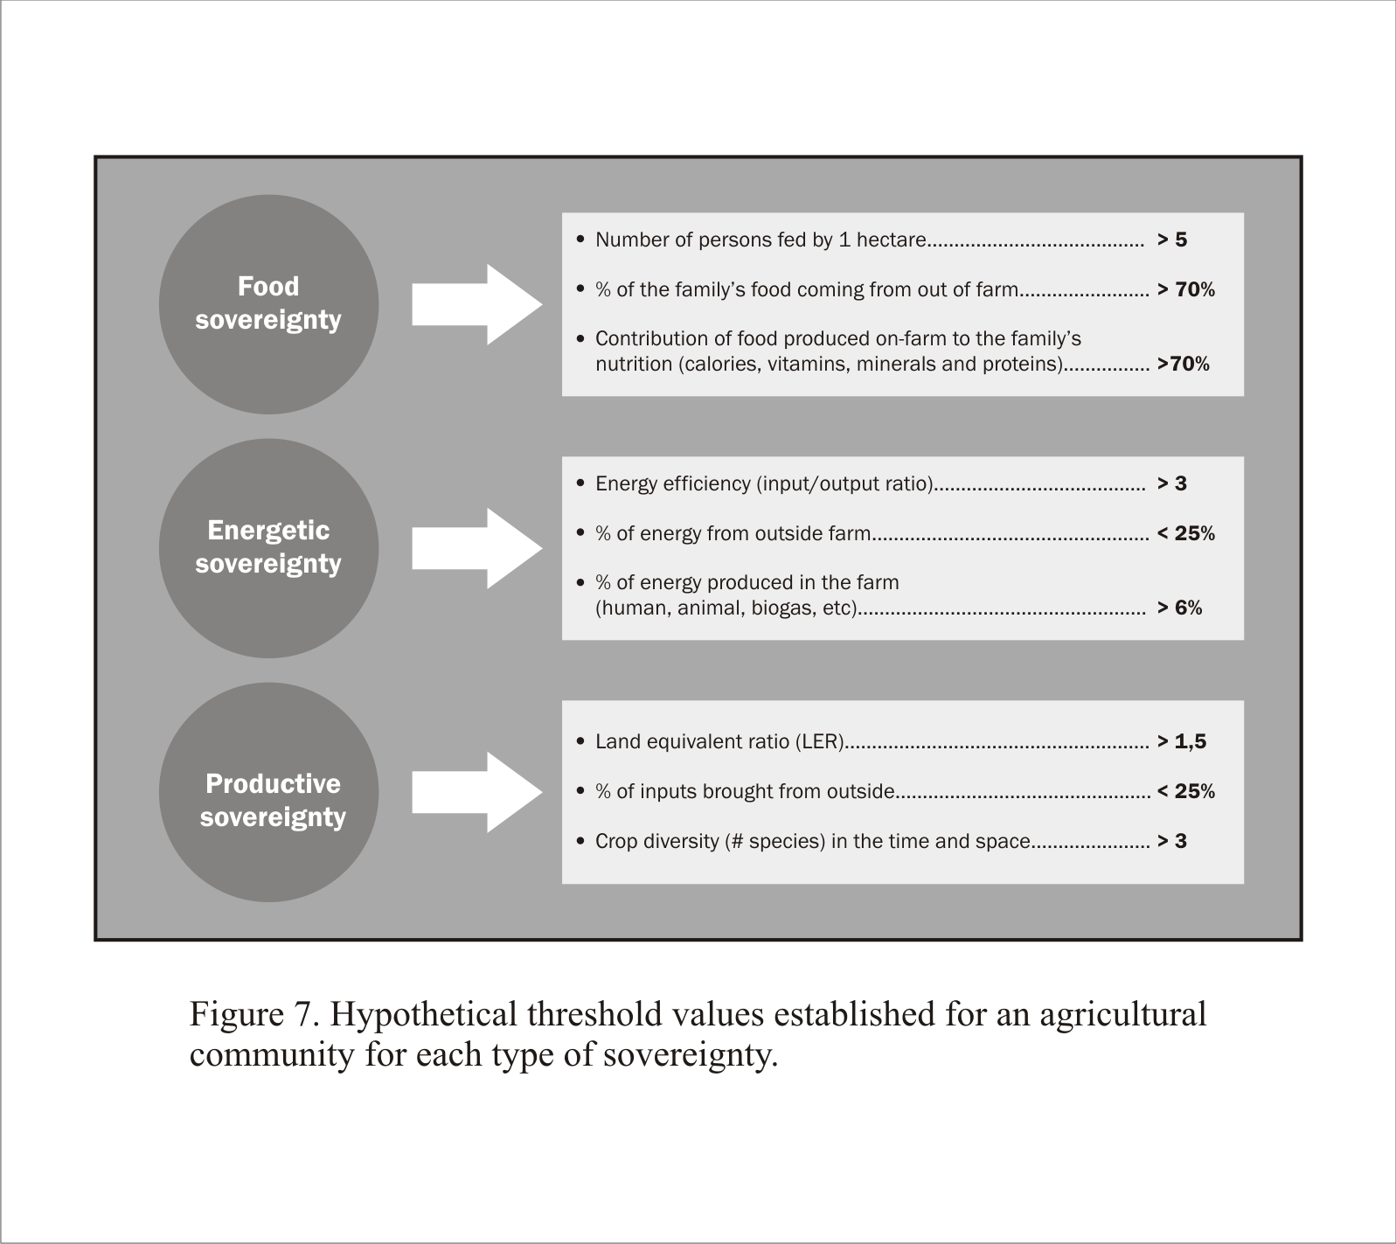

Slide 16
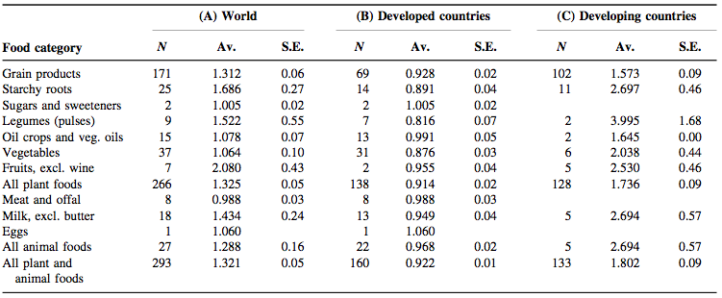
Badgley et al. 2007 (estudio de la Universidad de Michigan)
1: org.=conven. < l: conven. mayor que org. >1: org. mayor que conven.
Casi 300 estudios comparativos de agricultura orgánica/agroecológica y agricultura convencional

Slide 17
Notes:
17

