Slide 1
Governance of Emerging Value Chains and their Impacts on Traditional Communities
Research in Progress Seminar
Eliane Superti
Federal University of Amapa/Visited Researcher of ISS
Scholarship of Visiting Professor from CAPES/BR
esuperti@gmail.com

Slide 2
Research Element’s
Research theme: Adverse inclusion in Globalization/GVC’s
Objective: Analyze the insertion of quilombolas communities in açaí GVC and the possibilities of social upgrade.
Objects of research: Açaí extractivists of 5 quilombolas communities in Amapa/Brazil, Middlemen and Exporter Company.
Focus:
Impacts in livelihood and work process of direct/indirect relation with exporting company
Informal relationship/Fair trade
Economic upgrade/Social upgrade

Slide 4
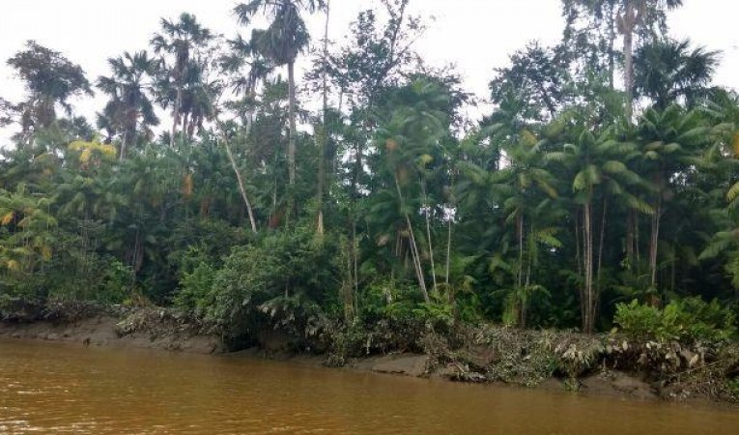
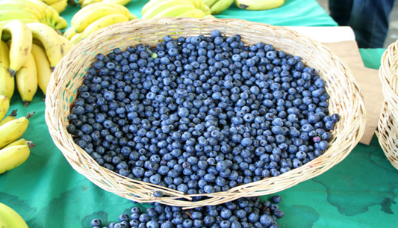
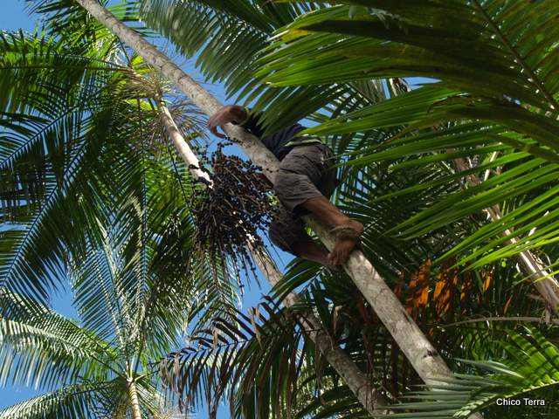

Slide 5
Communities that not have direct relation with exporting company. The middleman link the communities with the Chain (Field work conclued)
Quilombolas Communities
Communities originally founded by escaped black slaves in 19 century.
Traditional communities according to law (Decree 6.040 / 2007).
Rural black population - low income and low levels of schooling.
Located along rivers in hard-to-reach areas. Extractivism and small-scale agricultural production, fishing and hunting.
Off-season - they live on what they have accumulated from the sale of açaí extractivism.
Community that have direct relation with exporting company.
The exporting company has commercial relation based in Fair Trade
(Field work not finishied)

Slide 6
Questions
What we would like to share with this audience is our question:
where is the point at which we might say social upgrading occurred?
What else might be needed for social upgrading?
Is there a point at which the inclusion of traditional communities in GVC processes is inconsistent with market demands (e.g. for upscaling and standardization)?

Slide 7
Methodology
Field work involves participant observation with extractivist quilombola families.
Semi-structured interviews with focal groups
Communities leaders
Middlemen – agent that buys the açaí in the communities and resells it at “açaí fairs”
Boatmen - responsible for buying açaí for the exporter company
Documentary analysis (Secondary information)
Bibliographic research

Slide 8
Comparison
Work Process – No direct relation
Each family organizes the harvest of açaí in their area
Everyone can harvest in the common area.
Internal and external informal agreements to harvest with reciprocity of work (internal members) or payment by work day (external people)
No Purchase guarantee by middlemen
The collective organization of the work feeds the internal cohesion of the group.
No management of native açaí palms.
Work Process – Direct Relation
Each family organizes the harvest of açaí in their area.
Don’t exist common area
Hire Contract workers during the harvest period for a week with fixed payment
Purchase guarantee by exporting company
No collective organization of work
Management of native açaí palms.

Slide 9
Comparison
Middlemen
Provide small services for families and advance payments
The bonds of trust and friendship link the extractivists to the middlemen.
The middlemen defines of the price - there is no negotiation with extractivist
There is no standard of quality and packging
The community has no other way of transportation – no bargaining power.
Export Company
Invested resources from its Fair Trade Fund
School building, training for the management of the harvest area, Water Treatment Equipment
Company’s buyer determines the price based on Fair Trade
Determines a standard of quality and packaging
The community has no other way of transportation – no bargaining power.

Slide 10
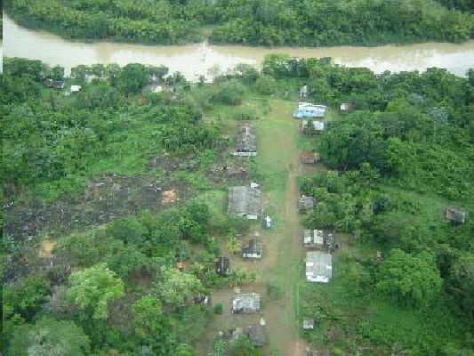
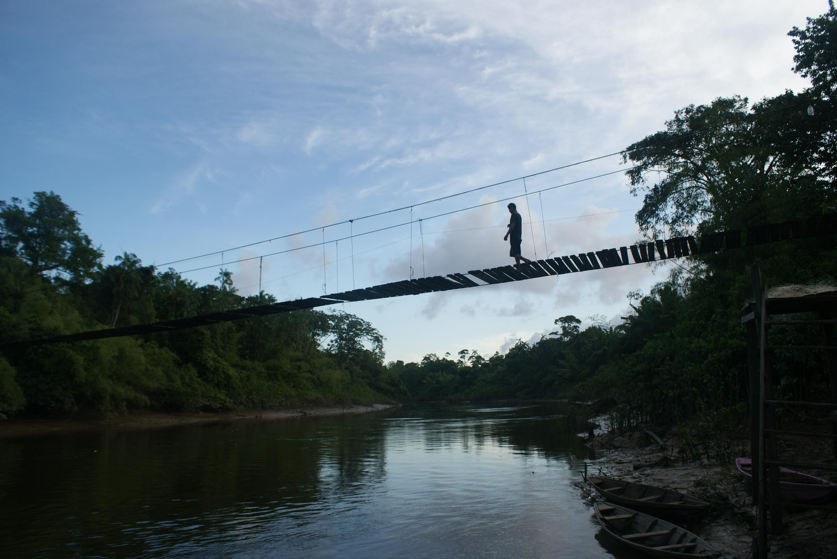
Cunani

Slide 11
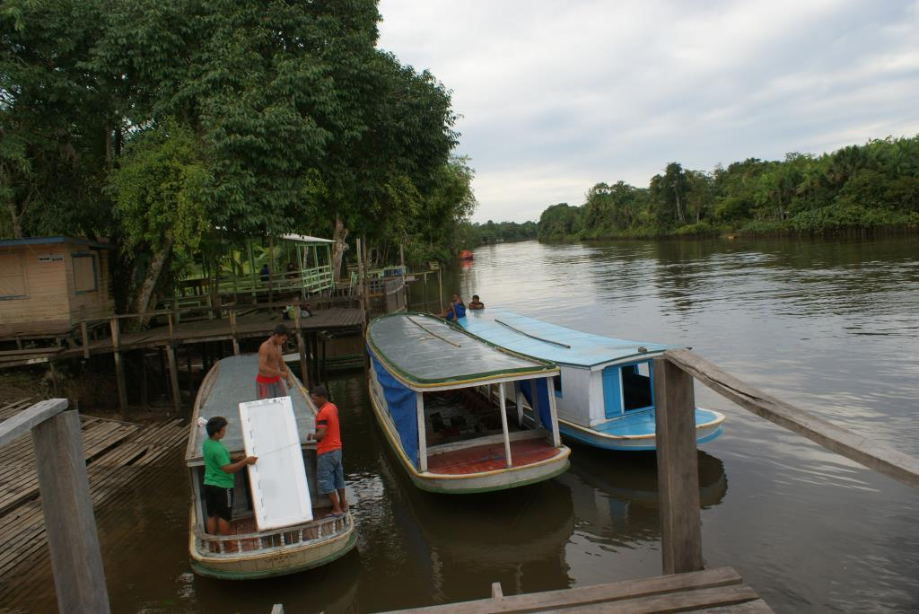
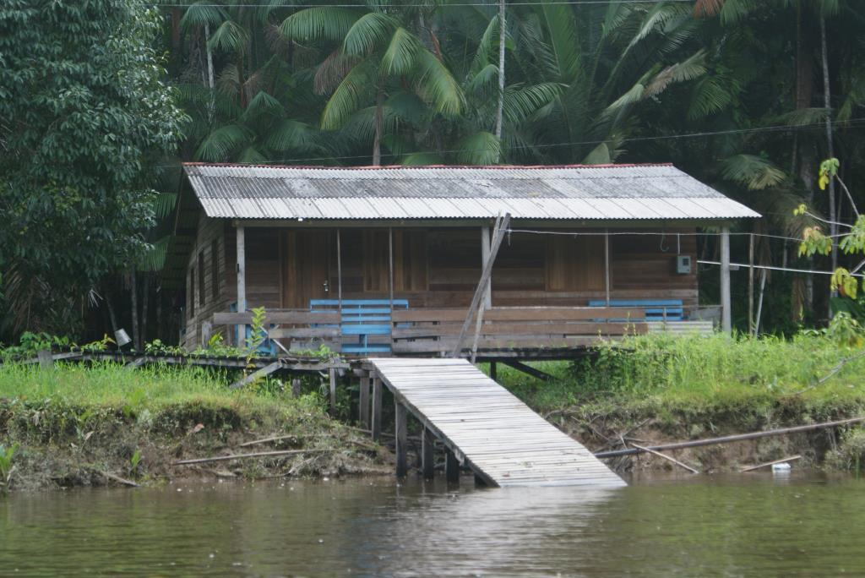
Porto Abacate

Slide 12
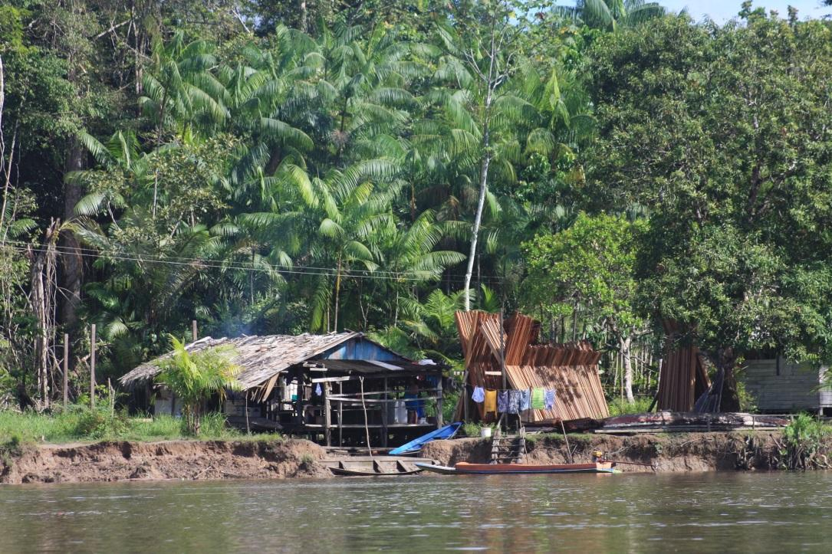
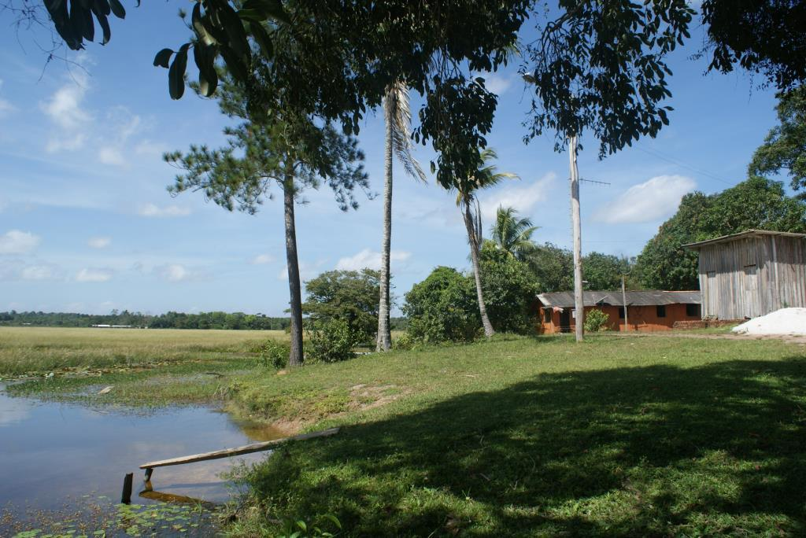
Nossa Senhora do Desterro

Slide 13
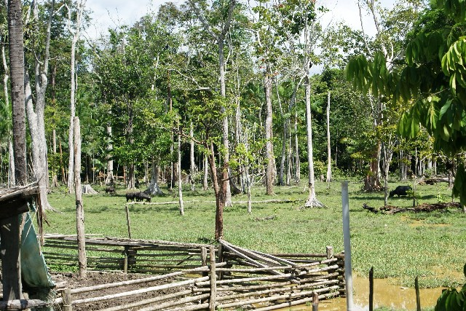
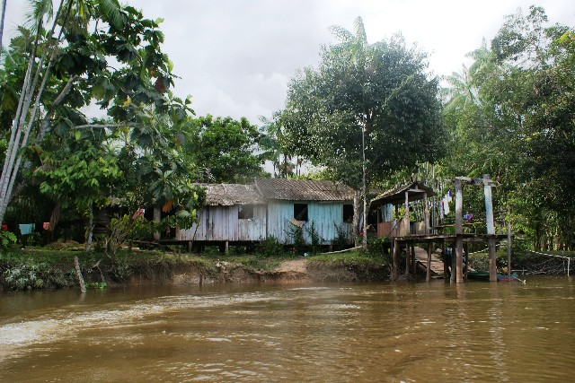
Engenho do Matapi

Slide 14
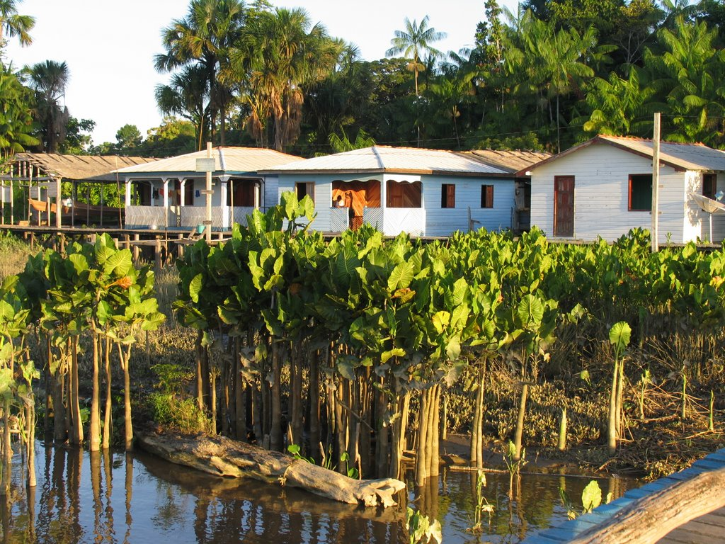
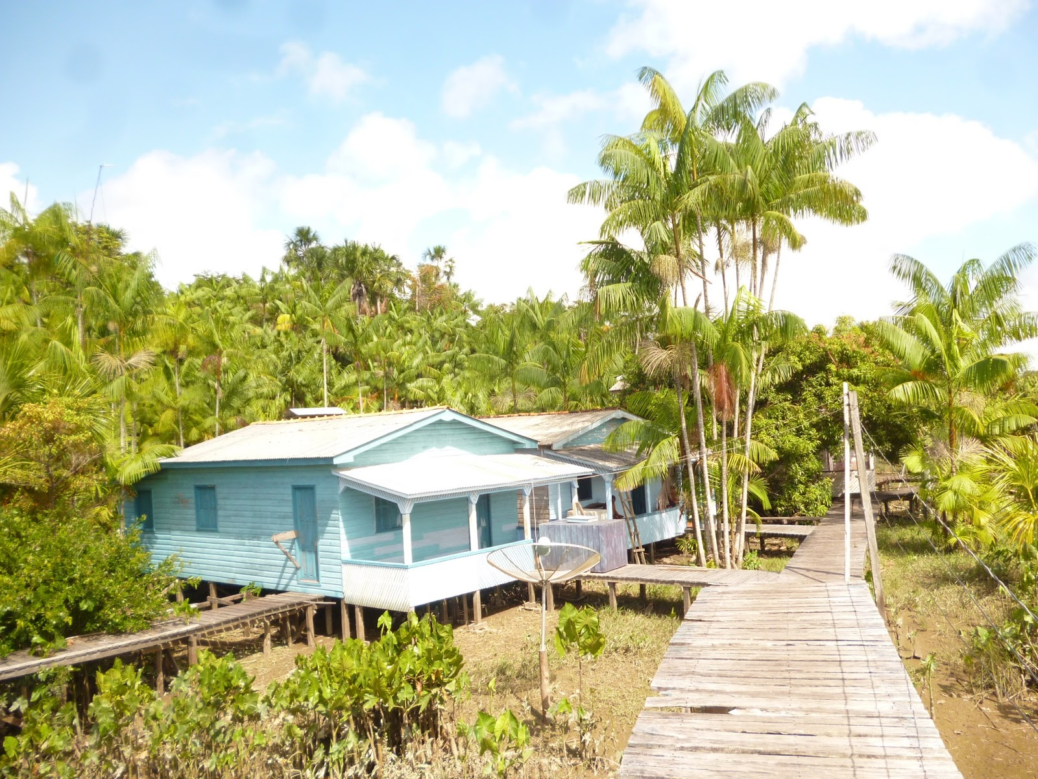
Mazagão

Slide 15
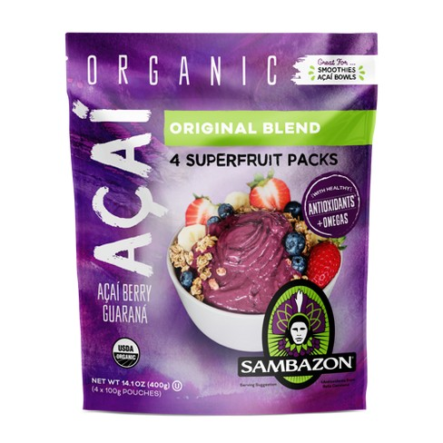

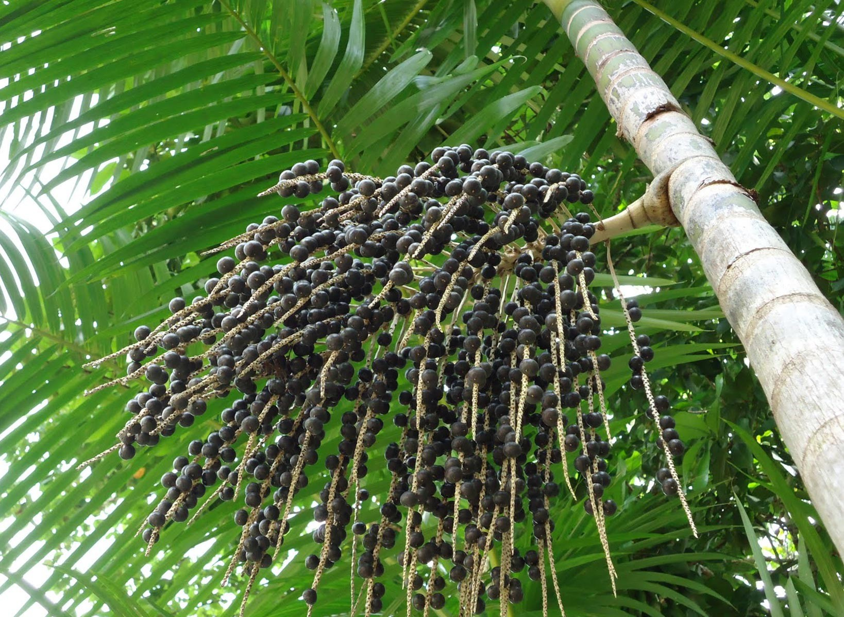
THANKS!!
Eliane Superti
esuperti@gmail.com

